Slide 1
autism & Augmentative and alternative communication
Mackenzie Boon, M.Ed.
University of Utah school psychology program
March 23, 2016
Superheroes Social Skills Training, Rethink Autism Internet Intervention, Parent Training, Evidence-based Practices Classroom Training, Functional Behavior Assessment: An Autism Spectrum Disorder, Evidence-based Practices Training Track for School Psychologists
US Office of Education, Personnel Preparation Grant #H325K12306
William Jenson, Ph.D., Elaine Clark, Ph.D., Julia Hood, Ph.D, & John Davis, Ph.D.

Slide 2
OBJECTIVES
Outline autism and common comorbid conditions, including intellectual disability and speech impairment
Briefly discuss the facilitated communication controversy
Discuss evidence-based interventions available to aide in speech development

Slide 3
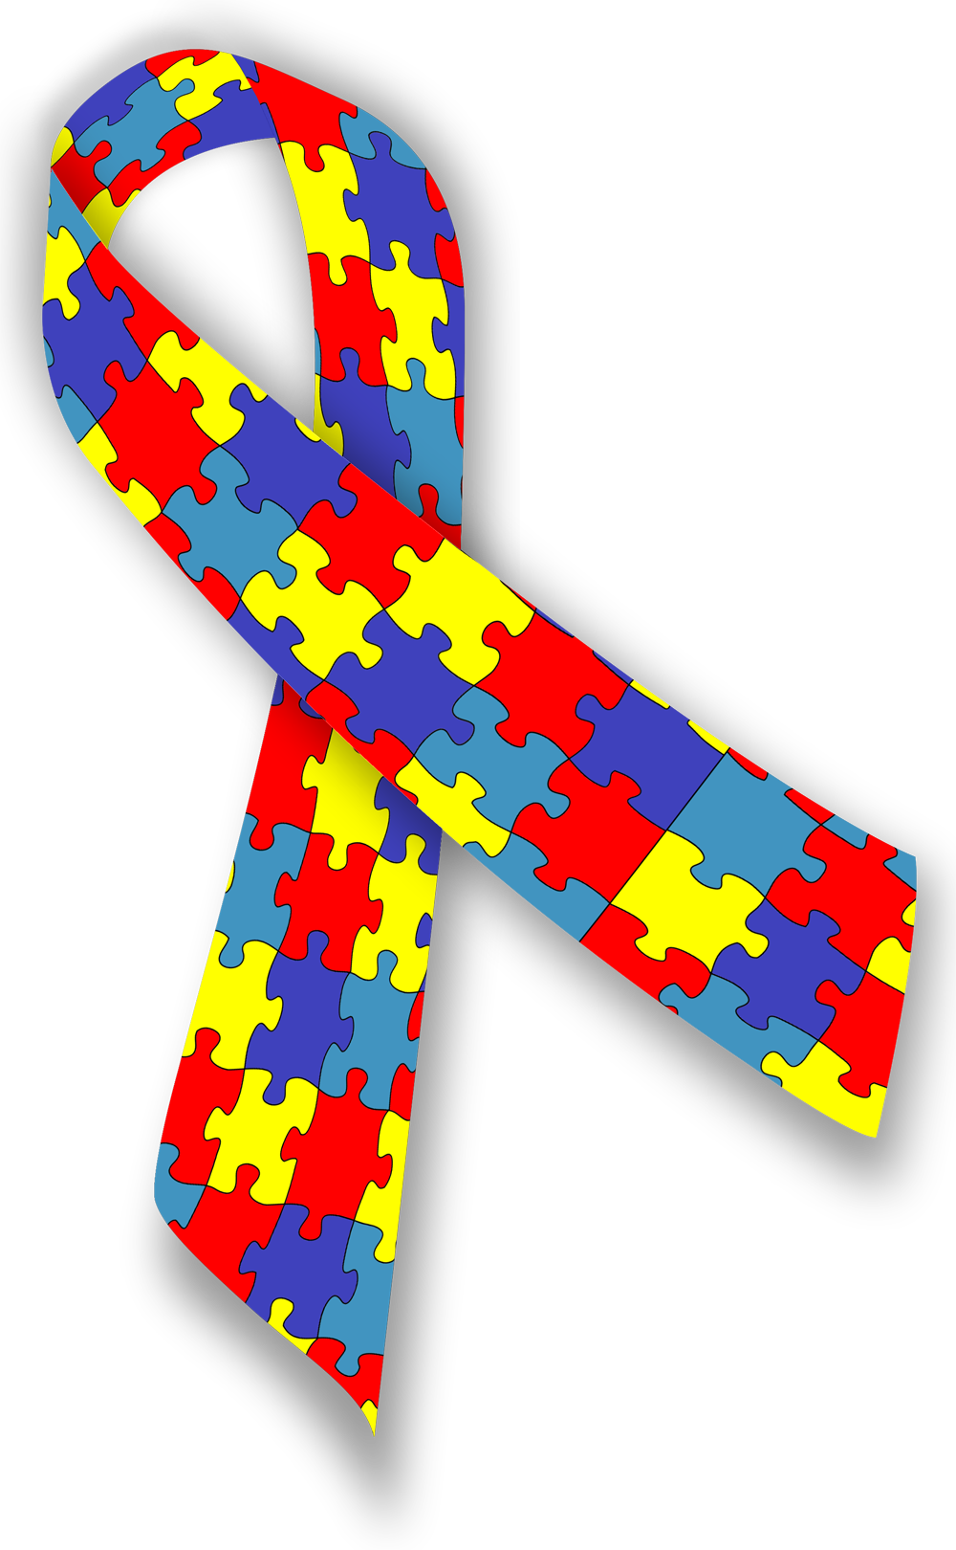
AUTISM SPECTRUM DISORDER (ASD)
ASD is characterized by:
  Persistent deficits in social communication and interaction
  Restricted, repetitive patterns of behavior, interests, or activities
1 in 68 American children, favoring males
Common co-morbid conditions
  Gastrointestinal Disorders
  Sleep Disturbances
  Epilepsy
  ADHD
  Mood and Behavior Disorders
  Intellectual Disability
  Anxiety, OCD, and Specific Phobias
APA, 2013; CDC, 2014; Tsai, 2014; Matson & Nebel-Schwalm, 2007; Manninon, Leader, & Healy, 2013

Slide 4
ASD and Intellectual disability (ID)
The CDC (2014) recently estimated that 31% of youth with ASD have intellectual skills in the ID range (IQ=≤70)
Another 23% of the IQs of children with ASD fall in the borderline range (IQ=71-84)
46% of children with ASD are estimated to have average to above average IQs (IQ =≥85)
CDC, 2014; Weiss & Riosa, 2015

Slide 5
ASD and Significant SPEECH impairment
It is estimated that approximately 25-30% of individuals with autism are minimally verbal
Heterogeneity exists among cognitive and linguistic skills of minimally verbal children
The high prevalence of communication impairment among individuals with ASD makes effective communication interventions a high priority
Lubas, Mitchell, & De Leo, 2014; Tager-Flusberg & Kasari, 2013

Slide 6
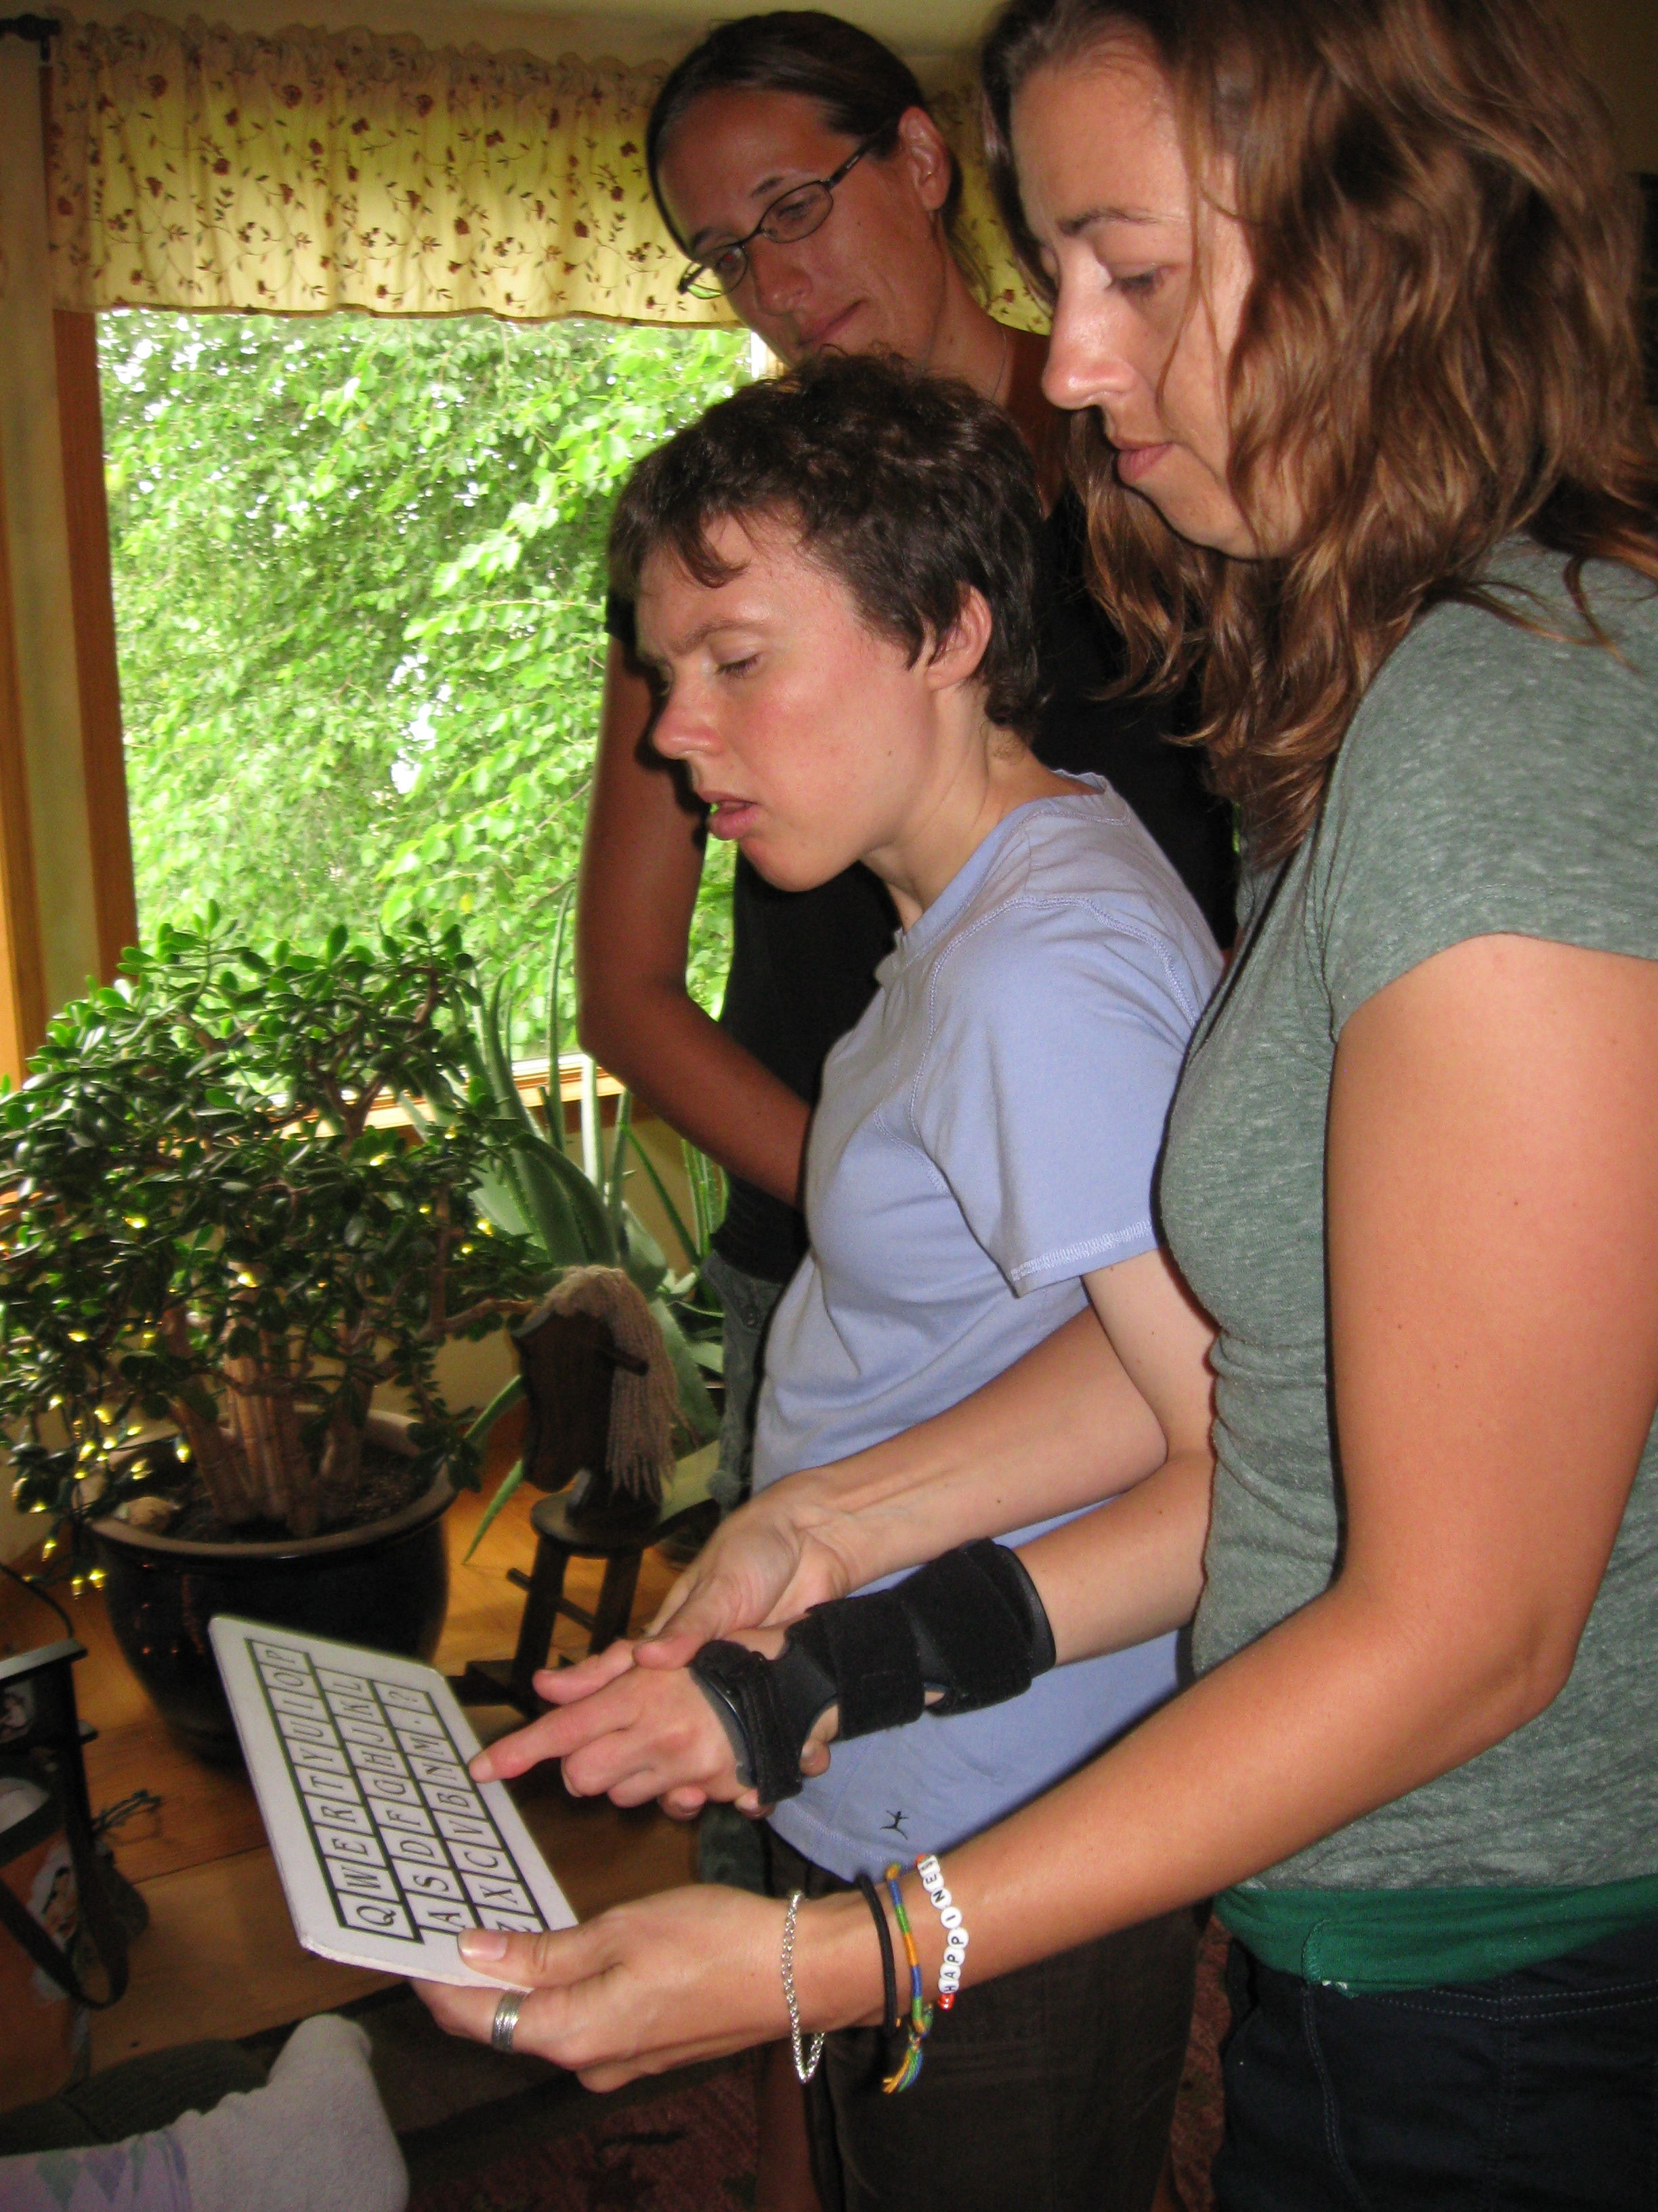
A Controversial “FAD” intervention
Facilitated Communication (FC)
  “In FC, a facilitator typically supports the hand or arm of the person with the disability, thereby assisting them in pointing to letters on a keyboard or communication device.”
  Saloviita, Leppänen, & Ojalammi, 2014

Slide 7
Facilitated communication (FC)
There is no empirical support for the claim that text produced using FC truly comes from the client
  Countless studies suggest that the communication is instead produced by the facilitator
  Many capable individuals have been restricted in their communication as a result of FC
Especially disturbing is that fact that numerous unsubstantiated claims of sexual abuse were made through FC
FC is un-established in the National Standards Project, Phase 2, suggesting little to no evidence of effectiveness
Saloviita, Leppänen, & Ojalammi, 2014; Palfreman, 2013; National Autism Center, 2015

Slide 8
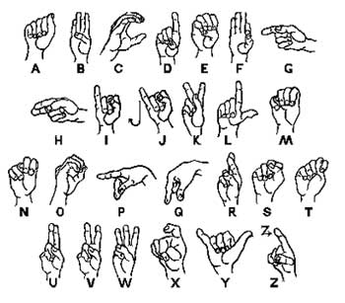
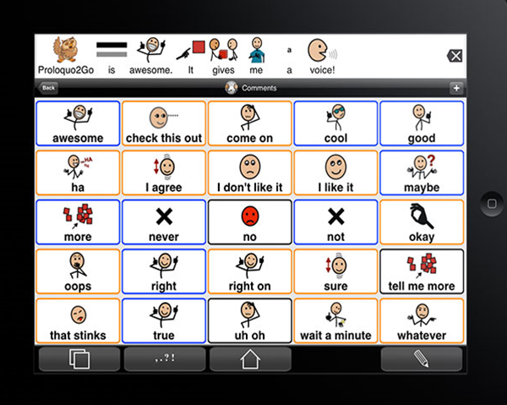
Evidence-based Intervention
Augmentative and Alternative Communication (AAC)
  Unaided devices Aided devices
Ganz et al., 2014

Slide 9
AUGMENTATIVE and alternative COMMUNICATION (AAC) History
“AAC is any tool, strategy, or technology that compensates for, enhances, expands, or helps develop communication skills” Cafiero & Meyer, 2008
First attempts began in the 1970s with emergence of sign language and gestural symbols
Picture Exchange Communication System (PECS) emerged in the 1980s
Improving technological capabilities gave rise to AAC technologies, which were introduced in the early 1990s
  Barriers: cost, programmability and personalization, stigmatization
Lubas, Mitchell, & De Leo, 2014

Slide 10
AAC HISTORY Cont’d
In order to produce a more convenient and affordable tool, AAC apps were created
In February of 2014, the Apple App Store had more than 250 apps under the keyword “AAC”
  Cost ranged from free all the way up to a few hundred dollars
Today, many families often have several mobile devices, increasing the opportunity for the use of AAC apps
Lubas, Mitchell, & De Leo, 2014

Slide 11

Unaided systems
Gestures, Body language, Sign language
  Often used less than aided systems
  Difficulty with imitation and poor motor skills may lead to frustration
  A communication barrier with peers and teachers often still remains
  Nevertheless, some individuals with ASD show preference for and great success with unaided systems
Ganz & Simpson, 2004; Ganz et al., 2012

Slide 12
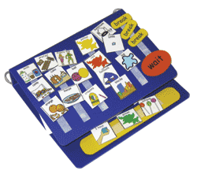
aided systems
Picture Exchange Communication System (PECS)
  “Uses pictures as a means for the user to communicate with others by handing a picture or pictures to another individual” Ganz et al. 2014
PECS is taught in six instructional phases:
  Phases 1 and 2: Teaching the individual to exchange pictures for preferred items and activities
  Phase 3: Discriminate between preferred and non-preferred items
  Phase 4: Making requests using complete sentences
  Phase 5: Answering questions
  Phase 6: Variety of comments
Ganz et al., 2014; Lerna, Esposito, Conson, Russo, & Massagli, 2012

Slide 13
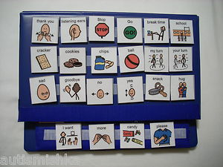
PECS
According to Ganz and colleagues (2014),
  PECS demonstrates statistically significant larger effects than speech-generating devices for individuals with ID (IRD=.84)
    Concrete vs. abstract communication may be helpful for those with ID
  PECS is more effective for individuals with ID and ASD than individuals with ASD alone
  PECS is most effective for preschoolers
    Yet still moderately effective for all age groups
Ganz et al., 2014

Slide 14
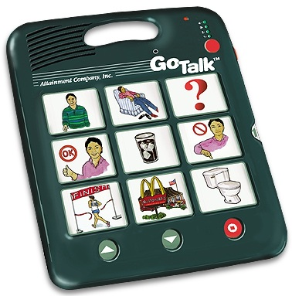
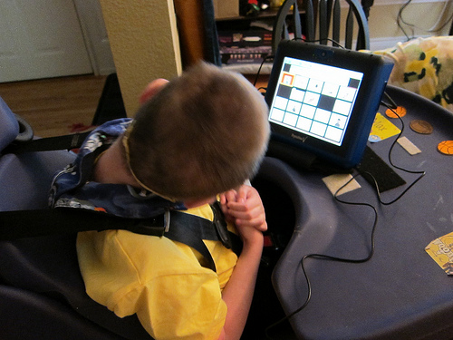
Aided systems
Speech-generating devices (SGDs)
  Produce pre-recorded or computer-generated speech upon the user’s command
Dedicated SGDs include systems, such as:
  Dynavox V (dynamic display) - $7,800 to $8,400
  Go Talk (static display) – around $200
    Both typically require some sort of software, such as Boardmaker ($399+), to create layouts and symbols
    Often expensive, cumbersome, time-consuming to program and personalize
Ganz et al., 2014; Shane et al., 2012

Slide 15
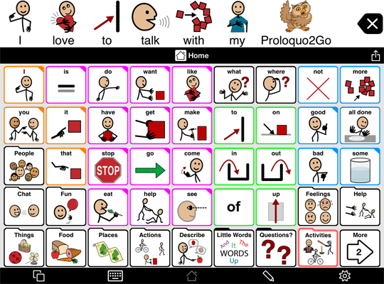
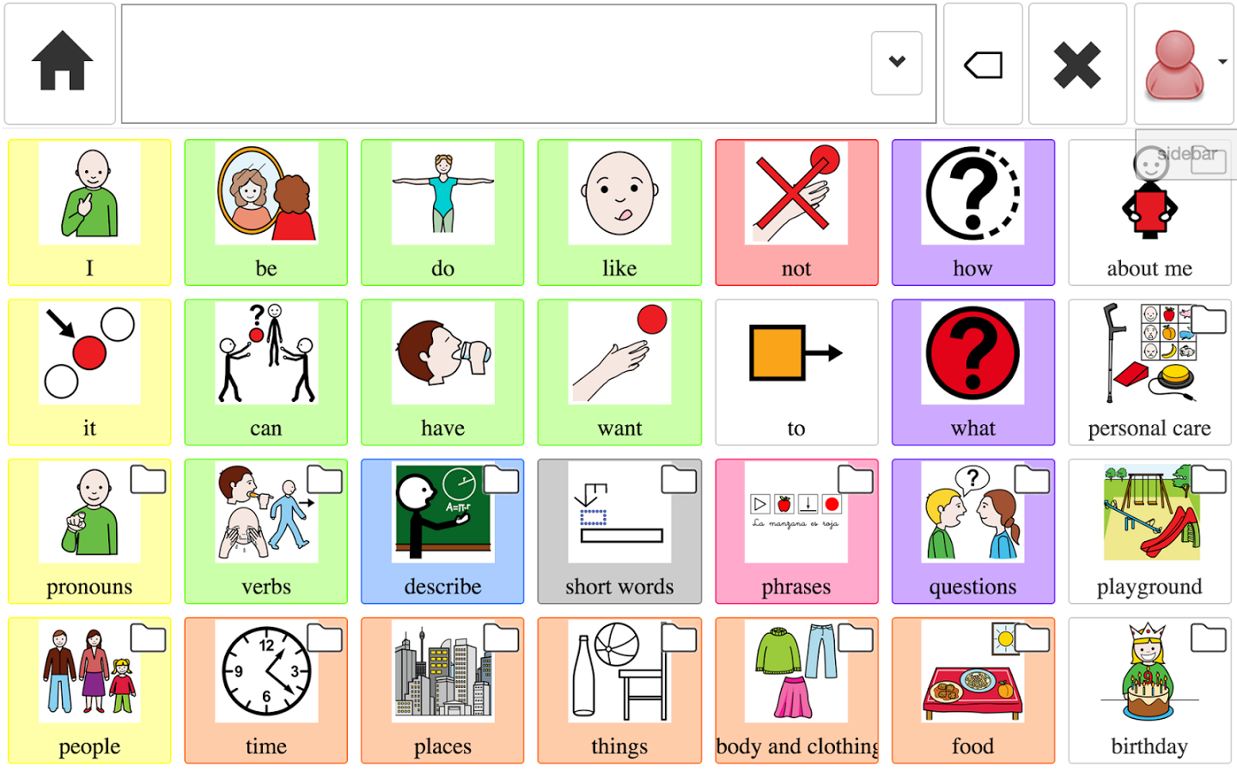
AIDED SYSTEMS
AAC Apps
  Portable hardware, such as iPads and tablets, expand opportunities for use of AAC for many individuals
  Devices are small, low cost, easy to transport, and socially acceptable
  Many AAC apps, such as Proloquo2Go and CoughDrop, function like dedicated SGDs
    Proloquo2Go - $249.99, dedicated to one device
    CoughDrop - $6/month or $200/5 years, cloud based
Shane et al., 2012

Slide 16
Aided devices
Ganz and colleagues (2014) found
  A larger effect size for SGDs than for PECS for individuals with ASD and no ID
    SGDs are more effective than other picture-based systems for individuals with ASD and ID
  SGDs had greatest effect for preschoolers
    Yet still moderately effective for all age groups
Lorah and colleagues (2015) highlight the following:
  Software and training protocol make a big difference in terms of success
  Collaboration with SLPs and other professionals is key
  Teaching procedures, such as reinforcement, prompting, errorless learning and other EBPs should be incorporated
Ganz et al., 2014; Lorah, Parnell, Whitby, & Hantula, 2015

Slide 17
AAC Effects on speech
Some level of pre-treatment functional speech and imitation skills appear to be strong predictors of subsequent speech production
Schlosser & Wendt (2008) conducted a systematic review and found:
  No declines in speech production as a result of AAC intervention
    The claim that AAC hinders speech development does not appear to be supported
    AAC should not be considered as a “last resort”
  A small number of individuals may show no improvement, but the majority of individuals experience at least modest gains in speech production
Schlosser & Wendt, 2008; Ganz et al., 2014

Slide 18
Final thoughts
Decisions involving different communication systems should include:
  Assessment of learner characteristics and abilities
  Discussion of desired outcomes and goals of the intervention
Aided systems are generally preferred and appear to be acquired quicker by learners
  Specifically, SGDs appear to be most preferred
  However, it is important to consider individual preference and abilities in order to increase likelihood of success
Gevarter et al., 2013

Slide 19
THANK YOU!

Slide 20
REFERENCES
American Psychiatric Association (2013). Diagnostic and statistical manual of mental disorders (5th ed.) Arlington, VA: American Psychiatric Association.
Cafiero, J. M. & Meyer, A. (2008, April). Your child with autism: When is augmentative and alternative communication (AAC) an appropriate option? E-Parent Magazine, 28-30.
Centers for Disease Control and Prevention (2014). Prevalence of autism spectrum disorder among children aged 8 years - autism and developmental disabilities monitoring network, 11 sites, United States, 2010. MMWR Surveillance Summaries, 63(2), 1-22.
Ganz, J. B., Earles-Vollrath, T. L., Heath, A. K., Parker, R. I., Rispoli, M. J., & Duran, J. B. (2012). A meta-analysis of single case research studies on aided and augmentative communication systems with individuals with autism spectrum disorder. Journal of Autism and Developmental Disorders, 42, 60-74.
Ganz, J. B., Mason, R. A., Goodwyn, F. D., Boles, M. B., Heath, A. K., & Davis, J. L. (2014). Interaction of participant characteristics and type of AAC with individuals with ASD: A meta-analysis. American Journal of Intellectual and Developmental Disabilities, 119(6), 516-535.
Ganz, J. B. & Simpson, R. L. (2004). Effects on communicative requesting and speech development of the picture exchange communication system in children with characteristics of autism. Journal of Autism and Developmental Disorders, 34(4), 395-409.
Gevarter, C., O’Reilly, M. F., Rojeski, L., Sammarco, N., Lang, R. Lancioni, G. E., & Sigafoos, J. (2013). Comparing communication systems for individuals with developmental disabilities: A review of single-case research studies. Research in Developmental Disabilities, 34, 4415-4432.

Slide 21
references
Lerna, A., Esposito, D., Conson, M., Russo, L, & Massagli, A. (2012). Social-communicative effects of the picture exchange communication system (PECS) in autism spectrum disorder. International Journal of Language and Communication Disorders, 47(5), 609-617.
Lorah, E. R., Parnell, A., Whitby, P. S., & Hantula, D. (2015). A systematic review of tablet computers and portable media players as speech generating devices for individuals with autism spectrum disorder. Journal of Autism and Developmental Disorders, 45, 3792-3804.
Lubas, M., Mitchell, J., & De Leo, G. (2014). User-centered design and augmentative and alternative communication apps for children with autism spectrum disorder. Sage Open, 1-10.
Manninon, A., Leader, G., & Healy, O. (2013). An investigation of comorbid psychological disorders, sleep problems, gastrointestinal symptoms and epilepsy in children and adolescents with autism spectrum disorder. Research in Autism Spectrum Disorders, 7, 35-42.
Matson, J. L. & Nebel-Schwalm, M. S. (2007). Comorbid psychopathology with autism spectrum disorder in children: An overview. Research in Developmental Disbabilities, 28, 341-352.
National Autism Center (2015). Findings and conclusions: National standards project, Phase 2. Retrieved April 17, 2015 from: http://www.nationalautismcenter.org/
Palfreman, J. (Producer). (1993, October 19). Prisoners of silence. Frontline. From https://www.youtube.com/watch?v=CzCGux7qD1c

Slide 22
references
Saloviita, T., Leppänen, M., & Ojalammi, U. (2014). Authorship in facilitated communication: An analysis of 11 cases. Augmentative and Alternative Communication, 30(3), 213-225.
Schlosser, R. W. & Wendt, O. (2008). Effects of augmentative and alternative communication intervention on speech production in children with autism: A systematic review. American Journal of Speech-Language Pathology, 17, 212-230.
Shane, H. C., Laubscher, E. H., Schlosser, R. W., Flynn, S., Sorce, J. F., & Abramson, J. (2012). Applying technology to visually support language and communication in individuals with autism spectrum disorder. Journal of Autism and Developmental Disorders, 42, 1228-1235.
Tager-Flusberg, H. & Kasari, C. (2013). Minimally verbal school-aged children with autism spectrum disorder: The neglected end of the spectrum. Autism Research, 6, 468-478.
Tsai, L. Y. (2014). Prevalence of comorbid psychiatric disorders in children and adolescents with autism spectrum disorder. Journal of Experimental and Clinical Medicine, 6(6), 179-186.
Weiss, J. A. & Riosa, P. B. (2015). Thriving in youth with autism spectrum disorder and intellectual disability. Journal of Autism and Developmental Disorders, 45, 2474-2486.

