Slide 1
The Early start denver model
Katherine Havlik
Superheroes Social Skills Training, Rethink Autism Internet Intervention, Parent Training, Evidence-based Practices Classroom Training, Functional Behavior Assessment: An Autism Spectrum Disorder, Evidence-based Practices Training Track for School Psychologists
US Office of Education Personnel Preparation Project Grant H325K12306
William Jenson, Ph.D., Elaine Clark, Ph.D., John Davis, Ph.D., Julia Hood, Ph.D.

Slide 2
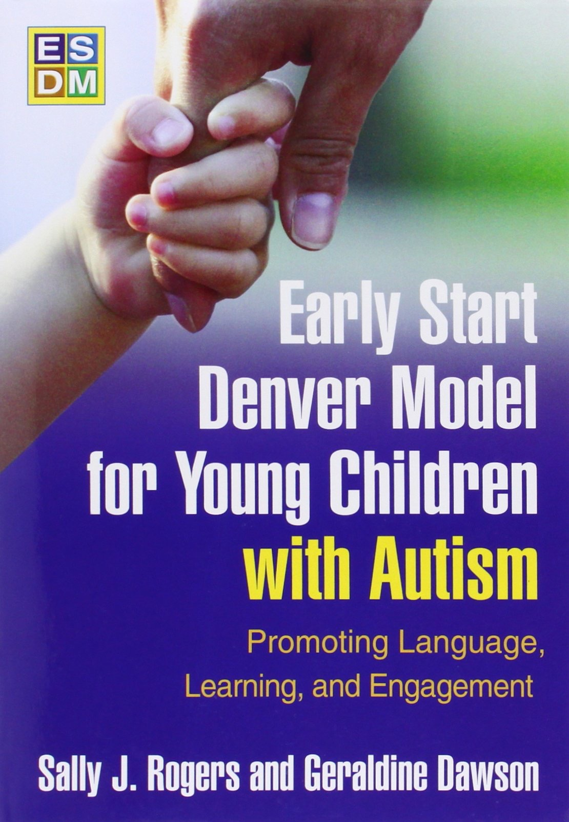
Overview
Early Start Denver Model Background
Distinguishing ESDM from other treatments
Overview of intervention components
  Assessment
  Objectives
  Teaching skills
  Taking data
  Therapy sessions
  Group Delivery
Researcher studies
Literature reviews

Slide 3
What is esdm?
ESDM is a comprehensive early intervention for infants and toddlers between the ages of 12-48 months
It is a naturalistic developmental model of treatment that incorporates some teaching elements of ABA, and focuses on building strong, positive social relationships with caregivers
ESDM aims to increase the rates of development across all domains and decrease the core symptoms of autism
(Schriebman et al., 2015, http://www.ucdmc.ucdavis.edu/mindinstitute/research/esdm/)

Slide 4


Theoretical Background
Developed by Sally Rogers, Ph.D. and Geraldine Dawson, Ph.D. as an extension of the Denver Model, an intervention for children with autism between the ages of 24-60 months
The American Academy of Pediatrics recommends that children be screened for autism between 18-24 months of age, so Rogers and Dawson wanted to target an intervention specifically towards that age group
The aim of ESDM is to capitalize on high levels of brain plasticity during infancy and toddlerhood
        Not just to change behaviors associated with autism, but to actually change brain structure and function in order to promote future social development
        Children with autism are naturally less socially-oriented, so without intervention they have less opportunities to engage in activities that will build neural pathways in the same way as typically developing children
(Dawson et al., 2012; Rogers & Dawson, 2010)

Slide 5
Roots of ESDM
The Denver Model
  For children aged 24-60 months, uses a developmentally-oriented curriculum to address behaviors in multiple domains. Focuses on building relationships and skills through positive, lively social interactions.
Rogers and Pennington’s Model of Interpersonal Development in Autism
  A developmental model hypothesizing that children with ASD naturally lack imitation - a skill present in typically developing children from birth - which subsequently affects the development of social milestones
Social Motivation Hypothesis of Autism
  Children with ASD lack sensitivity to social reward, causing a lack of interest in social activities, which leads to isolation and poor social skills
Pivotal Response Training
  A method of teaching using ABA principles that aims to increase the motivation to socially engage
(Rogers & Dawson, 2010)

Slide 6
Distinguishing ESDM from other teaching models
Lovaas Model | PRT/Incidental Teaching | Other Developmental/Social Models (SCERTS, DIR/Floortime)
Similarities: Curriculum covering all developmental domains Intensive teaching Data-driven approach Use of behavioral teaching procedures (ABC model) | Similarities: Child-centered More “natural” than DTT Use of behavioral teaching procedures | Similarities: Based on patterns of typical social and communicative development Emphasis on relationship building Play-based therapy sessions
Differences: Child-centered vs adult-directed teaching Explicit emphasis on affect and quality of relationship with caregiver Use of a developmental-science model ranter than operant behavioral model More “natural” | Differences: Developmentally-based curriculum Explicit emphasis on affect and quality of relationship with caregiver | Differences: More behaviorally-oriented More data driven Targets all developmental domains Stronger evidence base
(Rogers & Dawson, 2010; Schreibman et al., 2015)

Slide 7
Who participates in ESDM?
Children
  Children with ASD begin the intervention between the ages of 1-3, and continue treatment until they are 4-5
  Curriculum addresses developmental skills that naturally occur between 7-48 months of age
Treatment Team
  Multidisciplinary team that establishes learning objectives and oversees child progress
  Team members may include clinical/developmental/educational psychologists, professionals in special education, speech-language pathologists, occupational therapists, ABA specialists, and family members who receive training and direct supervision by these professionals
  One lead therapist that works 1:1 with the child, other team members are available for consultation as needed
(Rogers & Dawson, 2010)

Slide 8
esdm therapist training
Prerequisites:
  Professionals who work regularly with 12-48 month old children with ASD
  Have an educational degree beyond a Bachelor’s degree
Application and training process:
  Order and read the ESDM Training Manual
  Attend two ESDM Training Workshops - Introductory and Advanced
  Apply for certification and supervision
  Submit training materials for supervision and feedback - Complete an ESDM Curriculum Checklist assessment, develop learning objectives and teaching steps for a practice child, and submit a 30-minute unedited video of a therapy session in which the learning objectives and teaching steps are addressed
    Feedback is provided by ESDM supervisor. If the developed curriculum is appropriate and the video demonstrates 80% fidelity to ESDM techniques and the planned objectives, it can count as one of two official submissions
  Submit 1-2 additional videos and learning plans for new children. No feedback is provided for these submissions, but if they are rated at 80% or higher fidelity, the applicant can be certified as an official ESDM therapist.
http://ucdmc.ucdavis.edu/mindinstitute/research/esdm/pdf/certification_steps.pdf

Slide 9
family role in esdm
Parental goals are an important consideration in developing learning objectives
Parents involved in intervention process have reported greater feelings of self-efficacy and children maintain gains for a longer period
Parental training in ESDM delivery allows for continued practice of objectives in natural environments, maximizing intervention delivery
Involvement helps parents become better advocates for their children
(Rogers & Dawson, 2010; Marcus et. al, 2005)

Slide 10

Using esdm
1:1 intensive therapy, generally 15-20 hours of therapist contact per week
Generally occurs in-home (the child’s “natural environment”) but can occur in a clinical setting, and has been adapted for group delivery
Components of the intervention:
  Assessments every 12 weeks to gauge developmental skill level in all domains
  Learning objectives and teaching steps targeted during play-based therapy sessions that typically last 1 hour
(Rogers & Dawson, 2010)

Slide 11
Getting started:
the curriculum checklist
A tool to assess developmental level and skills in a variety of domains:
  Receptive communication
  Expressive communication
  Social Skills
  Play Skills
  Cognitive Skills
  Fine Motor Skills
  Gross Motor Skills
  Adaptive Behavior Skills
Four skill levels for each domain, corresponding with specific developmental periods:
  12-18 months
  18-24 months
  24-36 months
  36-48 months
(Rogers & Dawson, 2010)

Slide 12
Curriculum checklist
Administered in the same way as the intervention, during an interactive play-based session
  Therapist engages the child in a play activity and stops every few minutes to note behaviors observed on the curriculum checklist, then resumes the session
  Part of the session involves observing parent child interactions, and interviewing parents about behaviors that can’t be observed in the session
  Skills at different levels marked as +, +/-, or -
(Rogers & Dawson, 2010)

Slide 13

(Rogers & Dawson, 2010)

Slide 14
Selecting learning objectives
ESDM suggests choosing 2-3 objectives for each learning domain, even if a child has significant weaknesses in a specific domain.
Generally start with items from the Curriculum Checklist that the child performed inconsistently
Aim to complete most skills in a developmental level before working on skills in the next level
Children will work on objectives for 12 weeks, then complete a new Curriculum Checklist assessment to see how skills have progressed, and to select a new set of objectives to work on
(Rogers & Dawson, 2010)

Slide 15
Writing learning objectives
Written objectives contain four main components:
  Specific antecedent/stimulus that will elicit target behavior
  An observable, measurable behavior
  Criterion defining objective mastery
  Criterion defining generalization of the objective
[Antecedent:] During vocal games at home and in the clinic, [Behavior:] Andrew will spontaneously use 2-3 different vowel-consonant combinations and will vocalize [Mastery Criterion] 5 or more times in a 10 minute period [Generalization] over three consecutive sessions.
(Rogers & Dawson, 2010)

Slide 16
Teaching the objectives
Once objectives have been defined, break them into smaller steps using task analysis
  Behavior chains: A chain of behaviors that occur in a specific order
  Behavior bundles: Behaviors that co-occur in order to meet the objective, but do not need to occur in a specific order
(Rogers & Dawson, 2010)

Slide 17
Teaching strategies
During joint activity play sessions, therapists may use prompting, shaping and fading to develop target behaviors
Eliminate distractions in learning environment
Therapist positions self across from child so child has a clear view of their face and body
Observe what activities the child chooses to engage in, narrate what is happening and add sound effects
Elaborate on the play activity
Imitate the child, and prompt the child to imitate you
Be helpful - see what the child wants and help them obtain it. This establishes your presence as a natural reinforcer.
Control the materials - require the child to gesture or vocalize to get them from you
Take turns - when the child is engaged in a one-person activity observe, take materials and say “my turn!” then hand them back and say “your turn!”
(Rogers & Dawson, 2010)

Slide 18
What does a session look like?
Child interest cues an activity
Adult follows the child’s lead, maintaining a positive affect and using language to describe what is happening
Adult elaborates on the activity using skills such as turn taking, imitation, and variation on the play theme, while making sure the activity remains social and reciprocal
Adult weaves in target vocabulary and frequently elicits verbal and nonverbal communication from the child
(Rogers & Dawson, 2010)

Slide 19
Joint activities
Definition: An activity in which two partners are engaged with each other in the same cooperative activity, attending to the same objects
During sessions, therapists alternate between object focused and sensory-social joint routines. Sessions begin and end with “hello” and “goodbye” routines, and generally include a snack. Each joint activity typically lasts for a few minutes.
The goals of ESDM joint activities:
  Engage the child in activities that provide practice opportunities for target skills
  Develop a positive relationship with the child in which the adult makes activities more interesting and socially rewarding
(Rogers & Dawson, 2010)

Slide 20
Tracking progress:
the data sheet
For every objective, note the date started and the date the objective is passed
During each session, therapists aim to probe acquisition skills and recently mastered skills
Data marked the same way as on the Curriculum checklist (+, +/-, or -)
During a one hour session, the therapist pauses at 15 minute intervals to mark data sheet and review which teaching targets still need to be practiced
(Rogers & Dawson, 2010)

Slide 21
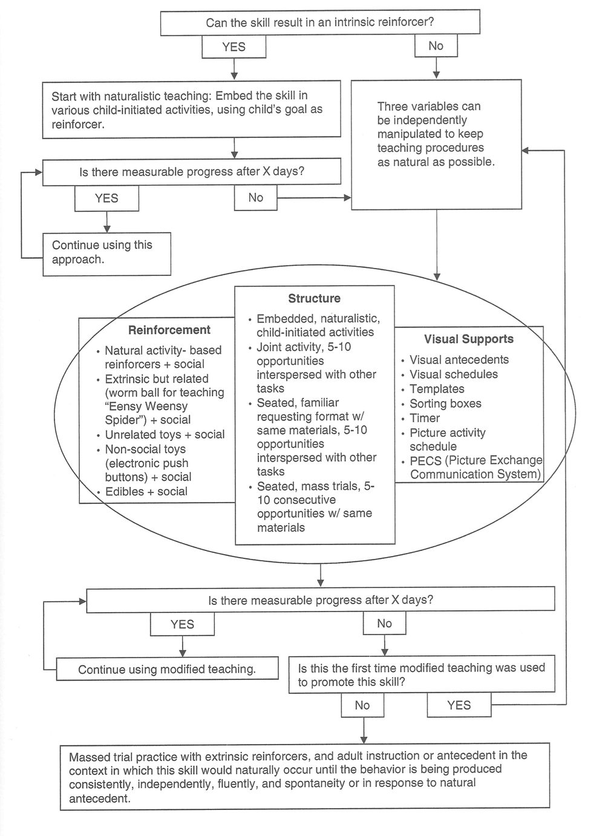
Troubleshooting:
When a child is not progressing
Adequate progress: measurable progress on acquisition skills as reflected by data sheets, every 3-5 days for children receiving 20+ hours/week of therapy, or every 1-2 weeks for children receiving less intensive therapy
What to adjust:
  Reinforcer strength
  Teaching structure
  Visual supports

Slide 22
Transitioning out of esdm
Parents and treatment team create a transition plan
If parents do not have providers outside of the ESDM team, the team should make appropriate referrals
Parents and team members should interface with new treatment providers about the child’s progress and goals
Set up an IEP meeting and discuss the child’s skills, learning objectives and needs
The ESDM team often remains available as consultants for a set period of time following the child’s transition
(Rogers & Dawson, 2010)

Slide 23
ESDM in a group setting
Children still have individual learning objectives and participate in some 1:1 therapy as well as group activities
A major benefit of group delivery is developing peer interaction skills
Group routines:
  Predictable daily schedule with activities that rotate weekly.
  Activities are balanced to target various learning domains.
  Activities last approximately 10 minutes
  Therapists should aim to elicit active participation from all children, and provide individual learning opportunities approximately every 30 seconds for each child
Data
  Staff record data following every activity and review each child’s learning objectives
  Staff meet weekly to review learning objectives and progress of each child
Eapen study: Pre-post study of 26 children with autism with a mean age of 49.6 months demonstrated statistically significant gains in receptive and expressive communication, developmental quotient scores, and adaptive skills
Vivanti et al. study: Moderators predicting better outcomes in group-delivered ESDM include imitation, advanced skills in functional object use, and goal understanding.
(Eapen, Crncec, & Walter, 2013; Rogers & Dawson, 2010; Vivanti et al. 2012)

Slide 24
ESDM studies
In 2010, Dawson et al. published the first randomized controlled trial comparing ESDM to a community treatment control group
Procedures:
  Random assignment of 48 children, 18-30 months old diagnosed with autism or PDD-NOS
  ESDM group received yearly assessments, 20 hrs/week of intervention, parent training, parent delivery of ESDM for 5+ hrs/week, as well as any additional community services they selected
  TAU group received yearly assessments, autism education, and referral to community resources
Outcome measures:
  Autism Diagnostic Interview - Revised, Autism Diagnostic Observation Schedule, Mullen Scales of Early Learning, Vineland Adaptive Behavior Scales, Repetitive Behavior Scales
(Dawson et al., 2010)

Slide 25
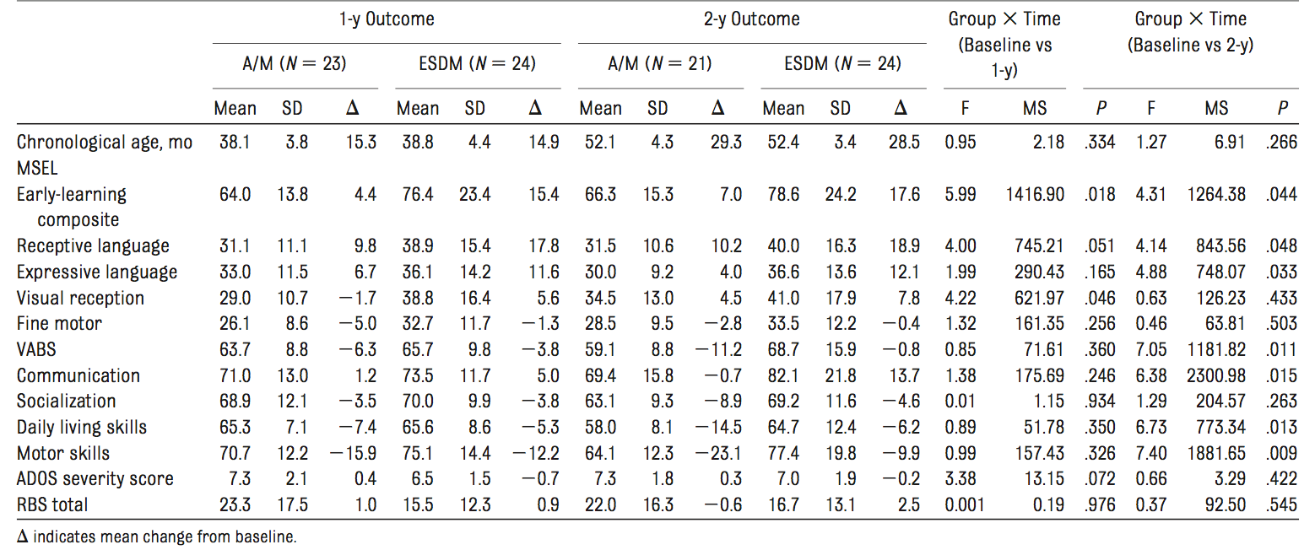
1 year Outcomes
  IQ: ESDM group demonstrated significantly more cognitive improvement on the MSEL (average score increase of 15.4 vs 4.4)
  Language: ESDM group improved 17.8 points on measures of receptive language, compared to 9.8 by TAU group
  Adaptive Skills: Both groups made some improvements, but demonstrated slower development than the normative sample
  ADOS/RBS: No significant difference in severity scores
(Dawson et al., 2010)

Slide 26
2 year outcomes
  IQ: ESDM group demonstrated significantly more cognitive improvement on the MSEL (average score increase of 17.6 vs 7 points)
  Language: ESDM group improved 18.9 points on receptive language and 12.1 points on expressive language measures, compared to 10.2 and 4 by TAU group
  Adaptive Skills: ESDM group showed similar standard scores at year 1 and year 2, indicating a steady rate of development; TAU group demonstrated an 11.2 point decline, indicating delays and an increasing gap from the normative sample
  ADOS/RBS: No significant difference in severity scores
  Diagnostic Status: Children in ESDM group significantly more likely to have improved diagnostic status (autism to PDD-NOS) - Improved diagnosis for 7 ESDM participants and 1 TAU, but diagnosis became more severe for 2 ESDM participants and 5 TAU participants
(Dawson et al., 2010)

Slide 27

eeg Follow up study
In 2012, Dawson et al. followed up with the same group of children, examining brain activity when presented with social and nonsocial stimuli
EEG activity in children:
  Alpha waves increase during states of relaxation and decrease during active stimulus processing
  Theta waves increase during tasks requiring working memory and focused attention
  Typically developing infants show sharp increases in theta waves when engaged in social activities like peekaboo
  Individuals with ASD demonstrate lower levels of theta activity than peers when presented with social stimuli
(Dawson et al., 2012)

Slide 28
EEG Follow up study
Following the original ESDM study, participants received EEGs when they were 49-77 months old (approximately 2.5 months after other assessments were completed)
  In addition to the original study participants, 17 typically developing children participated as a comparison group for the EEG study
  Participants were shown 140 unique color photographs - half of racially diverse female faces, half of toys - presented in random order on a screen
Results:
  73% of ESDM participants and 71% of typical children demonstrated higher cortical activation when viewing faces than when they viewed objects, compared to only 36% of the ASD community treatment group. ESDM and typical peers also demonstrated a faster neural response to social photographs.
  EEG measurements with higher cortical activation for faces were correlated with higher levels of social engagement as measured by the PDD-Behavioral Inventory Composite Expressive and Expressive/Receptive Social Communication indices
  No significant correlation between EEG results and measures of IQ, language, or adaptive behavior
(Dawson et al., 2012)

Slide 29
Long term outcomes
2 years following the original RCT, 39 of the 48 children were reassessed at age 6 to measure the intervention’s long term outcomes.
  Following the previous phase of the study, parents were interviewed every 6 months about what services (and # of hours per week) their children received
Results:
  Developmental outcomes: Both groups demonstrated continued improvement in intellectual and adaptive functioning. ESDM composite, nonverbal, and adaptive scores were higher than the community treatment group, but not at a statistically significant level.
  Core symptom outcomes: ESDM group received significantly lower ADOS Total and Repetitive Behavior Scale scores
  Diagnostic outcomes: 2 ESDM children classified as “no diagnosis,” no change in community group, however, these changes are considered nonsignificant
  Challenging behavior: No significant differences between groups
  Peer Relationships: ESDM children were rated by parents as having better peer relationships than community group, but not at a statistically significant level.
(Estes et al., 2015)

Slide 30
Parent training studies
In 2009, Vismara et al. conducted a pre-post study examining the efficacy of a 12-week, low intensity (1hr/week of therapist contact) parent training study in which parents were taught to use ESDM techniques.
  8 families (2 dropped out midway through) with children 36 months old or younger with autism received 12 1-hour training sessions from ESDM therapists involving instruction, modeling, practice and feedback.
  DVs = parent mastery of ESDM techniques, child social communication behavior
  Parents demonstrated improved use of ESDM techniques as measured by the ESDM fidelity checklist; children demonstrated increased spontaneous functional language use and imitative behavior
In 2012, Rogers et al. published a study examining the same parent-training program, but with a more rigorous design (RCT, more participants)
  Random assignment of 98 14-24 month old children considered “at risk” for ASD on multiple screening measures. ESDM group received 12 weeks of parent training, control group was referred to community resources
  Improvements in both groups, but no significant differences between ESDM and control group.
(Rogers et al., 2012; Vismara et al., 2009)

Slide 31
Review of early intensive interventions for ASD
In 2012, Warren et al. conducted a systematic literature review of intensive interventions for children 12 and younger with ASD
  Examined studies from the years 2000-2010 with at least 10 participants (excluded single subject designs) - 34 met inclusion criteria
  Studies were classified in 3 main categories:
    UCLA/Lovaas-based Early Intensive Behavioral Interventions (EIBI)
    Comprehensive interventions for children younger than 2 years of age
    Parent training protocols
  Outcomes of interest: Core and associated ASD symptoms
  Studies assessed for strength of evidence and methodological rigor
(Warren et al., 2012)

Slide 32
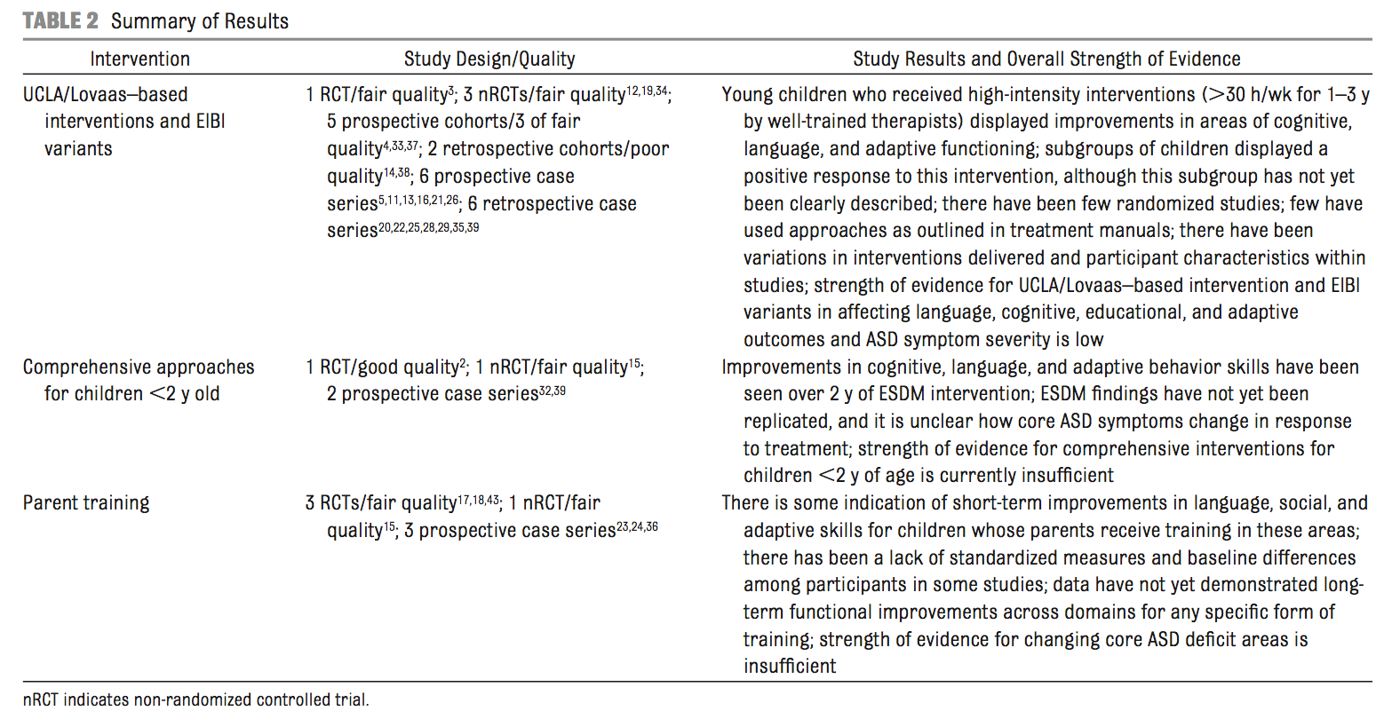
Results
UCLA/Lovaas EIBI and Comprehensive Early Interventions have reported positive outcomes in cognitive performance, language and adaptive behavior for some children
Many studies limited by methodological concerns - need for more evidence to support treatments
Strength of evidence ranged from insufficient to low
ESDM the only “good quality” study, but needs to be independently replicated
(Warren et al., 2012)

Slide 33
Review: Evidence base update
In 2015, Smith & Iadarola published an updated review of treatments for children 5 or younger with ASD
  Studies published from 2007-2014
  Randomized or quasi-experimental designs
  Inclusion of single subject designs, but the highest classification for these is “possibly efficacious” per Journal of Clinical Child & Adolescent Psychiatry standards
  Outcomes of interest: Core and associated ASD symptoms, and specifically targeted skills (e.g. joint attention)
  Levels of classification: Well established, probably efficacious, possibly efficacious, experimental, and questionable
(Smith & Iadarola, 2015)

Slide 34
Review: Evidence base update
Studies categorized by theoretical background and target outcomes
Theoretical Background | Scope | Subject(s)
ABA therapy Developmental Social Pragmatic (DSP) ABA + DSP ABA + DSP | Comprehensive Focused | Individual child Group delivery Parent
ESDM considered a Comprehensive, ABA + DSP intervention
(Smith & Iadarola, 2015)

Slide 35
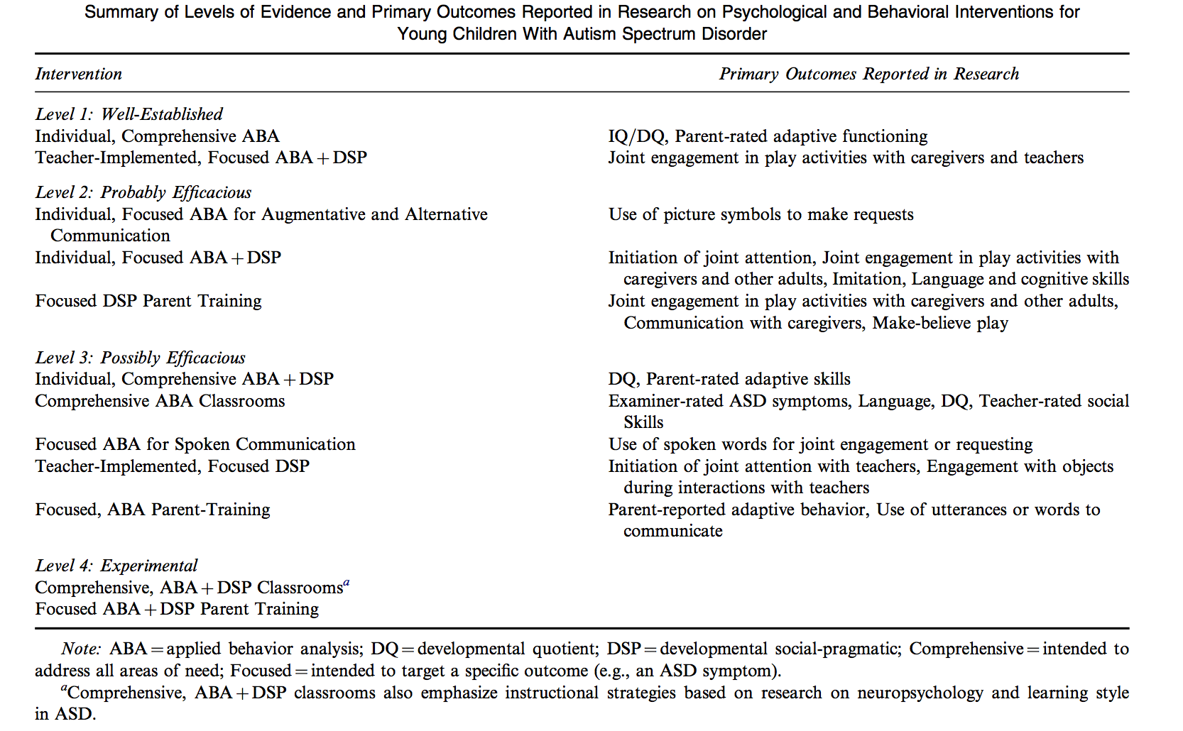
Results
Individual ESDM - Possibly Efficacious
ESDM Parent training - Experimental

Slide 36
Review: Effectiveness of esdm
In 2016, Waddington, van der Meer and Sigafoos published a systematic review of published ESDM studies from 2008-2015
  15 articles from 12 individual studies
  209 children diagnosed with autism or PDD-NOS or “at risk” for these diagnoses
  Average age below 60 months
  At least one objective outcome measure to be included in review
  Both group designs and single case designs included
  Study quality/rigor assessed using The Evaluative Method for Determining Evidence-Based Practices in Autism as “strong,” “acceptable,” or “weak.”
(Waddington, van der Meer & Sigafoos, 2016)

Slide 37
Quality ratings
Of the 15 articles:
  6 articles (3 unique studies) rated as “strong”
  1 study rated as “adequate”
  8 studies rated as “weak”
    Due to absence of control group, inadequate statistical power, failure to replicate the experimental effect, insufficient baseline data, or too few high quality indicators
(Waddington, van der Meer & Sigafoos, 2016)

Slide 38
Participant outcomes
Positive outcomes were defined as better results for ESDM group compared to control following intervention (group comparison studies), a significant improvement during the intervention (pre-post study), or improvements in the outcome measure for the majority of participants during intervention (single case design)
Negative outcomes defined as no difference between groups or greater improvements for TAU group (group comparison studies), no significant difference or a significant deterioration (pre-post study), or no improvement or deterioration in outcome measure for the majority of participants (single case design)
(Waddington, van der Meer & Sigafoos, 2016)

Slide 39
Participant outcomes
Child behavioral functioning and development:
  12 articles using 9 different outcome measures - the majority reported positive results, but some were mixed and some negative
Social interaction and communication skills:
  6 articles measured various social and communication skills - all articles reported positive outcomes except for 3 studies that reported negative outcomes for specific skills (imitation, social orientation, and joint attention)
Physiological measures:
  1 article reported mixed results as measured by EEG activity
Autism severity and diagnostic outcomes:
  7 articles included measures of severity - 2 reported positive outcomes, the rest were negative
  3 articles reported diagnostic changes - 2 positive, 1 negative
Parent and therapist outcomes:
  6 articles examined measures of parent skill - 5 reported positive results, 1 negative.
  3 articles examined additional parent outcomes - 2 found positive results 1 negative
  2 articles reported positive outcomes for therapist treatment integrity
(Waddington, van der Meer & Sigafoos, 2016)

Slide 40
Moderators of outcome
Rogers et al. (2012) found increased intervention hours, younger pre-treatment age and nonsocial orienting to be predictors of better outcome
  Vivanti et al. (2013) did not found no correlation between these variables and outcome
Vivanti et al. (2013) found imitation skills, functional object use, and goal understanding to be a predictor of positive outcome
  Rogers et al. (2012) did not find imitation skills to predict outcome, contrary to the study’s hypothesis
Estes et al. (2014) found number of negative life events predicted increased parenting stress and a decreased sense of competence in delivering intervention techniques
(Waddington, van der Meer & Sigafoos, 2016)

Slide 41
Conclusion
ESDM has demonstrated improvement in cognitive, language, adaptive and diagnostic outcomes for some children, but mixed or negative outcome for others
Preliminary findings suggests ESDM could be a promising treatment, but there is a need for a stronger base of evidence
Future research should include more methodologically rigorous studies and independent replication, examinations of generalization, studies with more diverse subject populations, and studies in which ESDM is compared to other manualized treatments

Slide 42
questions?

Slide 43
references
Collaborative START Lab Overview, UC Davis MIND Institute. Retrieved April 23, 2016. http://www.ucdmc.ucdavis.edu/mindinstitute/research/esdm/
Dawson, G., Jones, E. J. H., Merkle, K., Venema, K., Lowy, R., Faja, S., Kamara, D., Murias, M., Greenson, J., Winter, J., Smith, M., Rogers, S. J., & Webb, S. J. (2012). Early Behavioral Intervention is Associated with Normalized Brain Activity in Young Children with Autism. Journal of the American Academy of Child & Adolescent Psychiatry, 51(11), 1150-1159.
Dawson, G., Rogers, S., Munson, J., Smith, M., Winter, J., Greenson, J., Donaldson, A., & Varley, J. (2010). Randomized, Controlled Trial of an Intervention for Toddlers with Autism: The Early Start Denver Model. Pediatrics, 125(1), e17-e23.
Eapen, V., Crncec, Rudi, & Walter, A. (2013). Clinical outcomes of an early intervention program for preschool children with Autism Spectrum Disorder in a community group setting. BioMed Central Pediatrics, 13(3), 1-9.
Estes, A., Munson, J., Rogers, S., Greenson, J., Winter, J., & Dawson, G. (2015). Long-Term Outcomes of Early Intervention in 6-Year-Old Children with Autism Spectrum Disorder. Journal of the American Academy of Child and Adolescent Psychiatry, 54(7), 580-587.
Marcus, L. M., Kunce, L. J., & Schopler, E. (2005). In F. R Vokmar, R. Paul., A. Klin, & D. Cohen (Eds.), Handbook of Autism and Developmental Disorders (3rd ed., Vol. 2, pp. 1055-1086). Hoboken, NJ: Wiley.
Rogers, S. J., & Dawson, G. (2010). Early Start Denver Model for Young Children with Autism: Promoting Language, Learning, and Engagement. New York: Guilford Press.
Rogers, S. J., Estes, A., Lord, C., Vismara, L., Winter, J., Fitzpatrick, A., Guo, M., & Dawson, G. (2012). Effects of a Brief Early Start Denver Model (ESDM)-Based Parent Intervention on Toddlers at Risk for Autism Spectrum Disorders: A Randomized Controlled Trial. Journal of the American Academy of Child & Adolescent Psychiatry, 51(10), 1052-1065.

Slide 44
Rogers, S., & Vismara, L. A. (2008). Evidence-Based Comprehensive Treatments for Early Autism. Journal of Clinical Child & Adolescent Psychology, 37(1), 8-38.
Schreibman, L., Dawson, G., Stahmer, A., Landa, R., Rogers, S., McGee, G., Kasari, C., Ingersoll, B., Kaiser, A., Bruinsma, Y., McNerney, E., Wetherby, A., & Halladay, A. (2015). Naturalistic Developmental Behavioral Interventions: Empirically Validated Treatments for Autism Spectrum Disorder. Journal of Autism and Developmental Disorders. 45. 2411-2428.
Smith, T., & Iadarola, S. (2015). Evidence Base Update for Autism Spectrum Disorder. Journal of Clinical Child & Adolescent Psychology, 44(6), 897-922.
UC Davis MIND Institute ESDM Training Program. Retrieved April 9, 2016 from http://ucdmc.ucdavis.edu/mindinstitute/research/esdm/pdf/certification_steps.pdf
Vismara, L. A., Colombi, C., & Rogers, S. (2009). Can one hour per week of therapy lead to lasting changes in young children with autism? SAGE Publications and The National Autistic Society, 13(1), 93-115.
Vivanti, G., Dissanayake, C., Zierhut, C., Rogers, S., & Victorian ASELCC Team (2013). Brief Report: Predictors of Outcomes in the Early Start Denver Model Delivered in a Group Setting. Journal of Autism and Developmental Disorders, 43, 1717-1724.
Waddington, H., van der Meer, L., & Sigafoos, J. (2016). Effectiveness of the Early Start Denver Model: a Systematic Review. Review Journal of Autism and Developmental Disorders. 1-14.
Warren, Z., McPheeters, M. L., Sathe, N., Foss-Feig, J. H., Glasser, A., & Veenstra-VanderWeele, J. (2011). A Systematic Review of Early Intensive Intervention for Autism Spectrum Disorders. Pediatrics, 127(5), e1303-e1311.

