Slide 1
Management of Severe Anxiety and OCD Characteristics in Individuals With Higher Functioning Autism Spectrum Disorder: An Overview Natalie M. Jensen Superheroes social skills training, Rethink Autism internet interventions, parent training, EBP classroom training, functional behavior assessment: An autism spectrum disorder, evidence based practice (EBP) training track for school psychologists US Office of Education Personnel Preparation Project: H325K12306 Principal Investigators: William R. Jenson, PhD and Elaine Clark, PhD Grant Director: Julia Hood

Slide 2
Objectives:
Overview of anxiety and OCD in typically-developing (TD) pediatric populations
Overview of anxiety and OCD in pediatric populations with HFASD
Examination of:
Social factors
Cognitive factors
Parent factors
Restrictive, repetitive, rigid factors
Available treatments for anxiety and OCD and
treatment modifications made for HFASD populations
Interventions/Treatment:
Literature Reviews
Meta-Analyses
RCTs and other studies
Treatment manuals
Other treatment options
Notes:
Right off the bat: address the scope of this topic and my (unsuccessful) desire to be concise
What I’m leaving out for the sake of time: A description of ASD
Will give very light description on anxiety and OCD (starting with anxiety)

Slide 3
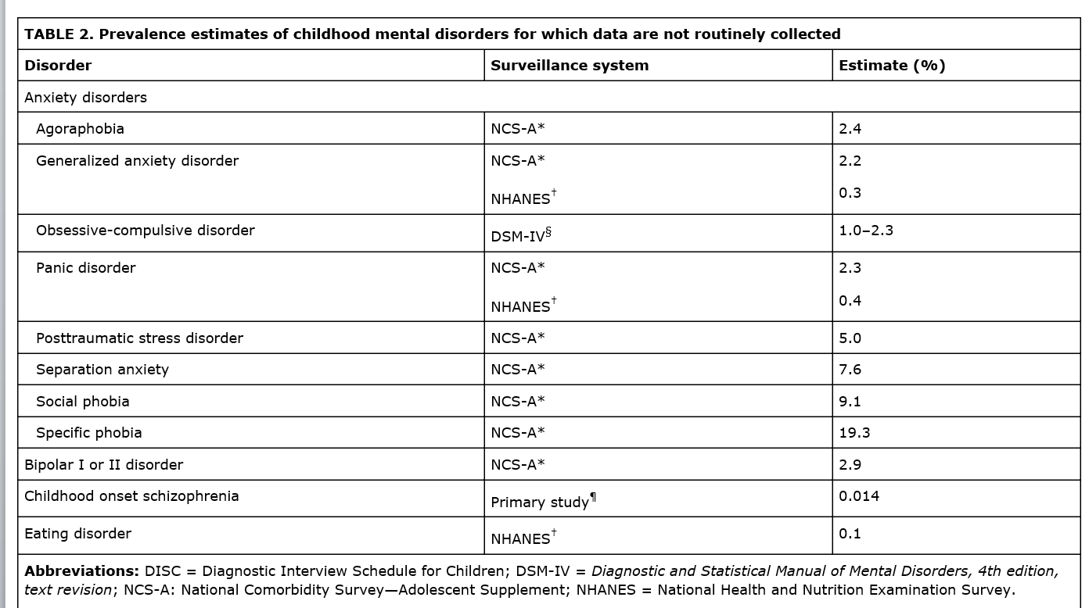
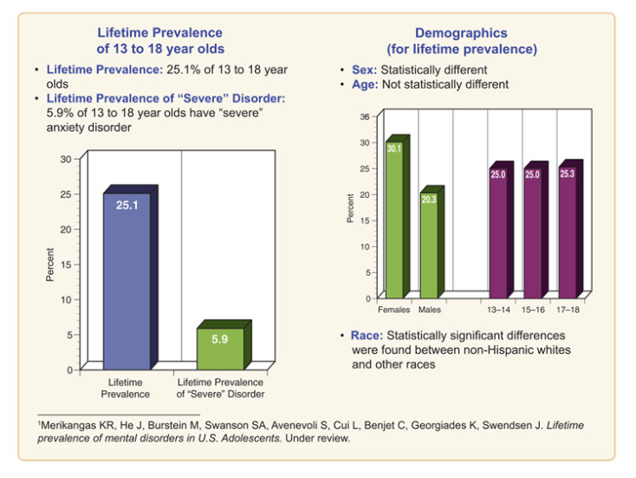
Anxiety & OCD (Typically Developing (TD))
CDC
NIMH
Center for Disease Control and Prevention. (2013) [Estimates of Anxiety Prevalence in the Population and Surveillance Systems Used to Capture Data]. Mental Health Surveillance Among Children — United States, 2005–2011. Retrieved from http://www.cdc.gov/mmwr/preview/mmwrhtml/su6202a1.htm#Tab8
Notes:
APA (1993): 2-15%
Generalized: pervasive, chronic anxiety that often leads to hypervigiliant bx
Anxiety: gap between challenges you’re facing and how competent you feel in handling the challenge

Slide 4
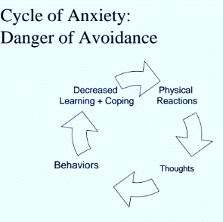
Anxiety (TD):
Characteristics: Physiological arousal, distorted cognitive appraisals and the hallmark of most anxiety: AVOIDANCE
Smith & Lazarus (1993): Four distinct appraisal dimensions:
Self Accountability: How much responsibility one has for the outcome
Emotion-focused coping potential: Emotional reactivity
Problem-solving coping potential: What you can/will do
Future Expectancy: What you predict will happen
Children with anxiety have low future anticipation, high self responsibility for events, and high uncertainty in abilities
Children with anxiety seem to have distorted appraisal biases in two categories (Beck et al. 1985; Pilecki and McKay 2011; Wright and Borden 1991):
Overestimate the nature of threat
Underestimate their ability to deal with threat
Notes:
Nice definition: “Anxiety consists of maladaptive responses to perceived threats which present in a combination of anxious behaviors, feelings and thoughts.”
Give example of the cycle: social avoidance

Slide 5
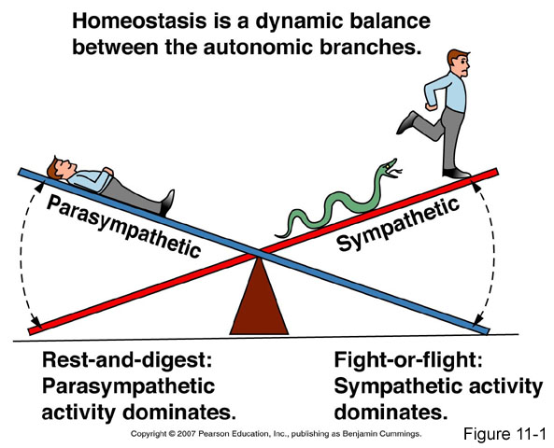
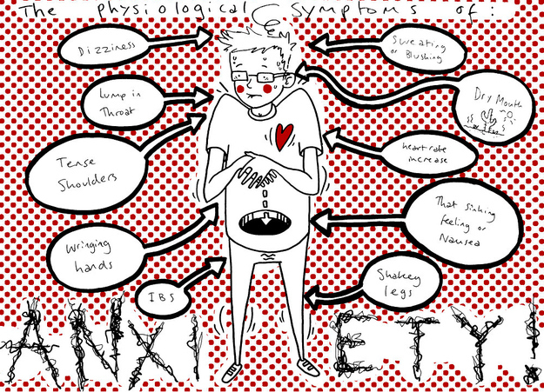
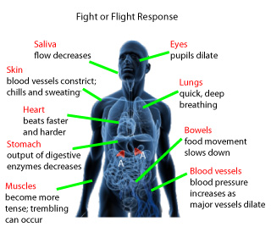
Notes:
Fight or flight response….
Use the example of a tiger coming into the room…..mice with the cat hair…
Animals literally shaking it off physically after a dangerous scenario

Slide 6
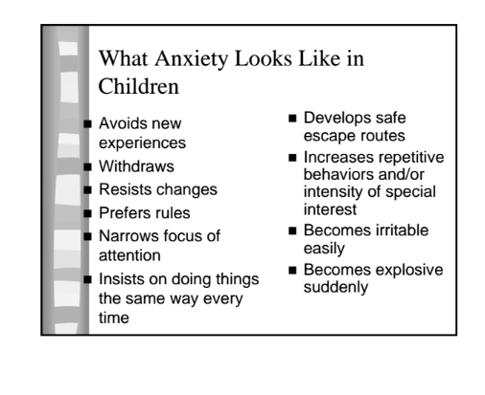
Anxiety (TD)
At risk for serious education problems, isolation, later unemployment, substance abuse, and other psychiatric problems (i.e. precursor to depression). (Velting et al. 2004; Tantum 2000)
Anxiety changes with age/development and presents differently across children (comorbid diagnoses, intellectual functioning, gender, parents (parent anxiety, modeling, parenting styles).
Cortical differences in children with anxiety?
Research has shown patterns of lower activity in the left frontal cortical regions and greater right frontal activation in individuals with affective and anxiety diagnoses. (Davidson et al. 2000; Henriques & Davidson 1990, 1991). Amygdalar volumes have been positively associated with anxiety severity and social-communication symptoms (Amaral, Schuman & Nordahl, 2008; Juranek et al., 2006)
Hepburn, Susan. Helping Children with Autism Spectrum Disorders Cope With Worry and Anxiety in School. [Power Point Slides]. Retrieved from: http://jfkpartners.org/Documents/PPT%20-%20Anxiety%20Webinar%20-%205-10-11.pdf
Notes:
Anxiety may present behaviorally in children (this list is from the lit and the FYF team)
Combination of physical and psychological symptoms
May not know how to get relief or communicate distress, may climb under table, explode, etc. to avoid….Bx approach would just focus on the bx but CBT approach adds the intentions and thoughts
SMALLER AMYGDALAS
CORTICAL DIFFERENCES (SUTTON ARTICLE): greater left side midfrontal activity linked to more social and general anxiety….usually the opposite in individuals with anxiety (TD)
CORBETT: Individuals with HFASD did not have the typical amygdala recruitment when looking at facial expressions….despite being able to appropriately identify the emotion.

Slide 7
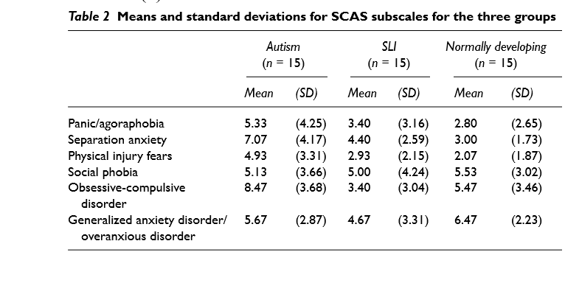
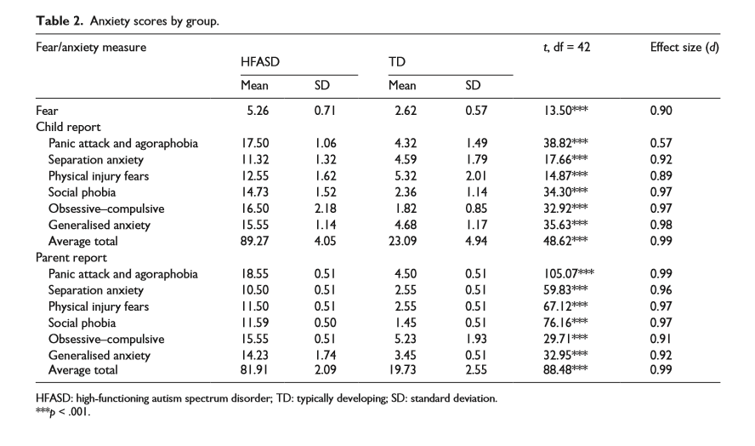
Anxiety and Autism
Children with ASD are more likely to have anxiety disorders than (Green & Wood, 2013):
TD children
Children with externalizing dx
Children with ADHD
Children with intellectual disabilities
Rates range from roughly 30-87 percent! (Most studies report prevalence rates around 50 percent)
Children with HFASD are more susceptible to anxiety than children with ASD+
Gillott 2001
Sharma 2014
Notes:
SCAS: Spence Childrens’ Anxiety Scale
SLI: Specific Language Impairment
HFASD: Fastest growing subgroup of ASD (US CDC 2009)

Slide 8
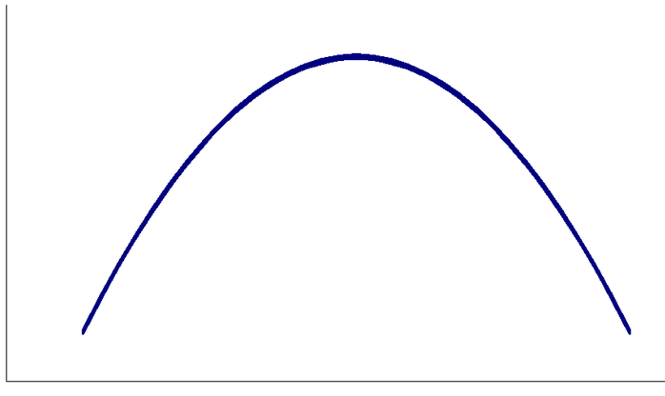
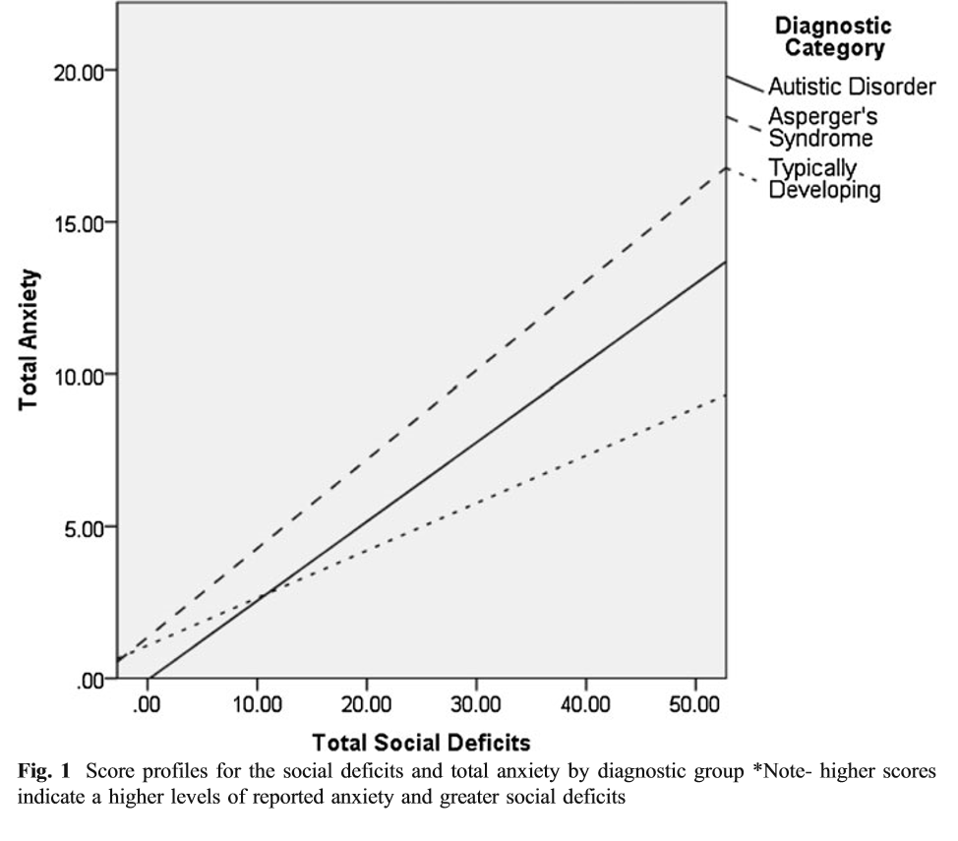
Social Factors
Social Anxiety
Bellini (2004) N=41 HFASD teens:
49% scored above the cutoff range for social anxiety
Positive correlation between self-reported social deficits and social anxiety
Negative correlation between assertiveness and social anxiety
Curvilinear relationship between empathy and social anxiety
Rieske (2012) N=181 children (n=59 ASD, n=49 Asperger's,
n=73 TD):
Elevated anxiety rates in both the ASD and Asperger's groups
Social deficits found to be a significant moderator for anxiety in the Asperger's group and approached significance as a moderator in the ASD group.
Consider the social implications of HFASD…
Low Empathy
High Empathy
Notes:
No, parent report too
PUGILESE (2012): Aggression increased with social anxiety
Bellini: Low empathy resulted in lack of social regard, unaware of or unconcerned with how people perceive them socially…..with increased empathic skills, more awareness of how others might perceive them.... And high empathy may be a result of improved insight and improved skills (ability to pick up on and understand feedback) , thus lessening anxiety…
Measures: SSRS (Social Skills Rating System: Gresham)
MASC: Multidimensional anxiety scale for children
BASC
SAS-A
Characteristics of an HFASD profile (i.e. social deficits, TOM, rigidity, repetitive behaviors, alexithymia etc.) seem to be potential risk factor for anxiety diagnosis.
Rieske: Measures administered included a demographic questionnaire, ASD diagnostic measure, psychopathology screener, challenging behavior inventory, and measure of adaptive functioning
Social Deficits Contribution to Anxiety in ASD:
Pugilese (2012): Found curvilinear pattern between aggression T-scores
and humiliation/rejection fears T-scores for HFASD group.
Similar social anxiety profile to SAD group
Similar aggression profile to ODD/CD group
Children with HFASD may have insight into social difficulties but approach difficulty in generating/executing adaptive social problem solving, self regulating distress and predicting outcomes.
Communication Disorders: Research suggests a positive relationship between communication difficulties and anxiety symptomatology (Beitchman et al., 2001; Blood, Blood, Maloney, Meyer & Qualls, 2007; Cantwell & Baker, 1987)
Davis (2010): Found that anxiety increased as communication deficits increased for both TD and PDD-NOS groups. However, the ASD group demonstrated an inverse relationship between anxiety and communication deficits.

Slide 9
ASD, Anxiety and Cognition
Uncertainty/Ambiguity regarding others thoughts and feelings (‘theory of mind) (ToM) may be a predictive factor for the development of anxiety and emotional difficulties (Blackshaw et al., 2001; Brent et al., 2004)
Alexithymia: inability to accurately identify, understand and verbally communicate subjective feeling states. Also, difficulty with fantasy and imaginal life.
Additional research regarding ASD cognition and links to anxiety has found:
Farrugia & Hudson (2006): HFASD group exhibited higher rates of negative cognitions than the TD group AND the AD (anxiety dx) group.
Sharma (2014): HFASD group demonstrated lower emotion focused coping potential, low problem focused coping potential, low future expectancy and high self-accountability.
Notes:
Alexithymia: diminished vocab to describe different levels of emotional experience (especially with subtle emotions)…use numbers to express emotional experience, use of other venues of expression (art, etc) .
May act out their feelings
SO MUCH AMBIGUITY FOR THESE LITTLE FRIENDS…
Farrugia & Hudson: Between group comparison (HFASD, TD, and AD)

Slide 10
Sharma data
Notes:
N=22 HFASD and N=22 TD peers (ages 8-11).
Presented them with “Strange Stories” to examine ToM…..Presented frustrating scenarios and observed child’s reactions, ability to problem solve, level of responsibility they took on.
Ambiguity: anxious individuals perceive ambiguous situations as more threatening….TOM difficulties have been linked to ambiguity….Kiddos with ASD often experience a lot of ambiguity in regards to instructions, social interactions, etc.
OCD: inflated responsibility

Slide 11
ASD, Anxiety and Parent Factors
Rapee (1997) suggests that ‘overprotective parenting’ increases child’s fear and anxiety because parents purposefully draw attention to awareness of danger, reduce level of perceived (or actual) child control and promote avoidant behavior
Vreeke (2013): Overprotective parenting correlated with anxiety symptoms in a sample of 168 children (note: not significant predictor on own, interaction with child exhibiting bx inhibition).
Reaven (2011): Parents of children with ASD may be more likely to be overprotective of their children (complicated due to increased needs…)
“Adaptive Protection” vs. “Excessive Protection”. Excessive protection involves limiting exposure and thus, opportunities to practice effective coping.
Kuusikko-Gauffin (2013): N=752 parents (n=131ASD parents and n=621 control parents):
Mothers of children with ASD demonstrated higher SAD scores in all measures
Fathers of children with ASD demonstrated higher SAD scores in: somatic and cognitive, avoidance and agoraphobia.
Notes:
Bettelheim “Refrigerator mothers”
Kuusiko: (Social Phobia and Anxiety Inventory)
ASD parents: more aloof, anxious, overly sensitive and shy than parents of kiddos with other clinical dx (Murphy et al. 2000)
ASD parents: more anxiety sensitivity, fatigue (linked to anxiety, parenting efficacy and parenting satisfaction) and higher rates of depression and alexthymia (difficulty identifying and describing one’s feelings)
ASD parents who were not “socially anxious” still showed elevated scores on the somatic and cognitive symptoms when compared to control parents.
Rapee example: “Yes, the elevator is really scary! You’re right to be scared….do you know 1,000 people get stuck in elevators for 15 hours or more every year….?”
Instead: “I get it….Elevator rides can feel kind of weird. I know you can do it and I’m here to help you. Let’s list all our favorite Little Pony movies in order while we ride up one floor.”

Slide 12
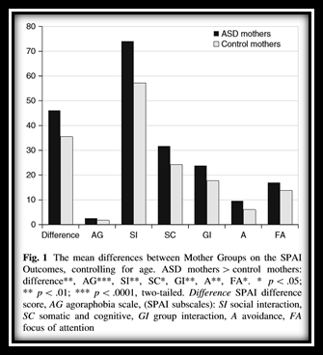
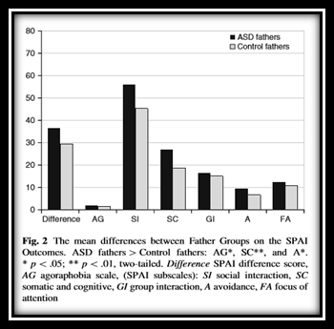
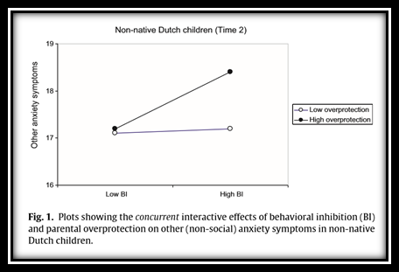
Kuusikko-Gauffin & Vreeke

Slide 13
Additional Considerations: Anxiety & ASD
Anxiety increases sensory symptoms, total ASD symptoms, irritability, sleep disturbances, disruptive behaviors, inattentiveness and health problems (i.e. gastrointestinal issues, etc.)
Children with ASD show higher cortisol patterns
Adolescence is a critical period for HFASD…
Difficulties with self-care (adaptive and functional skills) may compound anxiety problems and limit opportunities for success/self efficacy (Klin 2007)
Anxiety is the second most concerning problem reported by parents of youth with ASD (Mills & Wing 2005)
ASD children tend to underreport their anxiety symptoms
Notes:
Obsessive and ritualistic/repetitive behaviors play key role in management of fear and anxiety for children with ASD and can lead to further withdrawal into self (Howlin 1997; Tantam 2003)
Cortisol levels comparable to those with chronic stress
Risk factors for developing anxiety: HFASD, excessive self focus (Kendall & Ronan 1990), social cognitive deficits (2003), difficulty regulating stress levels, and heightened levels of arousal (Loveland 2005; Pfeiffner 2005)
Growing awareness of social disability
Emerging concept of self
Heightened complexity in social milieu
Decreased buffering from lower parent involvement
Less structure
126-127 of CBT Book

Slide 15
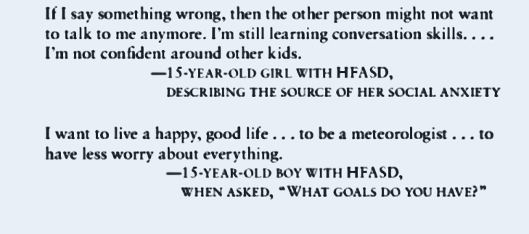
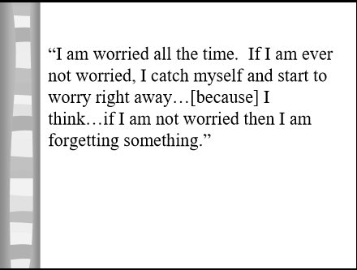
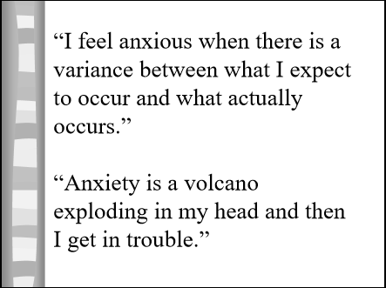
Children with HFASD describing their anxiety….
Notes:
Van Steensel (2013):
n=73 HFASD with comorbid anxiety (ASD+AD group), n=34 with anxiety diagnosis (AD group) and n=87 TD children.
Annual societal costs for ASD+AD group were 4 times higher compared to the AD group and 27 times higher than TD controls (Note: 80 percent of ASD+AD cost attributed to ASD symptoms. Anxiety severity did not sig. influence annual cost in ASD+AD group but did in AD group).

Slide 16
Anxiety Treatments (TD)
Cognitive Behavioral Therapy (CBT) is an empirically-supported treatment for anxiety disorders in
TD children.
Calm physiological response
Teach relaxation, psychophysiology awareness, etc.
Correct cognitive distortions*
Children with anxiety typically have more cognitive distortions than cognitive deficiencies.
Teach them to monitor thoughts, recognize thinking errors and begin to challenge them.
Develop coping strategies
Deep breathing, positive self talk, “middle path”, how to utilize pleasant distractions, etc.
Practice exposure in feared settings (used in approx. 80% of anxiety programs (Chorpita & Daleiden, 2009))
Start with fear hierarchy, role-playing, systematic desensitization, etc.
Exposure leads to the extinction of avoidance behavior and the habituation to maladaptive or excessive physiological responses (Davis & Ollendick 2005).
Notes:
CBT: Broadly conceived as the integration of cognitive and behavioral approaches for making specific, targeted changes in thoughts, feelings, and behaviors (Attwood & Scarpa 2013)
STINKY THINKING

Slide 17
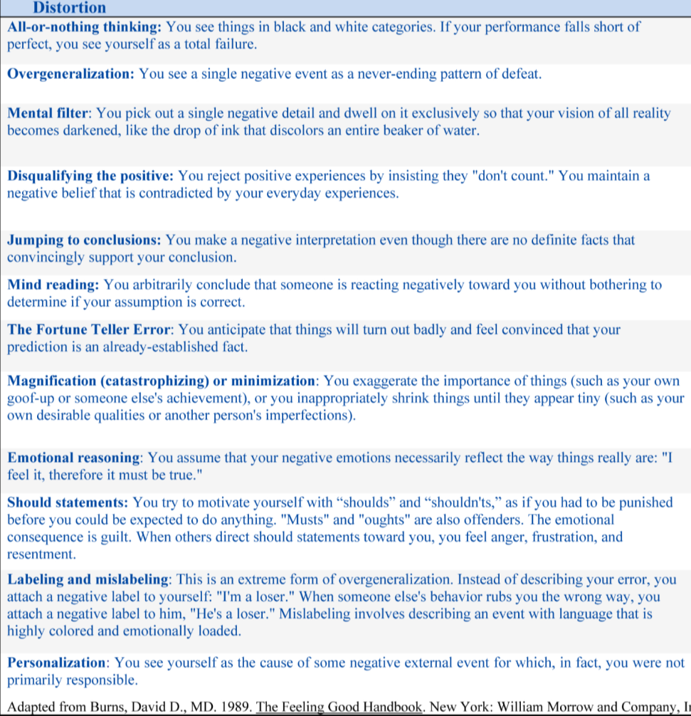
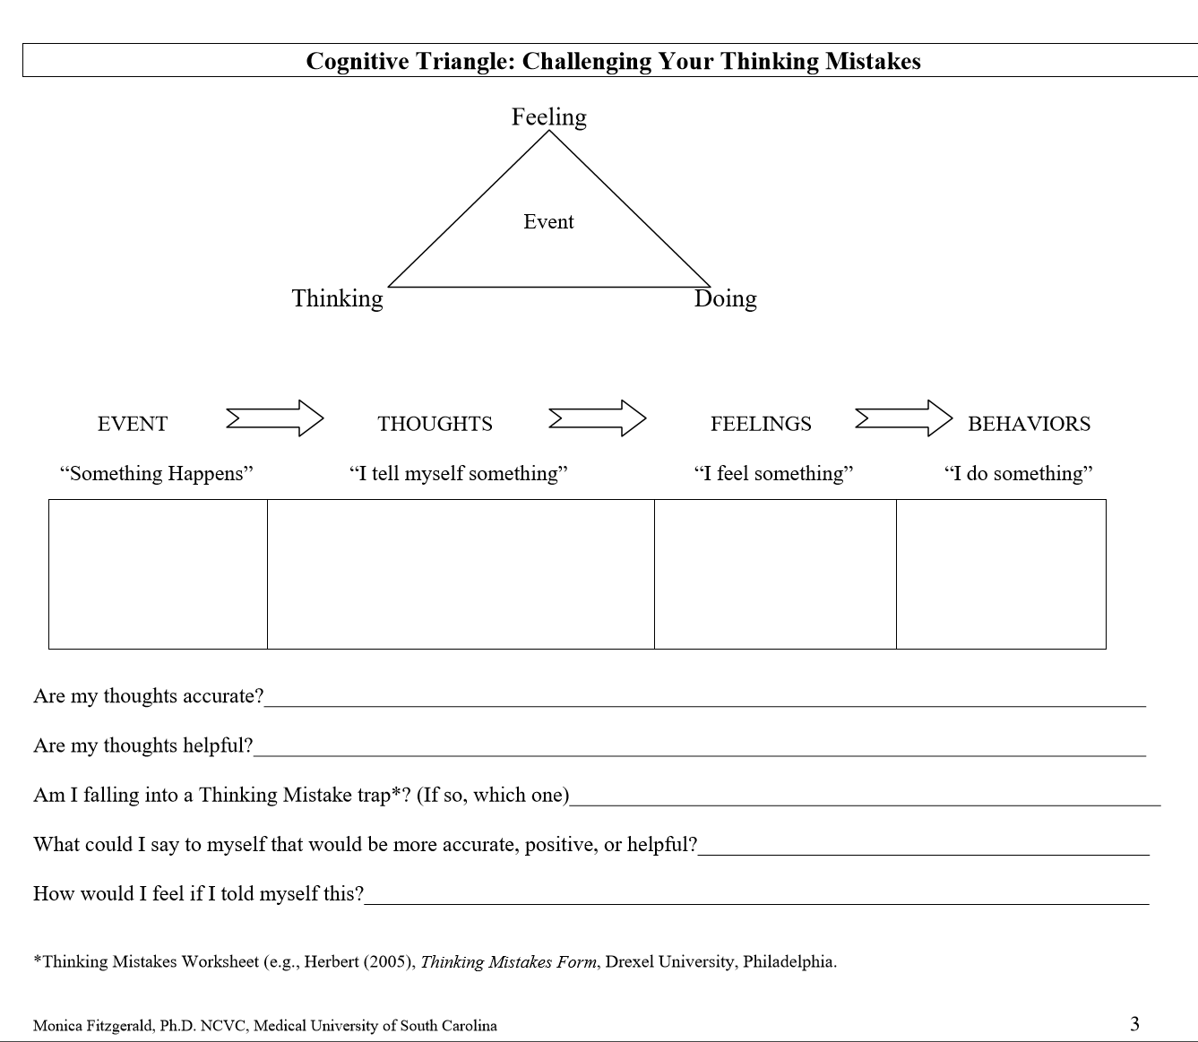
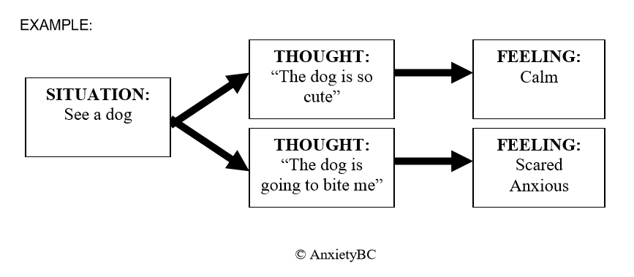

Slide 18
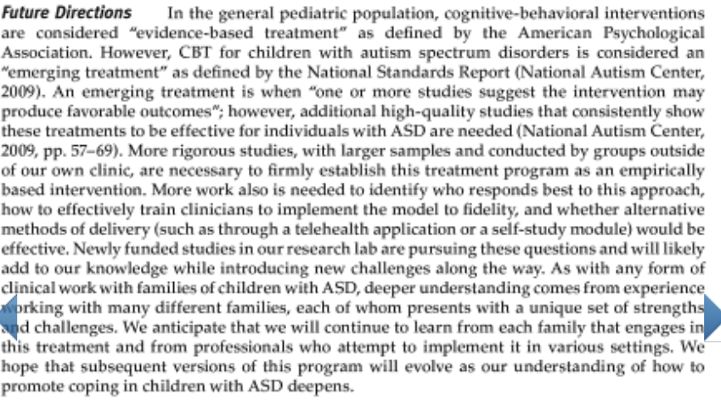
ASD and Anxiety Treatment
Concern in the literature regarding appropriateness of CBT for ASD populations given the abstract nature of CBT components like Socratic questioning, psychoeducation, self awareness, self evaluations, and self control (Attwood & Scarpa, 2013)
However, growing research suggests that with ASD-specific modifications, CBT can be effective with ASD populations (“emerging treatment” per National Standards Report (2009)).
Four broad trends in modifying CBT for ASD (Moore, 2010)
Disorder specific hierarchies
Incorporate social, communicative and functional skill development into tx
Increase affective education
Concrete and visual tactics
Utilize drawings, pictures, visual worksheets, narratives and social stories
Emphasize behavioral components, increase concrete practice opportunities
Child-specific interests
Use high interests and preferred language (What would
Harrison Ford do? (Sze and Wood, 2007; 2008)
Parent Involvement
Helps increase generalizability, decreases family accommodation of anxiety, etc.
Notes:
UTILIZE STRENGTHS
Disorder specific: social, communication, adaptive functioning (most incorporate some sort of social skills) lots of social skills programs are for under 13 ***WORK WITH RIGIDITY*** need more flexibility “what else could you do?” work with fear of making a mistake
Concrete and visual tasks: emotion statements (or scripts), pictures and drawings, visual worksheets, narrative and social stories, role play (use the literal thinking to your advantage) routine, schedule and structure.
USE RULES: what is excessive worry and normal worry (Storch)
Child specific interests: use child’s preferred language….often the approach is to be a “scientist” dissecting feelings. Helps with motivation and interest initially….have to balance therapeutic gain vs reinforcing problematic obsessions.
Parent involvement: how parents are involved varies greatly. phase out assistance and rescuing, opportunities for parents to network and gain support,

Slide 19
A comment on this literature:
It’s a new(er) area of research: “Dissemination and implementation of evidence based practice (EBP) for ASD has only recently begun and the implementation of treatments meant to address co-occurring psychiatric symptoms (i.e. anxiety) for ASD populations in ‘real world’ clinical settings is in it’s infancy.” (Reaven, 2014).

Slide 20
Most of the studies have been conducted:
In tightly controlled university settings
With very specific inclusion/exclusion criteria for subjects
By the authors/developers of programs being used
As pilot studies or case studies
Using measures that may or may not be reliable and valid
Without information on tx adherence
Without replication
Notes:
First anxiety assessment measure for anxiety with ASD populations (Mackenzie Boon)
MEASURES: ASD-CC Autism Specturm Disorders-Comorbid for Children: 49 item, informant based rating scale designed to assess symptoms of emotional difficulties in ASD. Depression, conduct disorder, ADHD, tic disorder, OCD, specific phobia, and eating difficulties. Moderately good inter-rater and test-retest and very good internal consistency. (Matson: 2009): looked at the construct validity of the measure by correlating with the BASC…results of EFA (exploratory factor analysis) were promising

Slide 21
What’s needed moving forward?
Independent replication in more natural settings
Appropriate assessment of dx and outcomes
Larger sample sizes
More representative samples (females)
Increased methodological rigor
Longer follow-up post tx
Comparisons to established tx

Slide 22
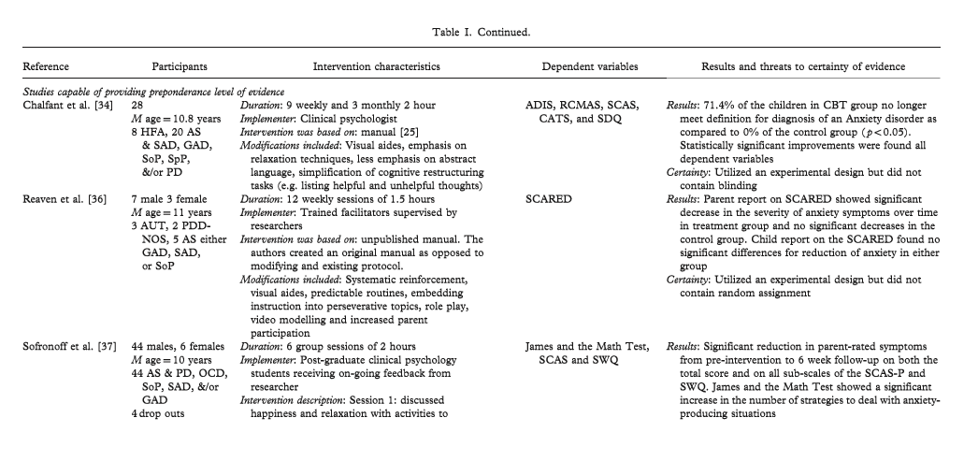
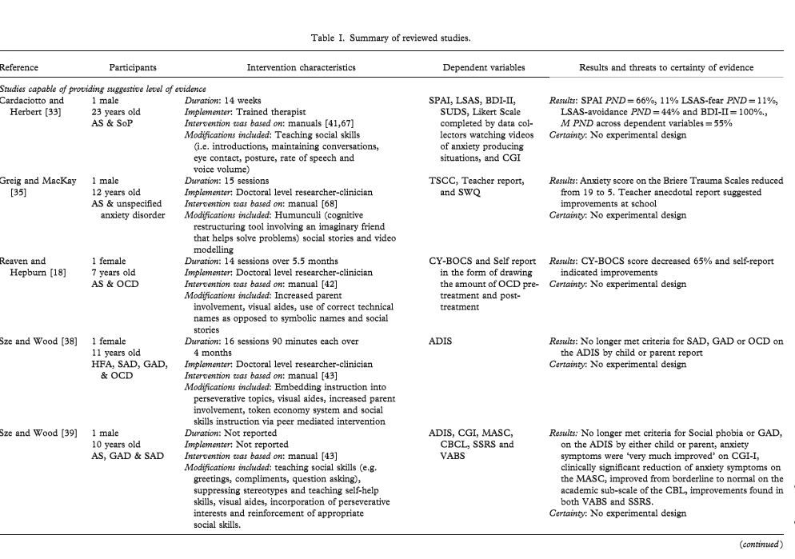
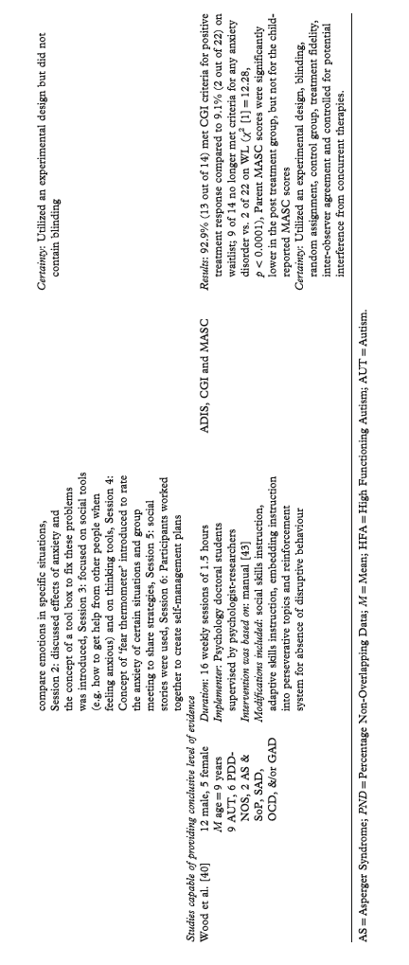
Lit Reviews
Lang (2010):
9 studies
Total N=110 with sample sizes ranging from 1-50.
Gender bias (more males)
CBT traits: 6-16 sessions, 1-2 hours long.
Every study used published CBT treatment manuals with modifications made for ASD population
Results: At least one DV in each study indicated
a reduction in anxiety symptomatology.
Notes:
7 of the studies included social skills training
Mostly male participants
5 were case studies
Not going to spend too much time here since we’ll be talking about the individual program in more detail

Slide 23
Meta Analyses
Sukholdosky (2013)
8 studies
2 did not use exposure treatment
3 incorporated social skills
N=469 total (252 in treatment)
Control conditions: 5 Waitlist, 2 Treatment as Usual (TAU) and 1 Social Recreation Program comparison
5 treatment manuals utilized
6-16 sessions, 60-120 minutes
Overall effect sizes (ES) were large, however removal of outlier decreased ES to .57 for parent ratings and .89 for clinician ratings (small ES for self report)
Ung (2015)
14 studies (Adds on to the Sukholdosky meta)
N=511 (283 in treatment)
Sample sizes range from 6-71 participants. (n=422 males)
M= 11 years
7 different treatments utilized
6-32 weeks (M=14.79 weeks), 60-120 minutes.
Individual tx=7, Group tx=6, Combined tx=1
Overall moderate ES (-.71) with larger ES for group administration (small ES for self report)
Notes:
UNG: larger ES for group administration was not statistically significant
Small ES (or no change) for self-report is common in this literature

Slide 24
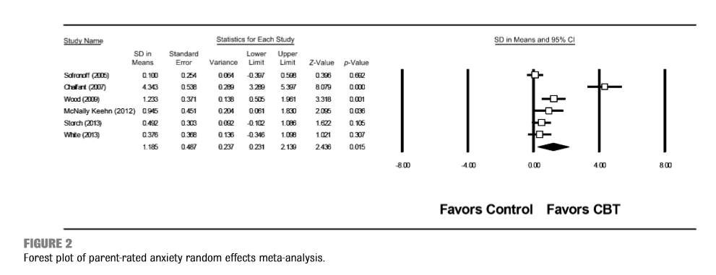
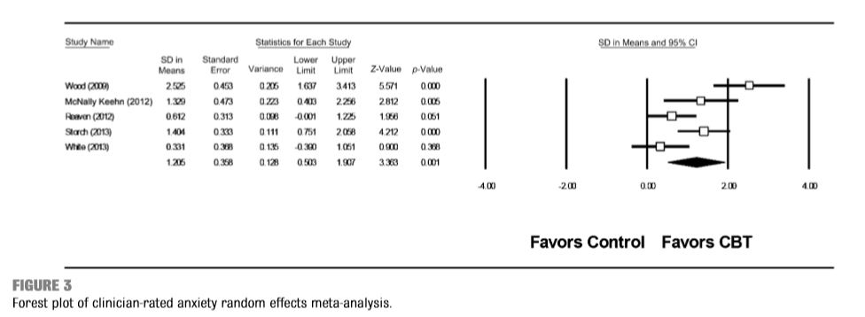
Sukholdosky Data

Slide 25
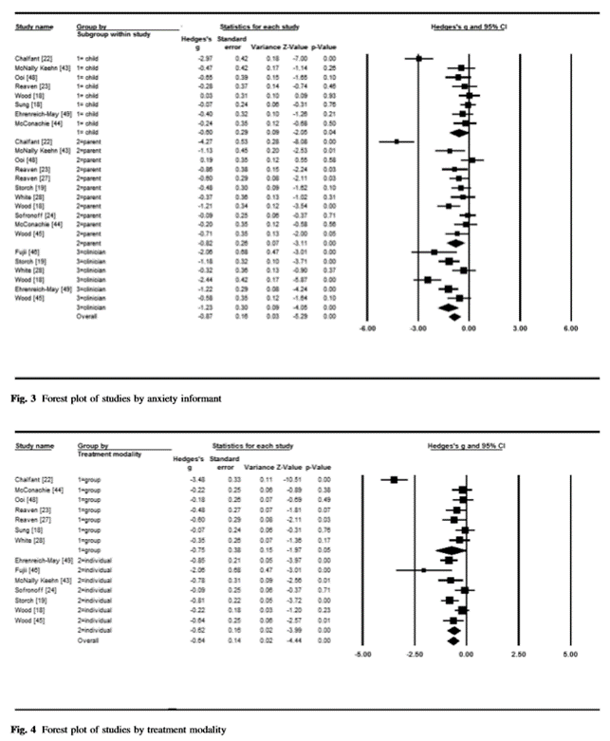
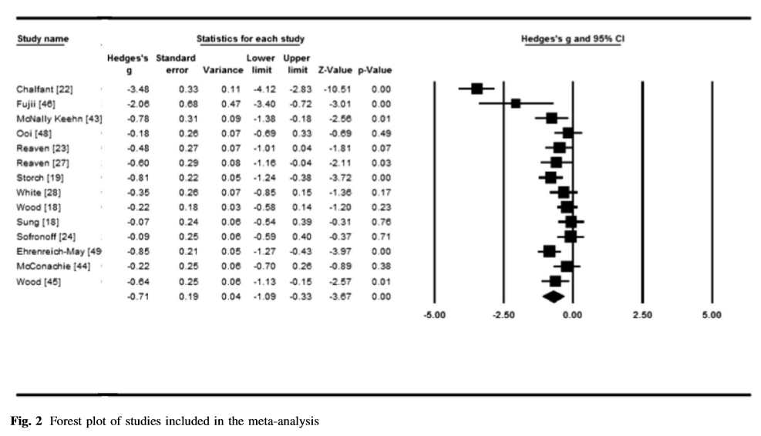
Ung Data

Slide 26
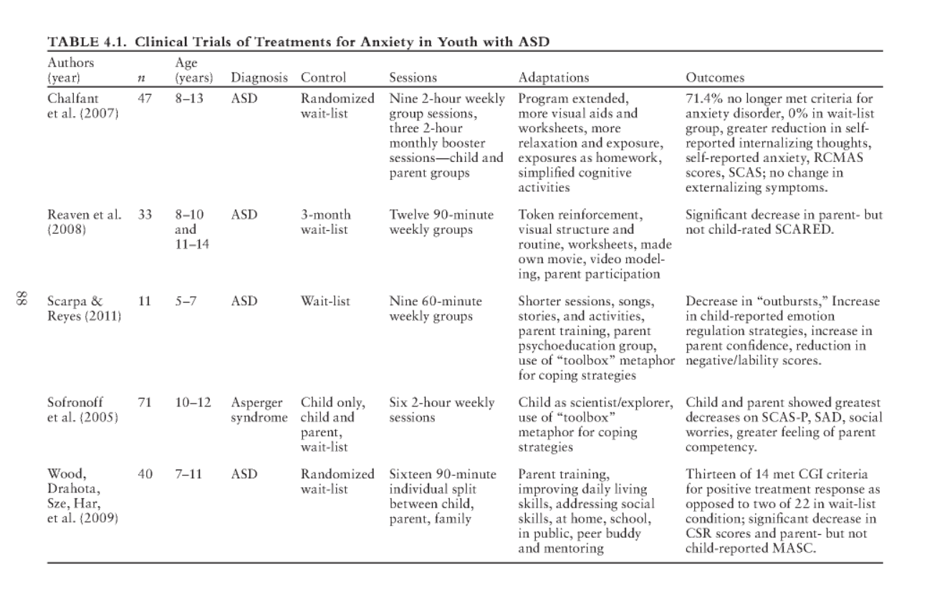
Overview of Treatment Programs:
Notes:
GIVE DISCLAIMER ABOUT HOW I’LL BE GOING THROUGH THE TREATMENT SLIDES
Included for a quick-look but I’m not spending time here since we will be talking about these programs.

Slide 27
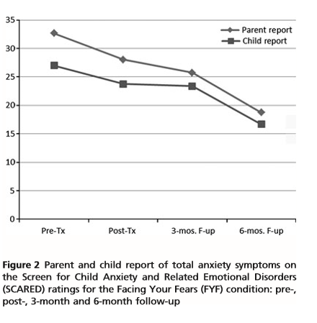
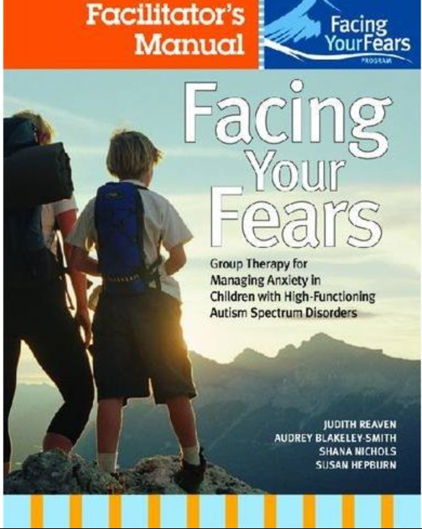
Intervention Programs: Face your Fears
Reaven, Blakeley-Smith, Nichols & Hepburn
‘Facing Your Fears’ original treatment manual was written with ASD population in mind.
Components include:
Graded exposure
Relaxation & Breathing
Recognition of automatic negative thoughts (“helper vs. worry bugs”)
Development of coping statements
Embedded social skills
Parent involvement (includes parent coaching, psychoeducation, training on adaptive vs. excessive protection and management of parents’ anxiety)
Psychoeducation (“stress-o-meter”)
Hands-on activities
Extra practice sessions
Video modeling & creating videos
Token economy system
2012
N=50, n=24 in intervention (vs. TAU)
Age range from 7-14 years
Intervention
12 weeks, multifamily sessions
Small groups of 3-6 children
Research clinic setting in Colorado
Detailed parent curriculum
Use of adapted worksheets, multiple choice lists, token economy.
Results:
Medium to large ES in clinician ratings of severity. ES of .85 for GAD criteria
Notes:
1.5 hour sessions
TeleCopes: online format….Susan Hepburn (telehealth)
“fight back with facts”….challenging distortions….reality check (Katherine’s “pineapple”)
For panic: try to prevent but if it happens, ride it out….about 7 minutes…

Slide 28
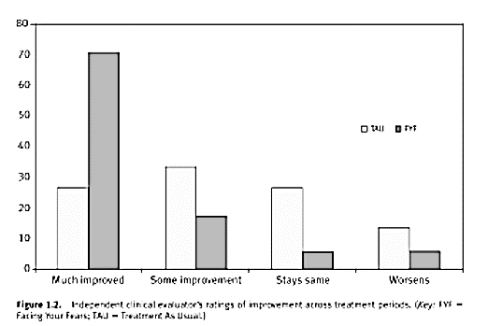
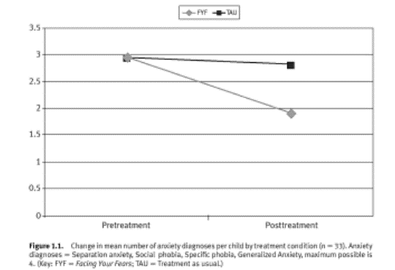
Facing Your Fears: Cora’s Eye Procedure
Facing Your Fears Results
https://www.youtube.com/watch?v=9jxrQXewGxQ
Notes:
Right graph: change in mean number of anxiety dx….Sep anxiety, social phobia, GAD, maximum possible is 4

Slide 29
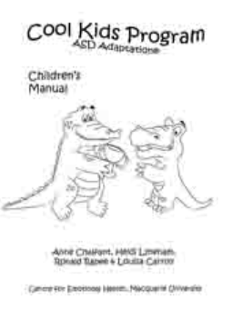
Intervention Programs: Cool Kids
Chalfant
Adapted already-available CBT program (“Cool Kids” (Lyneham, Abbott, Wignail & Rapee 2003) for ASD populations
Available in group (grades 2-6) or individual (children or adolescent) formats
Adaptations for ASD:
Added visual materials
Structured worksheets
Simplified cognitive therapy
Extended entire program length and extended time spent on concrete components like relaxation and exposure
Provided concrete analogies (detective thinking/stepladder)
Involved parents in treatment
Homework exposure sessions
2007:
N=47, mean age=10.8 years (vs. WL)
Random assignment of clinic referrals
27 percent HFASD & 72 percent Asperger's
Intervention
9 weekly sessions with 3 booster sessions (monthly)
Natural clinic setting in Australia
Measured changes in anxiety symptoms & cognition: ADIS, SCAS & CATS (Anxiety Disorders Interview Schedule, Children’s Automatic Thoughts Scale and Spence’s Children’s Anxiety Scale)
Results: 71.4 percent no longer met diagnostic criteria post-treatment. CATS suggests improvement (‘cognitive shift’)
Notes:
Detective thinking, facing fear (stepladder analogy), dealing with teasing/assertiveness, help them ID the type of anxiety they are demonstrating.
4 participant drop outs, 2 hour group sessions
Limitations: natural clinic setting (not research based, no tx integrity), no blind assignment.
No significant pre-tx differences.
CATS: improvement in self esteem, less internalizing thoughts
CATS was written by Rapee
Teachers: reported less externalizing difficulties

Slide 30
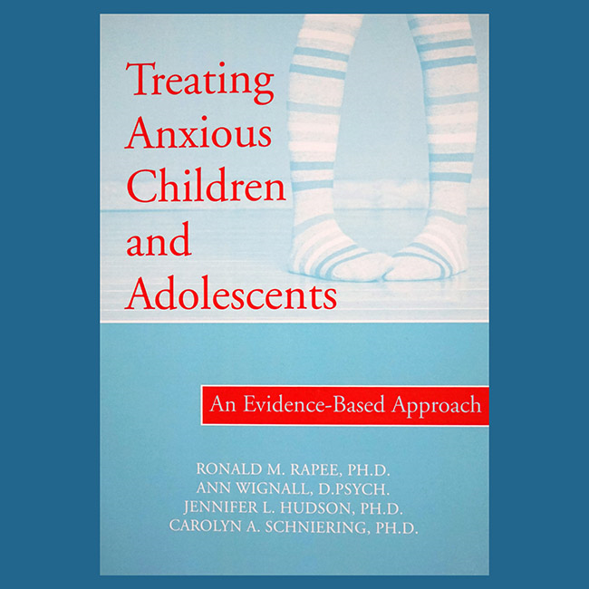
Cool Kids ASD Program
Australia (Macquarie University)
Cool Kids ASD Program is designed for clinical settings
Cool Kids ASD Program Kit: $65
Includes therapist manual and parent/child workbooks
Cool Kids Programs designed for school setting:
Cool Little Kids
Cool Kids (Chilled) Adolescent Anxiety Program
Study Without Stress
Online programs
Notes:
CECB: California Evidence Based Clearinghouse for Child Welfare
Levels 4 and 5 are concerning….1 is best…..
3: at least one study using some form of control with good methodological rigor

Slide 31
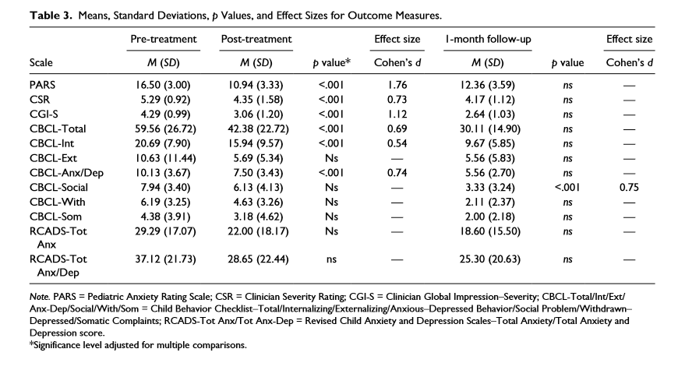
Intervention programs: BIACA
BIACA stands for “Behavioral Interventions for Anxiety in Children with Autism” and is built around “Building Confidence” program (Wood, McLeod, Hiruma & Phan)
Components Include:
Modular approach built around child
Embedded social skills training (peer “buddies”)
Parent training
Involvement with school/teachers
Hierarchy of fears
Cognitive restructuring
In vivo exposures
Reward System
Adaptive skills/improve independence
KICK: “Know I’m nervous…..Icky thoughts…..Calm thoughts…..Keep Practicing”
Ehrenreich et al. 2014
N=20 teens (Open trial)
Intervention
16 weekly sessions
30 minutes with child, 60 minutes with family
Research sites in California & Florida
Results
Significant reductions in anxiety severity per parent and clinician reports. Not all gains were held at 1 month follow up.
Notes:
Modular (individualized approach): uses a “tx algorithm” designed by Wood and Sze to determine tx.
ALL participants received: 3 sessions of coping skills practice, 8 sessions of in-vivo exposure.
Measures: CBCL, ADIS-V C/P, PARS, CGI-S, CGI-I, RCADS: Revised Child Anxiety and Depression Scale)
Self report not stat sig.
Currently comparing to Coping Cats AND WLC in a new study (should be out in 2017….

Slide 32
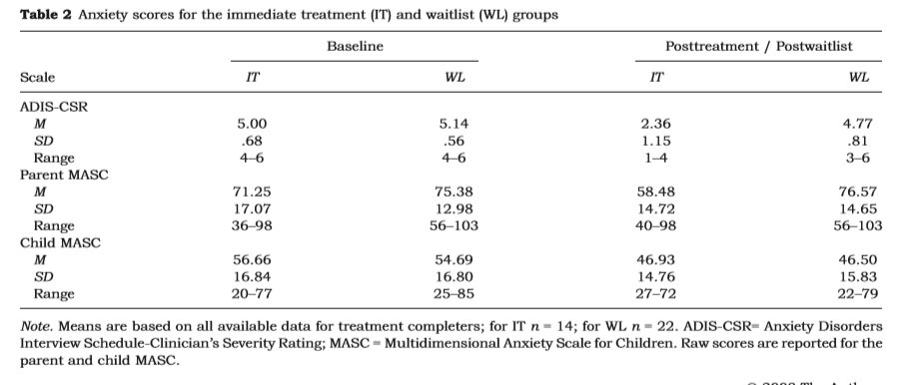
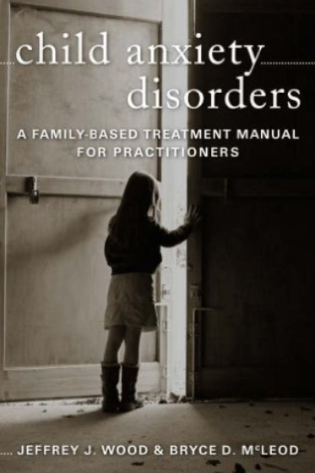
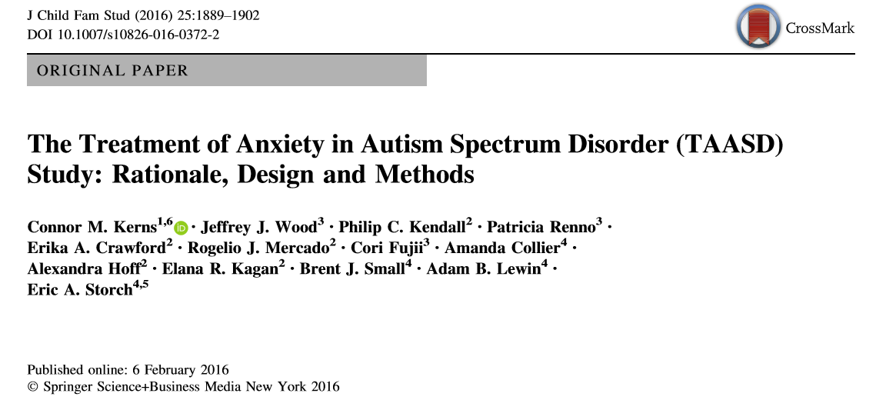
BIACA
Wood (2009)
N=40, n=17 in treatment (vs. WLC)
M=4.18 diagnoses including ASD
7-11 years old
Intervention
16 sessions
Research clinic setting in California
Changes made to BIACA to accommodate younger population
Minimum of 3 sessions spent on coping skills and 8 spent in-vivo exposure
Results
Mostly large ES in anxiety reduction. Remission of anxiety diagnosis in over half of sample. 78.5 percent had “positive response” to intervention (CGI) 80 percent of those present at 3 month follow-up, still diagnosis free
Notes:
90 minute sessions

Slide 33
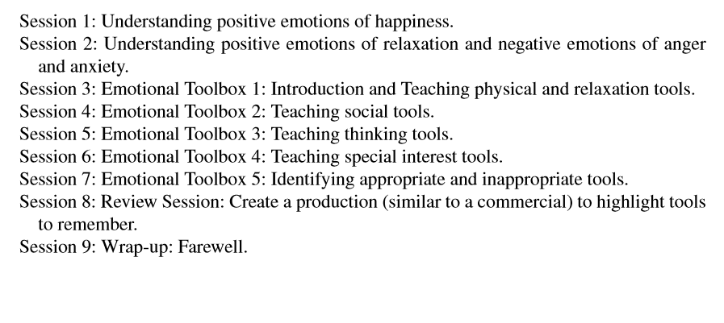
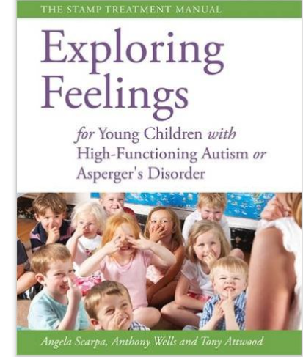
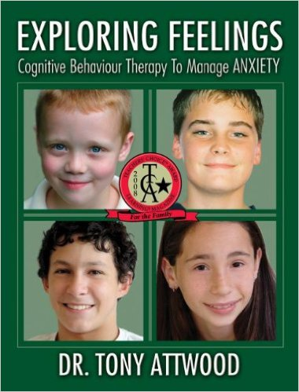
Intervention programs: STAMP
Scarpa (Based on ‘Exploring Feelings’ manual)
STAMP stands for “Stress and Anger Management Program for Young Children (ages 5-7) with ASD”
Components include:
“Emotional Toolbox”
First stage: Affective Education
Second stage: Cognitive Restructuring
Increase help-seeking behaviors and pleasurable activities
Make a “commercial” exhibiting skills
Developmentally appropriate adjustments:
Shorter sessions
Age appropriate games
Songs
Lots of visuals and hands-on activities

Slide 34
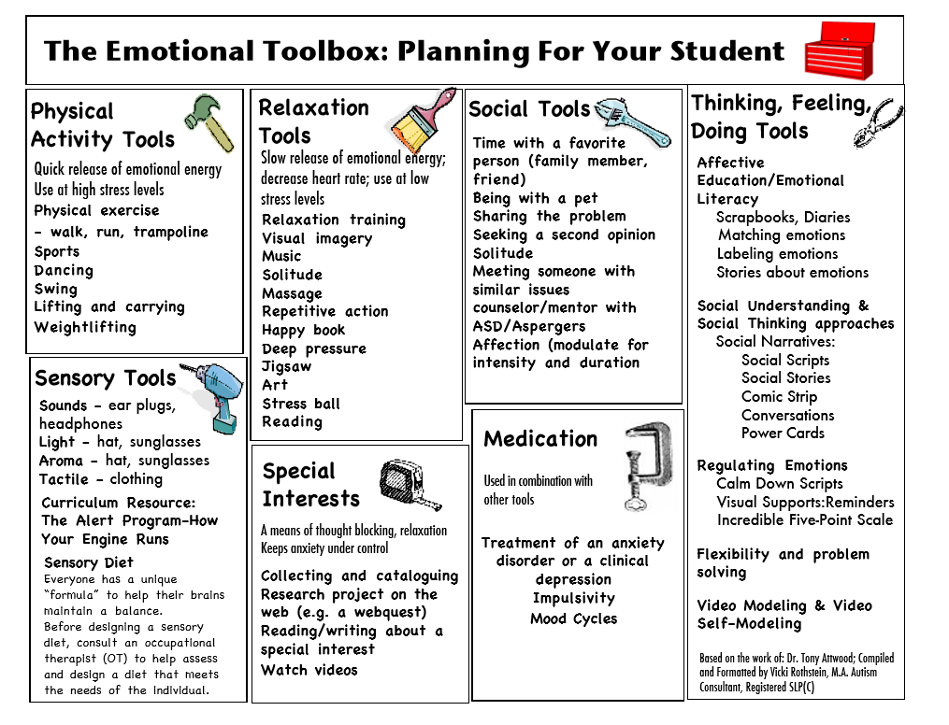
Intervention Programs: Exploring Feelings
The “Emotional Toolbox” is used to “fix feelings”
Notes:
Exercise: Exact same effect on anxiety as SSRIs! (emerging tx from NSP)
Make an actual “toolbox” out of a shoebox…

Slide 35
Exploring Feelings/STAMP
McConachie (2014)
N=32, n=17 “immediate tx” n=14 “delayed tx”
9-13 years old
Modified “Exploring Feelings” manual for UK use
Intervention
7 group sessions
Parent component
Clinic setting North-East England
Results: Both children and parents reported a reduction in anxiety symptoms post treatment and at follow up (Still in clinical range)
Sofronoff (2005)
N=71, n=23 (Child Only), n=25 (Child + Parent) n=23 (WL)
10-12 years old
All had Asperger's diagnosis
Intervention
6 sessions
Clinic setting in Australia
Results: Significant reduction in symptoms at 6 week follow up for both groups, fewer social worries, increased strategy generation for problem tasks, increasing gains between post intervention and follow up. (Child + Parent group had higher gains at follow up)
Pilot (Scarpa 2011)
N=11, n=5 “Immediate tx”
n=6 “Delayed”
5-7 years old
Intervention
9 sessions
Children in STAMP group while parents were in psychoeducational/training
Clinic setting in Virginia
Results: Parents reported more confidence in both child and their ability to handle anxiety. Parents also reported less negativity/lability, better emotional regulation, less outbursts, and more coping skills
Notes:
McConachie: five children did not meet ASD critieria on the ADOS (did meet on the SCQ)
Sofronoff: Outcome measures: SCAS, Social Worries Questionnaire and James problem solving task (Attwood)
Scarpa: initial group differences! (parent income)
SOCIAL STORES

Slide 36
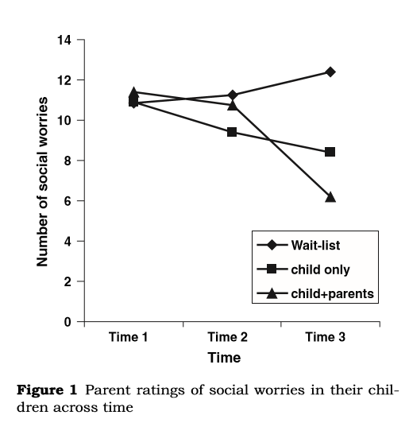
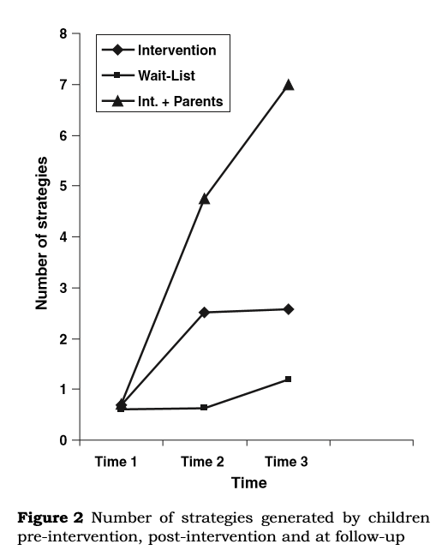
Exploring Feelings Data
Data from Sofronoff
Notes:
Middle graph: “James and the math test”: substitute teacher for the day, still have to take math test, math is hard, kids are loud…worried about teasing. What can he do?

Slide 37
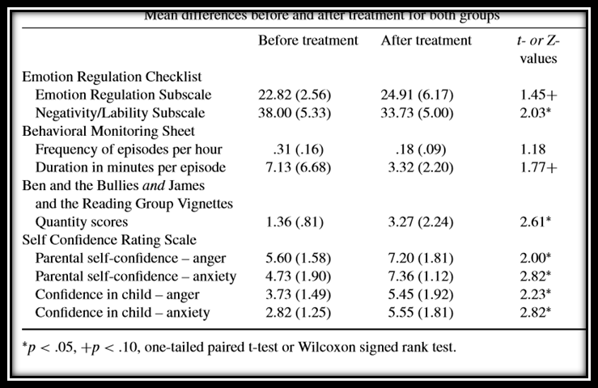
Scarpa (STAMP) Data:

Slide 38
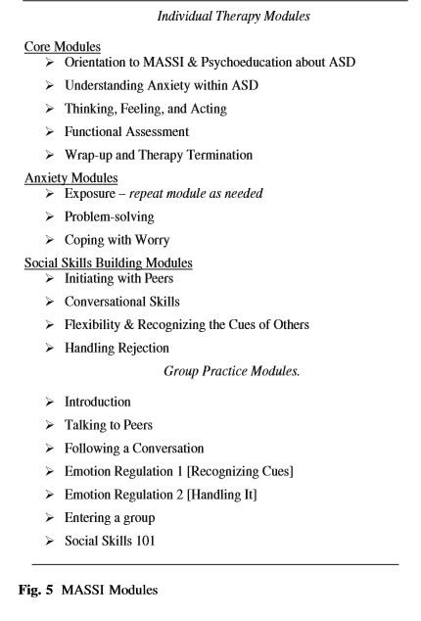
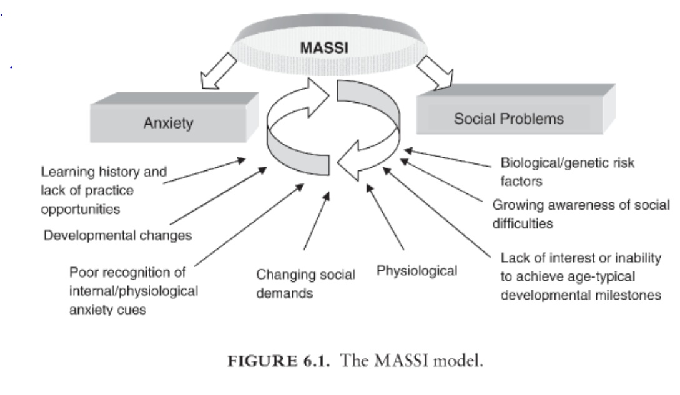
Intervention Programs: MASSI
MASSI stands for “Multimodal Anxiety and Social Skills Intervention for Adolescents with Autism Spectrum Disorder” (White, Scahill & Ollendick)
Designed for teenagers
Components include:
Based on bi-directional relationship between anxiety and ASD-related social difficulties
Teaches cognition and behavior from an ABA/FBA perspective (antecedents and consequences)
Multimodal tx that includes individual, group and parent sessions
Targets anxiety first, then social skills
Lots of practice sessions.
Direct and specific feedback
White (2013): In an RCT trial of 30 teens comparing tx to WLC, large ES for improved social functioning and medium ES for anxiety reduction. However, results for anxiety reduction were not statistically significant (within group)
Notes:
Also assessed treatment feasibility with consumer satisfaction measures, attendance rates, treatment integrity, etc.
Lost 5 participants
Executive Functioning (teens with ASD): disinhibited, impulsive, and lack of insight

Slide 39
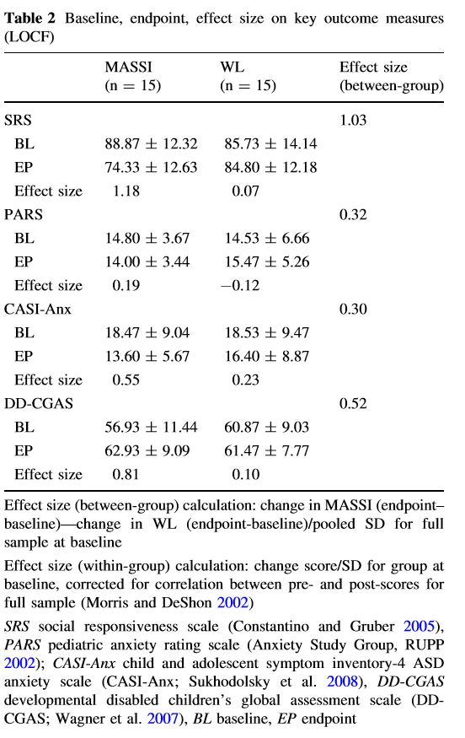
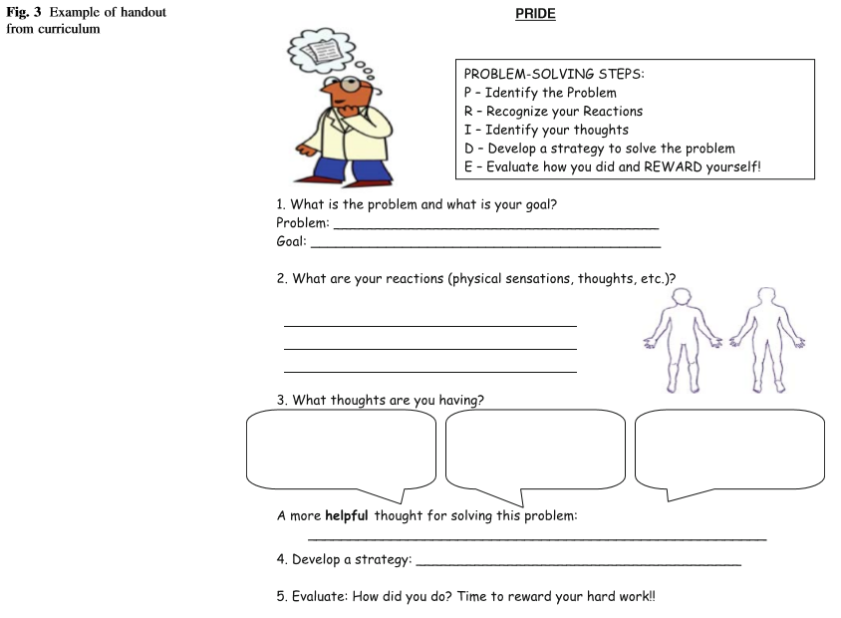
MASSI
Notes:
Lost 5 participants (attrition)

Slide 40
Intervention programs: Coping Cats for ASD
McNally (2013)
N=22, n=12 tx and n= 10 WLC
8-14 years old
ASD diagnosis and at least one primary anxiety diagnosis
Modified Coping Cats manual for ASD population
Intervention
16 weeks (Sessions 1-8 dedicated to skills training, Sessions 9-16 focused on exposure tasks in hierarchical sequence
2 parents sessions included for psychoeducation
Modifications included: Concrete reviews at end of session, added written and visual stimuli, extended sessions, use of child-specific interests, frequent sensory input, frequent breaks, use of concrete language and reinforcement strategies.
Results: 58 percent of children in CBT group no longer met anxiety diagnosis criteria at post-tx measurement while 100 percent of WLC still met criteria. 2 month follow up: recovery rates dropped to 36 percent (CBT group)
Notes:
Limitations: reliance on parent report, parents not blind to intx, used of measures designed for TD children, third author implemented tx
Feeling frightened?
Expecting Bad Things to Happen?
Actions & Attitudes that can help
Results & Rewards
Exposure: “Going places and doing things.”

Slide 41
Coping Cats:
Now available: Interactive Computer Programs:
Child Anxiety Tales: Online Parent Training Program
Camp Cope-A-Lot: The Coping Cat CD (12 session, interactive computer based intx) http://www.workbookpublishing.com/fearplan.swf
Cost: $200 (can only implement with one child)
Annual subscription: $200 (allows you to include other children)
Notes:
Feeling frightened?
Expecting Bad Things to Happen?
Actions & Attitudes that can help
Results & Rewards

Slide 42
CBT vs. Social Recreational Program
Sung (2011)
N=70, n=36 CBT n=34 “Social Recreation” (SR) Program
9-16 years old. Singapore sample
Intervention
CBT program
16 sessions, 90 minutes
Small group delivery (2-3 children)
No parent training component
Combination of Coping Cat, Exploring Feelings and other unpublished treatment approaches
Modifications for ASD: structure, visual strategies, role play and social stories
SR program
16 sessions, 90 minutes
Small group delivery (2-3 children)
No parent component
Programming consisted of crafts, cooperative games, motor coordination skill development, and activities of daily living. No explicit CBT components taught. Social etiquette encouraged.
Results: Both groups showed reduction in anxiety severity at 6 month follow up without statistically significant differences. SR group also showed significant reduction in panic attack symptoms.
Notes:
THIS SLIDE MAY HAVE TO GO….

Slide 43
Obsessive Compulsive Disorder (OCD) and ASD
Characterized by recurrent, intrusive and repetitive thoughts, impulses or images AND compulsive behaviors that the individual feels driven to perform…Typically, these thoughts & behaviors are distressing to the person (Egodystonic)
OCD rates in TD children and teens range from 0.5-3.0 percent of the population
50 percent of adults with OCD report childhood or adolescent onset
Children and adults diagnosed with OCD have also demonstrated difficulties with:
ToM
Executive Functioning
Attention
Social Skills
Lack confidence in one’s ability to perceive,
attend and remember
ASD rates of OCD: 6.2 percent (Anholt 2010), 10 percent (Neil & Sturney, 2014) Up to 14x more likely than typical peers (Mack, 2010)
Important to look at the purpose of the repetitive/”compulsive” behavior for clues…Is the child repeating the behavior because he/she is trying to reduce distress or because he/she derives pleasure from the action (sensory/self stimulation)? Spectrum to consider with repetitive bx. Lower functioning seem to show more self-stim and self injury while higher functioning show more compulsive behaviors (Hollander et al. 2009)

Slide 44
OCD and ASD: Characteristics
Mack (2010):
Observed symptomatology differences in OCD only, OCD + ASD, and OCD + TS (Tic Disorder)
Results:
No statistically significant differences in emotional and behavioral disturbances. All populations reported high levels of disturbance.
OCD + TS population reported less control over impulses and more sexual/ordering compulsions
ASD population reported fewer somatic and superstitious obsessions than OCD population
ASD population demonstrated more social skills deficits than the other two populations
Liew (2014)
Observed the relationship between ASD traits and anxiety/obsessive compulsive traits in a sample of non-clinical college students (n=252, Singapore)
Results:
Prevention from or punishment of preferred repetitive behavior mediated the relationship between ASD traits, worry and obsessive–compulsive symptoms.
Frequent aversive sensory experiences also mediated the relationship between ASD traits, worry and obsessive-compulsive symptoms.
Additionally, ASD traits in this study were positively associated with social anxiety and depression.
Notes:
NO DIFFERENCE IN SYMPTOM SERVERITY…time occupied in compulsion/interference of obsession

Slide 45
Liew (2014)
Notes:
58 percent of the variance in social anxiety predicted by autistic traits and mediators
Bold typeface coefficients are significant

Slide 46
Treatment for OCD (TD)
CBT is recommended as the first line treatment for young people with OCD (National Institute for Health and Care Excellence, 2005; Geller & March, 2012)
CBT with Exposure Response Prevention (ERP) is considered the optimal/first line of treatment for childhood OCD (ES=1.45)
ERP requires the patient to interact with the feared stimulus in successive approximations culminating in direct contact with the stimulus. The goal of such forced exposure is to break the chain of avoidance.
Examples of ERP:
Frank: https://www.youtube.com/watch?v=OcXn3m3M-U0
Michelle: https://www.youtube.com/watch?v=5jOKtTyulXQ
Severin: https://www.youtube.com/watch?v=G5dlLL3FFzg
SRI medications (Fluoxetine, Fluvoxamine, Clomparmine and Setraline) have also proven effective in the treatment of OCD (ES=.48)
SRI effectiveness mixed amongst ASD patients
Notes:
Few studies exist that observe the effectiveness of CBT/ERP for children with ASD and OCD. Most available studies have been conducted with adults or consist of single-subject case studies.

Slide 47
Treatment for OCD (And Modifications For ASD)
Murray (2015): Analysis of pre/post tx for n=22 OCD only and n=22 OCD + ASD participants
OCD+ASD less responsive to tx
OCD +ASD remission rate of 9 percent vs. OCD only remission rate of 46 percent (stat sig)
Additional Findings in such studies:
Rates of tx “non responders” were similar to those in OCD only population (30-40 percent)
Modifications/adaptations to CBT programming for ASD populations:
Removal of or adjustment to cognitive restructuring and imagined exposure
Increased use of coping statements
Use of reward systems and bx charts
Use of social stories
Use of bx momentum
Increased affective education
Earlier onset of exposure component

Slide 48
Treatment for OCD in ASD: Lit Review
Neil & Sturney (2014) Systematic Review: Assessment & Treatment of Obsessions and Compulsions in Individuals with Autism Spectrum Disorder
21 informational papers (definitions, diagnosis, prevalence, developmental trajectory, risk factors and assessment)
OCD comorbidity rates ranged from 1.47 to 37 percent.
34 tx papers
Psychosocial Tx = 15 studies
6 non-experimental and 13 RCTs
7 case reports, 4 small N experiments,
2 uncontrolled group designs and two RCTs
CBT = 8
Bx Mod = 7
Pharmacological Tx=19 studies
Additional Observations:
Limited area of research
Lack of standardized measures and/or confusion over varied language use:
Terms like: repetitive, compulsive, ritualistic
Function of behavior, not topography
Lack of well-controlled experimental evaluation
Notes:
ONLY ONE RCT AS OF 2015

Slide 51
Neil & Sturney

Slide 52
CBT for OCD in HFASD
Study (Russell 2013)
N=46, n=23 to ASD-adapated CBT for OCD
n=23 to “Anxiety Management” (AM) program
Mean age=26.9 years (n=35 males)
Intervention
OCD CBT sessions consisted primarily of ERP techniques. M sessions=17.43
Modifications of OCD intervention: Use of more visuals, concrete language, structured/outline approach to sessions, homework assignments, and direct education on link between thoughts, feelings and behavior.
AM intervention: Anxiety education, mood education, healthy habits education, and problem solving. (Did not contain any of the “active” ingredients considered important for OCD management. Mean number of sessions=14.43
Results: ES of 1.01 for CBT and 0.60 for AM. More tx responders in CBT group (45 percent vs. 20 percent) but difference was not statistically significant. Symptom severity moderated tx effects in AM group. Effects of AM group were unexpected but similar effects have been found through other non-direct interventions (i.e. social recreation programs, social skills, etc.)
Notes:
Low effects in self report measures….3 CBT asked to move to AM 9 subjects in the AM group requested to move to the CBT group.

Slide 53
Children’s Books on Anxiety and OCD

Slide 54
Other Resources

Slide 55
The Take Aways:
Children with ASD have an increased risk of anxiety disorders and OCD.
Risk is especially high for HFASD
Parent, social, cognitive and other ASD-related factors all seem to play a part in the increased risk of anxiety and OCD symptomatology.
CBT tx manuals designed specifically for ASD populations are increasing in availability.
Preliminary research suggests that CBT interventions with and without ERP components have been efficacious in treating anxiety and OCD in HFASD.
Social skills, medications, bx modification and other anxiety management programs show promising results in anxiety reduction for ASD.
The amount of studies regarding OCD and anxiety tx for individuals with ASD is still relatively small and there is room for improvement regarding methodological rigor and replication.

Slide 56
For Your Time & Kind Attention

Slide 57
References:
Amaral, D.G., Corbett, B.A., 2003. The amygdala, autism and anxiety. Novartis Foundation Symposium, 251, pp. 177-187
Attwood, T. (2004). Cognitive Behaviour Therapy for Children and Adults with Asperger’s Syndrome. Behaviour Change, 21(3), 147-161.
Attwood T (2004) Exploring feelings: cognitive behaviour therapy to manage anxiety. Future Horizons, Arlington
Bellini, S. (2006). The development of social anxiety in adolescents with autism spectrum disorders. Focus on Autism & Other Developmental Disabilities, 21(3), 138-145.
Blackshaw, A.J., Kinderman, P., Hare, D.J., & Hatton, C. (2001). Theory of mind, casual attribution and paranoia in Asperger disorder. Autism, 5, 147– 163
Camargo, S., Rispoli, M., Ganz, J., Hong, E., Davis, H., & Mason, R. (2016). Behaviorally based interventions for teaching social interaction skills to children with ASD in inclusive settings: A meta-analysis. Journal of Behavioral Education, 25(2), 223-248.
Chalfant, A. M., Rapee, R., & Carroll, L. (2007). Treating anxiety disorders in children with high functioning autism spectrum disorders: A controlled trial. Journal of Autism & Developmental Disorders, 37(10), 1842-1857.
Chorpita BF, Yim L, Mofﬁtt CE, Umemoto LA, Francis SE (2000) Assessment of symptoms of DSM-IV anxiety and depression in children: a revised child anxiety and depression scale. Behav Res Therapy 38:835–855
Davis, T. E., III, Ollendick, T. H., & O ¨st, L. G. (2009). Intensive treatment of speciﬁc phobias in children and adolescents. Cognitive and Behavioral Practice, 16, 294– 303
Drahota, Amy, Wood, J. J., Sze, K. M., & Dyke, M. V. (2011). Effects of cognitive behavioral therapy on daily living skills in children with high- functioning autism and concurrent anxiety disorders. Journal of Autism & Developmental Disorders, 41(3), 257-265.
Dubin, A., Lieberman-Betz, R., & Michele Lease, A. 1. (2015). Investigation of individual factors associated with anxiety in youth with autism spectrum disorders. Journal of Autism & Developmental Disorders, 45(9), 2947- 2960.
Elder, L. M., Caterino, L. C., & Chao, J. (2006). The efficacy of social skills treatment for children with asperger syndrome. Education & Treatment of Children (ETC), 29(4), 635-663.
Ehrenreich, J. et al (2014) An Open Trial of Cognitive-Behavioral Therapy for Anxiety Disorders in Adolescents with Autism Spectrum Disorders. Focus on Autism and Other Developmental Disabilities 29 (3), 145-155
Farrugia, S., & Hudson, J. (2006). Anxiety in adolescents with asperger syndrome: Negative thoughts, behavioral problems, and life interference. Focus on Autism & Other Developmental Disabilities, 21(1), 25- 35.
Hallett, V., Lecavalier, L., Sukhodolsky, D., Cipriano, N., Aman, M., McCracken, J., et al. (2013). Exploring the manifestations of anxiety in children with autism spectrum disorders. Journal of Autism & Developmental Disorders, 43(10), 2341-2352.
Juranek, J. et al (2006). Association between amygdala volume and anxiety level: magnetic resonance imaging (MRI) study in autistic children. Journal of Child Neurology 21 (12), 1051-1058.
Klin, A., Saulnier, C. A., Sparrow, S. S., Cicchetti, D. V., Volkmar, F. R., & Lord, C. (2007). Social and communication abilities and disabilities in higher functioning individuals with autism spectrum disorders: The Vineland and the ADOS. Journal of Autism and Developmental Disorders, 37(4), 748–759.
Notes:
Need Neil & Sturney, Murray…..

Slide 58
Kuusikko-Gauffin, S., Pollock-Wurman, R., Mattila, M., Jussila, K., Ebeling, H., Pauls, D., et al. (2013). Social anxiety in parents of high-functioning children with autism and asperger syndrome. Journal of Autism & Developmental Disorders, 43(3), 521-529.
Laugeson, E., elaugeson@mednet.ucla.edu, Ellingsen, R., Sanderson, J., Tucci, L., & Bates, S. (2014). The ABC's of teaching social skills to adolescents with autism spectrum disorder in the classroom: The UCLA PEERS program. Journal of Autism & Developmental Disorders, 44(9), 2244-2256.
Liew, S., Thevaraja, N., Hong, R. & Magiati, I. (2014) The Relationship Between Autistic Traits and Social Anxiety, Worry, Obsessive-Compulsive, and Depressive Symptoms: Specifc and Non-Specific Mediators in a Student Sample. Journal of Autism Developmental Disorders 45, 858-872.
McNally Keehn, R., Lincoln, A., Brown, M., & Chavira, D. (2013). The coping cat program for children with anxiety and autism spectrum disorder: A pilot randomized controlled trial. Journal of Autism & Developmental Disorders, 43(1), 57-67.
March, J. S., & Mulle, K. (1998). OCD in children and adolescents: A Cognitive-behavioral treatment manual. NewYork,NY: The Guilford Press.
Murray, K. et al. (2015) Outcomes of cognitive behavior therapy for obsessive-compulsive disorder in young people with and without autism spectrum disorders: A case controlled study. Psychiatry Research 228, 8-13.
Neil, N. & Sturney, P. (2013) Assessment and Treatment of Obsessions and Compulsions in Individuals with Autism Spectrum Disorders: A Systematic Review. Journal of Autism and Developmental Disorders, 1, 62-79.
Pilecki B and McKay D (2011) Cognitive behavioural models of phobias and pervasive anxiety. In: McKay D and Storch EA (eds) Handbook of Child and Adolescent Anxiety Disorders. Part 2. New York: Springer, pp. 39–48
Pugliese, C., White, B., White, S., & Ollendick, T. (2013). Social anxiety predicts aggression in children with ASD: Clinical comparisons with socially anxious and oppositional youth. Journal of Autism & Developmental Disorders, 43(5), 1205-1213.
Rapee, R. M. (1997) Potential role of childbearing practices in the development of anxiety and depression. Clinical Psychology Review, 17, 47-67.
Reaven, J. A., Blakeley-Smith, A., Nichols, S., Dasari, M., Flanigan, E., & Hepburn, S. (2009). Cognitive-behavioral group treatment for anxiety symptoms in children with high-functioning autism spectrum disorders. Focus on Autism & Other Developmental Disabilities, 24(1), 27-37.
Reaven, J., Blakeley-Smith, A., Culhane-Shelburne, K., & Hepburn, S. (2012). Group cognitive behavior therapy for children with high-functioning autism spectrum disorders and anxiety: A randomized trial. Journal of Child Psychology & Psychiatry, 53(4), 410-419.
Russell, A. et al (2013) Cognitive behavior therapy for comorbid obsessive compulsive disorder in high functioning autism spectrum disroders: A randomized controlled trial. Depression and Anxiety, 30, 697-708.
Scarpa, A. & Reyes, N. (2011) Improving Emotion Regulation with CBT in Young Children with High Functioning Autism Spectrum Disorders: A Pilot Study. Behavioural and Cognitive Psychotherapy 39, 495-500.
Scarpa, A. & Attwood, T. (2013) CBT for Children and Adolescents with High-Functioning Autism Spectrum Disorders. The Guilford Press. New York, NY.
Smith CA and Lazarus RS (1993) Appraisal components, core relational themes, and the emotions. Cognition & Emotion 7(3/4): 233–269.
Sofronoff, K., Attwood, T., & Hinton, S. (2005). A randomised controlled trial of a CBT intervention for anxiety in children with asperger syndrome. Journal of Child Psychology & Psychiatry & Allied Disciplines., 46(11), 1152-1160.

Slide 59
Storch, E., Arnold, E., Jones, A., Ale, C., Wood, J., Ehrenreich-May, J., et al. (2012). The role of co-occurring disruptive behavior in the clinical presentation of children and adolescents with anxiety in the context of autism spectrum disorders. Child Psychiatry & Human Development, 43(5), 734-746.
Sukhodolosky DG, Bloch MH, Panza KE, Reichow B (2013) Cognitive-behavioral therapy for anxiety in children with high functioning autism: a meta-analysis. Pediatrics 132:1341–1350
Sung, M., Ooi, Y., Goh, T., Pathy, P., Fung, D., Ang, R., et al. (2011). Effects of cognitive-behavioral therapy on anxiety in children with autism spectrum disorders: A randomized controlled trial. Child Psychiatry & Human Development, 42(6), 634-649.
Tantum D: Psychological disorder in adolescents and adults with Asperger syndrome. Autism 2000; 4:47-62
Ung, D., Selles, R., Small, B., & Storch, E. (2015). A systematic review and meta-analysis of cognitive-behavioral therapy for anxiety in youth with high-functioning autism spectrum disorders. Child Psychiatry & Human Development, 46(4), 533-547.
Van Steensel, F., Bögels, S., & Bruin, E. (2015). DSM-IV versus DSM-5 autism spectrum disorder and social anxiety disorder in childhood: Similarities and differences. Journal of Child & Family Studies, 24(9), 2752-2756.
Van Steensel, Francisca J. Dirksen, C. D., & Bögels, S. M. (2013). A cost of illness study of children with high- functioning autism spectrum disorders and comorbid anxiety disorders as compared to clinically anxious and typically developing children. Journal of Autism & Developmental Disorders, 43(12), 2878-2890.
Vasa, R., Carroll, L., Nozzolillo, A., Mahajan, R., Mazurek, M., Bennett, A., et al. (2014). A systematic review of treatments for anxiety in youth with autism spectrum disorders. Journal of Autism & Developmental Disorders, 44(12), 3215-3229.
Vreeke, L. et al. (2012) Skittish, shielded and scared: Relations among behavioral inhibition, overprotective parenting, and anxiety in native and non-native Dutch Preschool Children. Journal of Anxiety Disorders, 27 (2013) 703-710
White, S. W., Oswald, D., Ollendick, T., & Scahill, L. (2009). Anxiety in children and adolescents with autism spectrum disorders. Clinical Psychology Review, 29(3), 216–229.
White, S., Schry, A., & Maddox, B. (2012). Brief report: The assessment of anxiety in high-functioning adolescents with autism spectrum disorder. Journal of Autism & Developmental Disorders, 42(6), 1138-1145.
Wong, N., Beidel, D., Sarver, D., & Sims, V. (2012). Facial emotion recognition in children with high functioning autism and children with social phobia. Child Psychiatry & Human Development, 43(5), 775-794.
Wood, J. J., Drahota, A., Sze, K., Har, K., Chiu, A., & Langer, D. A. (2009). Cognitive behavioral therapy for anxiety in children with autism spectrum disorders: A randomized, controlled trial. Journal of Child Psychology & Psychiatry & Allied Disciplines., 50(3), 224-234.
Wright JH and Borden J (1991) Cognitive therapy of depression and anxiety. Psychiatric Annals 21: 425–428.
Notes:
Need VREKE

Slide 60
Quiz & Comments

