Slide 1
Superheroes Social Skills Training, Rethink Autism Internet Intervention, Parent Training, Evidence-based Practices Classroom Training, Functional Behavior Assessment: An Autism Spectrum Disorder, Evidence-based Practices Training Track for School Psychologists
US Office of Education Personnel Preparation Grant H325K12306
William Jenson, Ph.D., Elaine Clark Ph.D., Julia Hood, Ph.D., & John Davis, Ph.D.
Overview of The Autism Curriculum Encyclopedia (ACE®), Rethink Autism, and Autism Apps
Lauren Anderson, B.S.
University of Utah School Psychology Program
July 6th, 2016

Slide 2
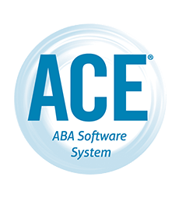

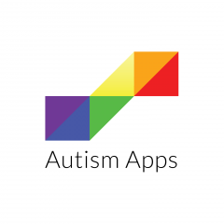
Overview
The Autism Encyclopedia Curriculum (ACE®)
  System description
  Cost
  Effectiveness
Rethink Autism
  Brief system description
  Parental Involvement
  Cost
  Effectiveness
Autism Apps
  Background
  Categories

Slide 3
The ACE®: Mission
“Our mission is to provide you with the very best in online ABA software and curriculum. We want to ensure you have the latest tools to help you maximize the effectiveness of your programs for learners with autism.”
(http://www.acenecc.org/history-mission/)

Slide 4
The ACE®: Background
Developed by staff at The New England Center for Children (NECC)
Serving individuals with ASD since 1975
  Non-profit organization devoted to helping children with ASD
  NECC Highlights:
    Serves 450+ students
    Given 1818 presentations
    Published 241 research articles
    1100+ employees
    Emphasis on using ABA methodologies
(http://www.acenecc.org/about-the-ace/)
Notes:
NECC Mission:
-educate teachers and parents so that they have the knowledge and methods developed y the NECC
Use technology to help teachers and families transform the lives of children with ASD
Reach many children by serving them with their curriculum
Emphasize early, intensive instruction using Applied Behavior Analysis
ABA METHODOLOGIES:
Teach skills at home, in residence, at school, and in the community
Data are taken before and during tx
Ineffective interventions are revised
Skills are taught systematically across different people and setting for generalization
DEVELOPED to help with teacher’s needs. Often times teachers were re creating lessons that were already available and needed a better system to have everything in one place

Slide 5
The ACE®: Background cont.
The ACE® Curriculum
  NECC employees wanted to use the curriculum in other settings
  Designed to provide ABA professionals with an ABA based, easy to use, effective software program
  Based on ABA principles
  Curriculum based on empirically established and scientifically reviewed evidence
  Over 3,700 students are on The ACE®
  Latest version: The ACE® 4.0
(http://www.acenecc.org/about-the-ace/

Slide 6
The ACE® Team
Top researchers and clinicians:
  Richard B. Graff, Ph.D., BCBA-D
  Rebecca MacDonald, Ph.D., BCBA, Program Director
  William H. Ahearn, Ph.D., BCBA-D, Director of Research
  Eileen Roscoe, Ph.D., BCBA-D, Assistant Director of Research
  Chata A. Dickson, Ph.D., BCBA-D, Director of Research, ACE®
  Jason Bourret, Ph.D., BCBA-D, Assistant Director, Organizational Behavior Management
ACE Customer Team:
  Kim Walter, MS, BCBA, LABA ACE® Training and Implementation Specialist
  Alyssa Freeze, MSEd, BCBA ACE® Coordinator
  Kelly McConnel, Ph.D., BCBA-D, LABA ACE® Training and Implementation Specialist
  Jacqueline MacDonald, Ph.D., BCBA-D, LABA ACE® Training and Implementation Specialist
  Cara Grieco, MS, BCBA ACE® Curriculum Specialist
  Maureen Cary, M.Ed., BCBA Assistant Director of Public School Services- New York Region
(http://www.acenecc.org/our-staff/)

Slide 7
The ACE®: Curriculum
ABA based teaching for ages 3-22: Incidental teaching, discrete trial training, and task analysis
Includes basic skills (e.g., picture identification) to complex skills (e.g., solving equations)
Team to develop lessons
Includes teaching materials
Easy to read and follow
Emphasis on consistency across classrooms, teams, and agencies
Individualization of lessons
More than 2000 ABA based teaching programs
“Best-practice services for children with autism are multifaceted and include a wide range of ABA methodologies to realize broad and durable behavior change in this population” (Steege et al., 2007, p. 93)
http://www.acenecc.org/about-the-ace/
Notes:
Incidental teaching
Creating an environment in which students’ interests are fostered, Maximizes learning opportunities, used to increase communication from a person, with access given to desired item after producing an elaborated response
Discrete trial training
Structured ABA technique that breaks down skills into small components. Skills are taught systematically, and reinforcement is used for desired behavior
Task Analysis
- Breaking down a skill into smaller,manageable components
-

Slide 8
The ACE®: Training
Must be a BCBA
Videos with each lesson
  Blackboard video feature
  Can be used for professional development
  Some agencies provide raises for completion of classes in Blackboard
Used by Vanderbilt
When you become a client:
  Assigned a BCBA level clinical implementation specialist

Slide 9
The ACE®: Domains
Discrimination
Communication
Social Skills
Academics
Self Help
Health and Safety
Recreation and Physical Education
Community
Vocational
Transition to Adulthood
http://www.acenecc.org/about-the-ace/

Slide 10
The ACE®: Sample Lesson Format
  Instructions
    Objective Statement
    Suggested Prerequisites
    Materials
    Additional Information
  Data Collection
    Baseline
    Training Step
    Previously Mastered Step
    Changing Steps
    Generalization
    Maintenance
  Criteria
    Go to Less Restrictive Prompt
    Go to More Restrictive Prompt
    Add Next Step
    Retrain Step
    Ask for Assistance
  Teaching Procedure
    Prompt Steps
    Error Correction
    Reinforcement
    Skill Breakdown

Slide 11
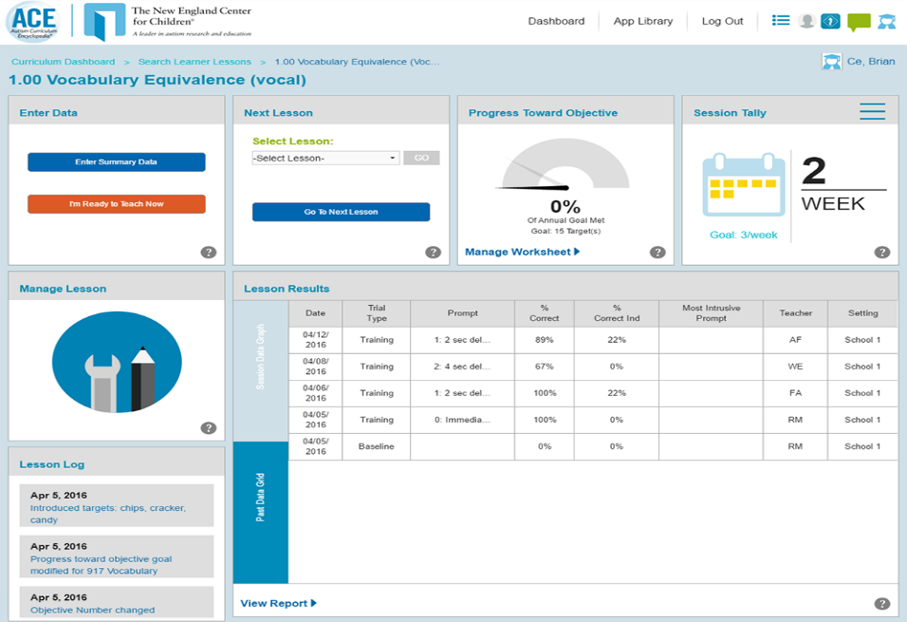
Dashboard

Slide 12
The ACE®: Data Entry and Procedures
Allows users to enter challenging behavior data during lessons
  Can video challenging behavior
Automatically graphs data
Different graphs for DTT, IT, and TA lessons
Customizable user dashboards
Paper based options for teaching programs also available
(http://www.acenecc.org/about-the-ace/)
Notes:
Can be used on iphone, ipad, etc

Slide 13
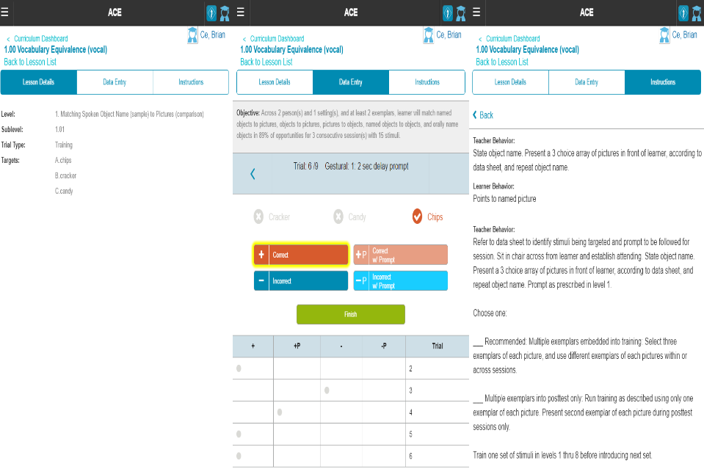
Dashboard: Data Entry and Teaching Procedures

Slide 14
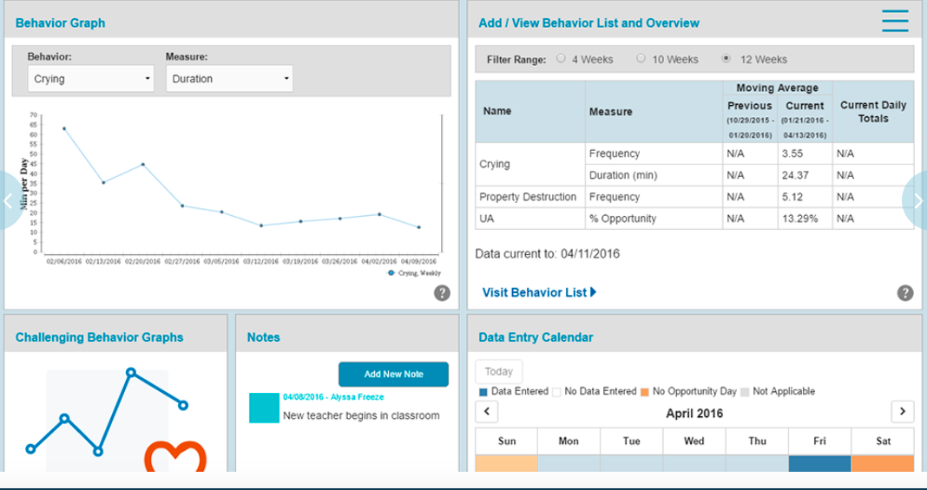
Behavior Data

Slide 15
The ACE®: Assessments
The Core Skills Assessment
  Direct assessment
  Targets 52 skills necessary for higher-level learning and independent functioning
  Materials provided
  Administered yearly
The ACE® Skills Assessment
  Indirect assessment
  Assesses skills from the entire curriculum
  Helps identify skill deficits and lesson plans to teach skills
  Recommends lessons based on assessment results
(http://www.acenecc.org/about-the-ace/)
Notes:
CSA To be used for children who are not easily assessed with standardized testing tools

Slide 16
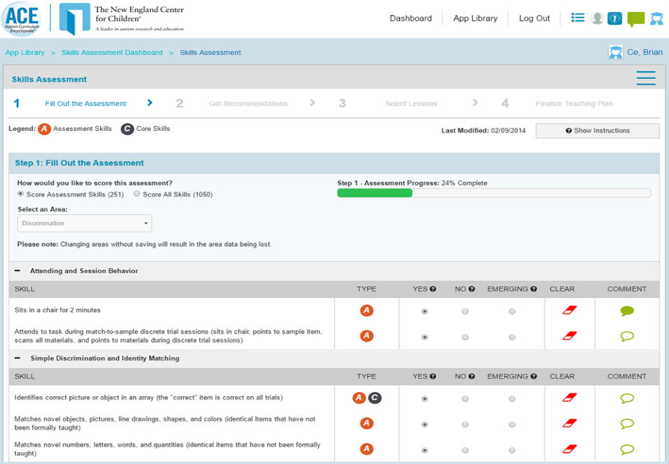

Slide 17
The ACE®: Reports
Curriculum
Session
Progress
Challenging behavior
Core Skills Assessment
  Can look at data across years
Skills assessment
…and more!
Notes:
Can also save medical reports and other information in the program

Slide 18
The ACE®: Settings
Designed to be used in ABA based settings by BCBAs
  Private School Districts
  Public Schools
  Consultants
  Clinics
  Universities
  Hospitals
Not available for parents/caregivers
  Parent portal in next version of The ACE®
http://www.acenecc.org/ace-implemented/

Slide 19
The ACE®: Pricing
Dependent on # of students (1-unlimited)
  3 packages
    ACE Basic
    ACE Advantage
      Can add on CSA, SA, or PA
      Challenging behavior module with data collection
    ACE Complete
      Can reach up to 180,000 per year for unlimited # of students
      EVERYTHING included

Slide 20
The ACE®: Effectiveness
Evidence-based components of the program
  Applied Behavior Analysis
    “Over the past 50 years, thousands of published research studies have documented the effectiveness of ABA across a wide range of populations” (Steege et al., 2007, p. 92)
  Discrete Trial Training
    “Implemented correctly, DTT clearly is one of the most powerful tools available for teaching children with autism” (Steege et al., 2007, p. 95)
  Incidental Teaching
    “Incidental teaching (IT; Hart & Risley, 1975, 1982) is a well-established procedure for teaching social, communication, and academic skills to children with autism and related disorders” (Steege et al., 2007, p.93)
  Task Analysis
    Task analysis and prompting procedures are effective strategies when for teaching certain tasks to individuals with ASD (Steege et al., 2007).
Testimonials
  https://vimeo.com/72294624
Awards:
  Innovation Award for ACE Application from Small Business Association of New England (SBANE) 2015

Slide 21
What is Rethink Autism?
“Rethink aims to place evidence-based treatment solutions in the hands of every educator, clinician or parent working with a child with special needs. We are unique in our footprint, leveraging the power of technology to provide clinical support, best-practice tools, and research-based content to all market segments, reaching more children with special needs than any other solution.”

Slide 22
Rethink Autism: The Team
Leadership:
  Daniel Etra, CEO
  Eran Rosenthal, President & COO
  Patty Mah, CFO
  Jamie Pagliaro, Executive VP & Chief Learning Officer
  Mike Civello, VP of Employee Benefits
  Patricia Wright, Vice President of Professional Services
  Lin Chong, Vice President of Curriculum
  Brian Sharp, EVP Education Division
Scientific Board:
  Bridget A. Taylor, Psy.D., BCBA-D
  Peter F. Gerhardt, Ed.D.
  Catherine E. Lord, Ph.D
  Louis A. Vismara, M.D
  Patricia Wright, Ph.D. MPH
  Maurice Feldman, Ph.D., C. Psych., BCBA-D
  Nicolette Bainbridge Brigham, Ph.D
  William R. Jenson, Ph.D
  Jamie Pagliaro

Slide 23
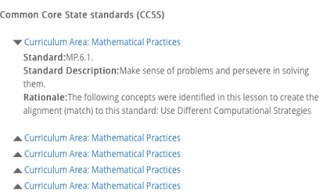
Rethink Autism: Curriculum
1,500 video-based lessons
Comprehensive, customizable curriculum
Can be used with many students at different levels
Easy to address Common Core and state standards
Emphasis on:
  Core developmental skills
  Inclusive practices
  Transition planning
  Behavior

Slide 24
Rethink Autism: Domains
Pre-Academic
Academic
Social/Emotional
Daily Living
Motor
Play/Leisure
Expressive Language
Receptive Language

Slide 25
Rethink Autism: Assessments
Abilities
  Recommended for all children
  Example: Does your child remain seated in a chair when asked?
Inclusion
  Recommended for children who attend school
  Example: Does your student raise his/her hand to answer questions in class?
Transition
  Recommended for children over 9
  Example: Does your child dress appropriately for the weather?

Slide 26
Rethink Autism: Training
Guided instruction in behaviorally-based teaching strategies
Video-based, training modules that model techniques
  11 training modules
Cost effective training
Professional development for:
  Teachers
  Para educators
  Parents
Webinars
Blog
Educator Tips
Notes:
-Behavior support: videos to address challenging behaviors in classroom, behavior tracking up, progress reporting, articles on best practice strategies, easy to use plan builder, materials
General diagnositic information video
Diagnostic criteria

Slide 27
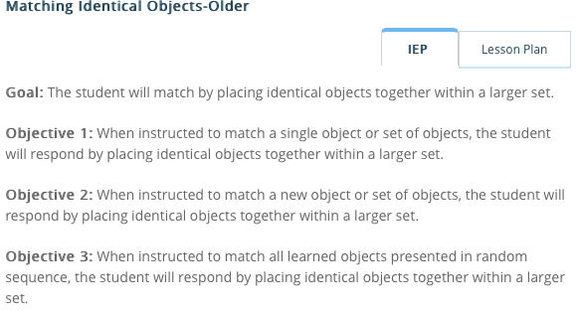
Rethink Autism: Data
Easy to use system for educators and parents
Can be used to evaluate student IEP progress
Access to graphs and progress reports
Easy to read and interpret

Slide 28
Rethink Autism: Behavior
Helps teachers decrease problem behavior
Offers numerous resources in order to create appropriate intervention plans
Can be used district wide for behavior supports
Steps: Watch, Read, Explore
  1. Define Behavior
  2. Determine Function
  3. Antecedent Strategies
  4.Consequence Strategies
  5. Track Effectiveness
  6. Evaluate Plan
Notes:
How to videos, articles, examples, case studies pertaining to positive behavior support, easy to use plan builder and a place to share and review plans

Slide 29
Rethink Autism: Parents
Parents can use Rethink at home
  Access to entire curriculum
  Problem behavior strategies
  Data collection procedures
  Web-based training
  Activities
  Teleconsultation
  Email Rethink therapists
Prior to signing up:
  Videos about lessons, ABA, Scientific Advisory Board
  How it works
  Time saving and problem behavior strategies, lesson plans
  Access to sample lessons
Free trial available
Affordable annual, quarterly, and monthly plans
Access to Rethink Peer Support
Notes:
Rethink peer support
- Can engage with other rethink users, share ideas, stories, insights, advice

Slide 30
Rethink Autism: Activity Center
Can be accessed by teachers, students, and parents
Customizable activities
Built-in prompts and feedback
Student activity is tracked and graphed

Slide 31
Rethink Autism: Pricing
Parents
Organizations
  1 Child
    Annually $59/month
    Quarterly $79/month
    Monthly $89/month
  2 Children
    Annually $53/month
    Quarterly $71/month
    Monthly $80/month
  3 Children
    Annually $50/month
    Quarterly $67/month
    Monthly $75/month
  $25/month optional curriculum support
  Dependent on size and needs
  $1,000+ per year
    Campuses
    Classrooms
    School Districts
    Clinics

Slide 32
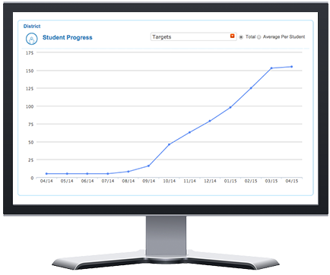
Rethink Autism: Admin Dashboard
Used to track and compare staff utilization
  Training
  Data collection
  Log-ins
Can easily look at student progress
(https://www.rethinkfirst.com/Home#ActivityCenter)

Slide 33

Rethink Autism: Effectiveness
Research based components of Rethink
  The effectiveness of ABA-based intervention in Autism Spectrum Disorders has been well documented through five decades of research.” (American Academy of Pediatrics, 2007)
  PBIS
  Inclusion
  Video modeling
  Discrete Trial Training
  Task Analysis
  Reinforcement strategies
Testimonials
  “His family is actually looking to move him back into his home because of the awesome progress he has made using these tools. It’s pretty cool.”- Jennifer Harris
  “Staff are thrilled with the program. It gives them an opportunity to see the progress made and the fruits of their labor as they are working with the children.” –Meryl Gill
  98% of administrators recommend Rethink
Awards

Slide 34
Rethink Autism: Dissertation by Jennifer Cardinal
Rethink Autism: Effectiveness of web-based applied behavior video modeling program on the performance of para-educators and students with autism spectrum disorder (2011)
  Purpose
    Examined the effectiveness of Rethink Autism with paraeducators and children with ASD
    Effectiveness of video modeling on para-educators ABA teaching
    Skills acquisition and student response of Rethink
    Generalization of skills to other curriculums
  Method
    Multiple baseline with generalization probes
    Public midsized charter school with 4 paraeducators matched with a student with ASD
    Baseline was collected by teaching Rethink lessons with existing skill set/materials/and pretest administered to student
    Intervention: Staggered, 3-phase using Rethink lessons (12 teaching sessions)

Slide 35
Rethink Autism: Dissertation cont.
  Results
    Effective in increasing para-educator DTT skill level
    Increased student performance
    High acceptability and treatment integrity
    Cost effective
  Limitations
    Wide range in quality of the videos teaching specific skills
    Lack of maintenance probes
    Lack of collaboration
    Small number of participants

Slide 36
What the research is telling us:
Effective interventions for children with ASD include:
  Early intervention
  Intensive instructional programming
  Systematic instruction (DTT, Incidental teaching)
  One-to-one and small-group instruction
  Instructional domains
    Social
    Communication
    Adaptive living
    Recreation-leisure
    Cognitive
    Academic skills
  Monitoring interventions
  Generalization
  Interaction with typically developing students
  Intervention in multiple settings
(Steege et al., 2007;The National Research Council, 2001)

Slide 37
What the research is telling us cont.:
“Comprehensive ABA programs use a wide range of assessments and interventions that are aimed at developing a broad range of cognitive, social, academic, leisure, and functional living skills needed for success at school, at home, and in the community” (Steege et al., 2007, p. 98)

Slide 38
The ACE® vs. Rethink Autism
 | The ACE® | Rethink Autism
ABA based curriculum | ✔ | ✔
Research based domains and strategies | ✔ | ✔
User-friendly | ✔ | ✔
Available in multiple settings | ✔ | ✔
Online training | ✔ | ✔
Program support | ✔ | ✔
Used solely by BCBAs | ✔
Parent access |  | ✔

Slide 39
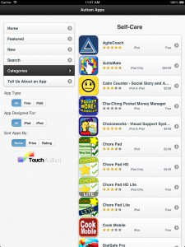
Autism Apps
Developed by Jenny W. Krones M.A., BCBA and Tom W. Krones
Comprehensive list of apps for individuals with ASD, Down syndrome, and other special needs
Contains links to information and reviews for each app
Can be used on iPads, iPhones, and iPods
Features:
  Featured Apps
  New Apps
  Apps By Touch Autism
  30+ Categories
  Submit an App

Slide 40
Autism Apps Categories
ABA
Alphabet
Art
Assessments
Behavior and Social Skills
Books
By Touch Autism
Cause and Effect
Choice-Making Apps
Colors
Communication (AAC)
Creative Play
Data Collection
Fine Motor and Writing Skills
Flashcards
Fun and Games
Geography
IEP
Literacy
Math
Medical and Health
Music
Numbers
Professionals
Puzzles
Reference
Reward Systems
Self-Care
Sensory
Social Stories
Speech and Language
Text to Speech
Time
Visual Schedules
Visual Timers
Vocabulary

Slide 41
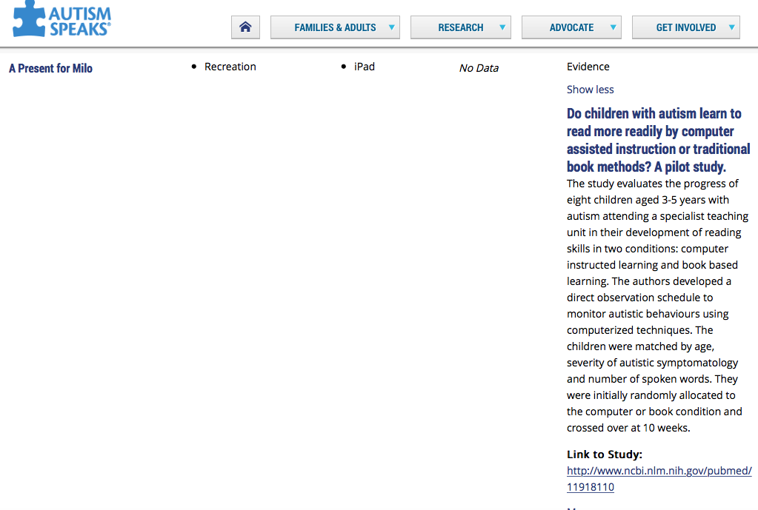
Autism Speaks: App Research Ratings
Anecdotal
Research
Evidence
Notes:
Anecdotal
No specific or related scientific studies
Research
Some related scientific studies, but no direct research support
Evidence
- Solid or specific scientific evidence that this type of app/technology is helpful

Slide 42
Summary
The ACE® and Rethink Autism are both comprehensive, ABA-based, web programs developed for individuals with ASD ages 3-22.
The ACE® can only be used by BCBAs.
Rethink Autism can be used by a variety of individuals, including parents.
Both programs include a wide range of evidence based teaching strategies.
Autism Apps includes many categories of apps that can be downloaded from the App store.
Autism Speaks includes research ratings for apps listed on their website.
More research needs to be conducted to determine the effectiveness of these programs as a whole.

Slide 43
THANK YOU!

Slide 44
References
Autism Apps - Touch Autism. (n.d.). Retrieved from http://touchautism.com/app/autism-apps/
A. (2012). Autism Curriculum Encyclopedia® (ACE®) - Assessment. Retrieved from https://www.youtube.com/watch?v=4cuAlm8Vj58
A. (2015). ACE Minute - Task Analysis Lesson Plans. Retrieved from https://www.youtube.com/watch?v=kPYsC7VnHQg
ACE NECC - ABA Software System. (n.d.). Retrieved from http://acenecc.org/
Autism Speaks. (n.d.). Retrieved from https://www.autismspeaks.org/autism-apps
Cardinal, J. (2011). Rethink Autism: Effectiveness of web- based applied behavior video modeling program on the performance of para-educators and students with autism spectrum disorder. Dissertation submitted to the Department of Educational Psychology, School Psychology.
Contemporary Applied Behavior Analysis Approaches. (2012). Retrieved from http://autismnow.org/articles/contemporary-applied-behavior-analysis-approaches/
Discrete Trial Training. (n.d.). Retrieved from https://www.autismspeaks.org/blog/2012/12/14/discrete-trial-training

Slide 45
References
Steege, M. W., Mace, F. C., Perry, L., & Longenecker, H. (2007). Applied behavior analysis: Beyond discrete trial teaching. Psychol. Schs. Psychology in the Schools, 44(1), 91-99. doi:10.1002/pits.20208
Szidon, K., & Franzone, E. (2009). Task Analysis. Madison, WI: National Professional Development Center on Autism Spectrum Disorders, Waisman Center, University of Wisconsin. Retrieved from http://autismpdc.fpg.unc.edu/sites/autismpdc.fpg.unc.edu/files/TaskAnalyis_Steps_0.pdf
The tools every district needs to design, deliver and monitor evidence-based practices in special education. (n.d.). Retrieved from http://www.rethinkfirst.com/

