Slide 1
Pivotal Response Treatment® and How it Maps onto Discrete Trial Training
By Amelia Mcclelland
Superheroes Social Skills Training, Rethink Autism Internet Interventions, Parent Training, EBP Classroom Training, Functional Behavior Assessment: An Autism Spectrum Disorder, Evidence-based (EBP) Training Track for School Psychologists
Principle Investigators:
William R. Jenson, PhD.
Elaine Clark, PhD
John Davis, PhD
Grant Director
Julia Hood, PhD
US Office of Education Personal Preparation Project: H325K120306

Slide 2
Overview
Brief overview of Autism Spectrum Disorders (ASD)
Description of Pivotal Response Training (PRT)®
  Pivotal learning variables
  Applications and pros and cons
  UCSB Koegel Autism Center
  Reviews and Meta-Analysis
Discrete Trial Training (DTT)
  Applications and pros and cons
Compare DTT and PRT
Free Operant Learning, Incidental Teaching, and Loosely Structured Training
Compare these different methods

Slide 3

Autism Review
Autism Spectrum Disorder (ASD) “group of developmental disabilities that can cause significant social, communication and behavioral challenges”
About 1 in 68 children has been identified with autism spectrum disorder (ASD)
The Academy of Pediatrics noted that Applied Behavioral Analysis (ABA) is a “notable” treatment for ASD and is widely used.

Slide 4
Pivotal Response Treatment(PRT) ®
Pivotal Response Training (PRT) is “a method of systematically applying the scientific principles of applied behavior analysis (ABA) to teach learners with autism spectrum disorders (ASD).” (Vismara, L.A., & Bogin, J. (2009))
Alternate names: Pivotal Response Training, Pivotal Response Teaching, Pivotal Response Therapy, Pivotal Response Intervention, and Natural Language Paradigm
Roughly 25 or more hours per week
Notes:
First developed and discovered in 1987
from the National Professional Development Center on ASDs
Targeting the 4 pivotal areas is thought to generalize improvement to other areas.
PRT is a Lifestyle
Can be used in a child directed and play based manner
(autism Speaks)

Slide 5



Pivotal Learning Variables
Motivation
  Establish Attention
  Use learner choice and shared control
  Vary tasks and responses (maintenance and acquisition; tasks/materials)
  Natural reinforcers and reinforce response attempts
Responding to multiple cues
  Varying stimuli and increasing cues (i.e., big red car vs. red car)
  Scheduling reinforcement
  Turn taking

Slide 6

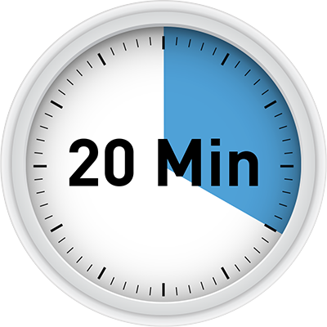


Pivotal Learning Variables (continued)
Self-management
  Clearly defined target behavior with collection frequency and collection method
  Teach how to discriminate desirable and undesirable behavior
  Gradually increase time for self-management
Self-initiations
  Peer mediated strategies
  Social initiations
  Question asking
  Language communication and social skill
Notes:
Motivation
Respond multiple cues
Self manage
Self initiations

Slide 7
Applications and Uses of PRT
Classrooms
  Often adapted or in conjunction with other interventions
Community settings
Home
Early Start Denver Model (ESDM): “a comprehensive behavioral early intervention approach for children with autism ages 12-48 months” (Autism Speaks)
  Based in Applied Behavioral Analysis
  Requires professional training

Slide 8

Strategies for Teaching based on Autism Research (STAR)
Manualized treatment program IN A BOX!
    “The ABA (Applied Behavior Analysis) instructional methods of discrete trial training, pivotal response training and teaching functional routines form the instructional base of this comprehensive program for children with autism.”
3 levels
  1: Basic verbal communication and following simple instructions
  2: Increase sentence length, interactive play, learn numbers, letters, sight words and answer “wh” questions
  3: Expands vocab and sight words, increases academic skills (reading, story recall, subtraction, addition) and follows more complex routines
Maps onto IEPs

Slide 9
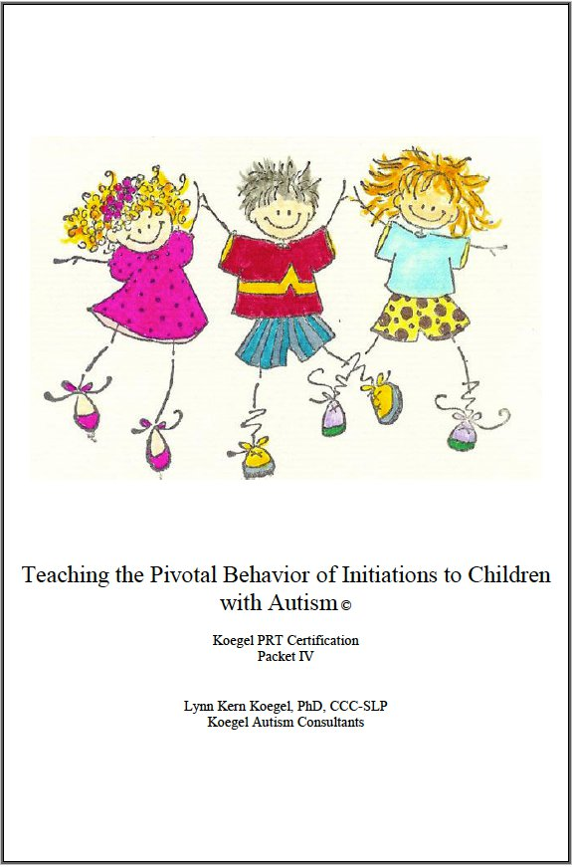
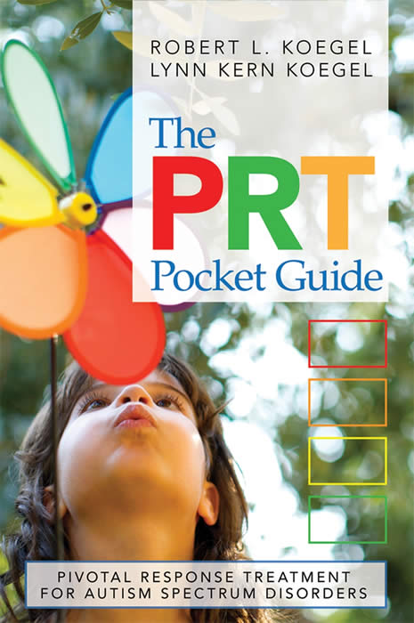
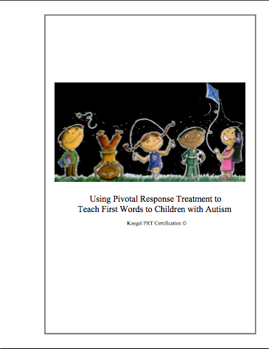
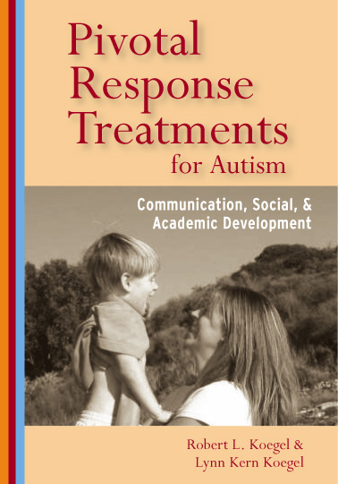
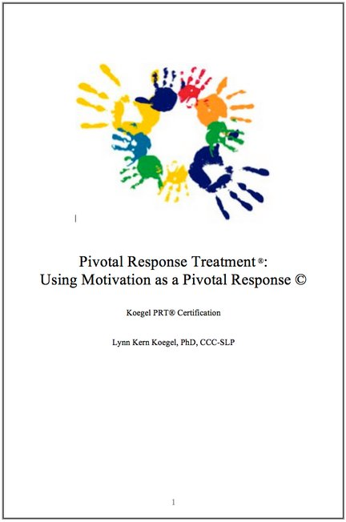
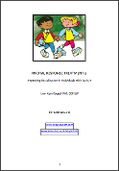
UCSB Koegel Autism Center
Naturalistic technique
“Used to teach language, decrease disruptive/self-stimulatory behaviors, and increase social, communication, and academic skills”
Child choice and direction are key
  Natural reinforcers
Over 200 peer reviewed journal articles and 30 books and manuals
Notes:
University of California SantaBarbra
Drs. Robert and Lynn Koegel

Slide 10
Current Reviews of PRT
Main reviews:
  Examining the Studies in Which the Pivotal Response Instruction is Used to Teach Social Skills (Bozkus-Genc & Vuran, 2013)
  Pivotal Response Treatment for Children with Autism Spectrum Disorder: A Systematic Review of Research Quality (Cadogan et al. 2015)
  Effectiveness of Pivotal Response Training as a Behavioral Intervention for Young Children with Autism Spectrum Disorders (Masiello, T. L., 2007)
Meta-Analysis of Pivotal Response Training for Children with Autism Spectrum Disorders (Bozkus-Genc & Yucesoy-Ozkan, 2016)

Slide 11
Meta-Analysis of Pivotal Response Training for Children with Autism Spectrum Disorders
Study Questions:
  What are characteristics of the participants and components of intervention in which PRT was used?
  What is the level of effectiveness of PRT with regard to teaching various behaviors to children with ASD?
  Does the effectiveness of PRT differ in terms of the characteristics of the intervention?
  Are percentage of nonoverlapping behavior (PND), percentage of nonoverlapping corrected data (PNCD), and percentage of data points exceeding the median (PEM) effect size calculations correlated?

Slide 12
Meta-analysis: Inclusion/Exclusion Criteria
Of 69 studies found 34 met criteria for inclusion
  Published 1979-2012
  In English
  1-13 years old with ASD diagnosis
  Examined the effectiveness of PRT
  Effect of independent variable shown in a line graph
  At least one data point in baseline and intervention phases
From 12 different journals

Slide 13
Meta-Analysis: Participants and setting
125 participants
  Mean of 4.8 years old
  Majority solely diagnosed with ASD (85.6%)
  Majority male (71.2%)
Settings:
  Clinics (26.4%)
  Schools (8.8%)
  Multiple (44.1%)

Slide 14
Meta-Analysis: Administration Styles and types of interveners
Administration:
  One-on-one (76.5%)
  Small group (8.8%)
  Rest did not disclose
Interveners:
  Family member/ caregiver (23.5%)
  Professional clinicians (38.2%)
  Students (17.6%)
  Peers (11.7%)
  Multiple interveners (9%)

Slide 15
Dependent Variables
Targeted Skills
  Communication and interaction skills (44.1%)
  Social skills (11.7%)
  Play skills (8.8%)
  Academic skills (2.9%)
Intervention outcomes
  Treatment integrity (44.1%)
  Maintenance (44.1%)
  Generalization (55.8%)
  Social validity (23.5%)

Slide 16
Discussion
PRT awareness showed an increase since 2000
All 3 effect size calculations found that PRT was effective
  PND: 13 highly effective, 11 fairly effective, and 10 questionable
      Questionable for play and social skills
  PNCD: 14 highly, 9 fairly, 10 questionable
      Questionable in play skills
  PEM: 27 highly, 4 fairly, 3 questionable
      Fairly or highly effective for all DVs
Notes:
nonoverlapping behavior (PND), percentage of nonoverlapping corrected data (PNCD), and percentage of data points exceeding the median (PEM

Slide 17
Discussion (continued)
Average age intervened with 0-9 years
72.2% male
Overall found PRT to be effective

Slide 18
Limitations
Single case research
Effect Sizes were not assessed based on quality of studies
Limited number of participants
Descriptive statistics
Generalization skills might have been negatively effected by overselectivity:
  Suggests multiple settings and interveners
Social validity could have been effected by skills targeted being the core deficits for each child

Slide 19
Future Directions
Research to demonstrate treatment integrity of PRT
Examine maintenance, generalizability, social validity, AND treatment integrity
Group and experimental design studies
Relationship between quality of instruction and effectiveness of PRT
Use inferential statistics

Slide 20
Official PRT Training
Long distance learning program
5 levels:
  Introductory Awareness of PRT research and methodology
  Introductory Implementer
  Generalization
  Advanced Implementers for teaching self-initiations, self-management, or facilitating social interactions
  Trainer of Trainers
Written exams and fidelity determined through videos ($300-675 per level)
Trainings available for teachers and schools
Notes:
Level I: Gets you familiarized with the research and procedures
Level II: (using PRT to teach first words and multiple word utterances
Level III: How to utilize PRT with multiple children with ASD
Level IV: Advanced Implementers for teaching self-initiations, self-management, or facilitating social interactions.
Level V: Trainer of trainers
Complete written exams at completion of each level. Must meet fidelity to be certified in their level. This is determined by submission of videos. Levels range from $300 to $675 a piece. Out of country options available. 15% discount if 5 or more people
Characteristics of Autism Spectrum Disorder (ASD), History and Development of PRT®, PRT® service delivery model, delineation of pivotal areas and the corresponding interventions (i.e., motivation, responding to multiple cues, self-initiations, and self-management), motivational procedures of PRT® for teaching social-communication (including child attention and clear instructions, maintenance tasks, child choice, contingent reinforcement, reinforcement of communicative attempts, direct and natural reinforcement, types of opportunities for evoking language, creating learning opportunities in the natural environment), facilitating social interactions with typically developing peers, self-management, Functional Behavior Assessment (FBA), and motivational academics. (from the UCSB website)

Slide 21
Limitations and Criticism of PRT
Limitations:
  Difficult to do one-to-one interventions:
    Turn taking and multiple cues are the hardest for teachers to implement
      Overselectivity
      No set developmental age.
  Difficult to know how the modifications made in classrooms influence effectiveness
  Unknown how combining multiple evidence based practices, including PRT, effects student outcomes in classrooms
Notes:
Reed et al. 2012 says typical 36months for consisted response to simultaneous multiple cues
The EBP that are being used in schools are often modified or combined by the teachers to fit their student’s individual needs.
*** problem because the efficacy and benefits of the programs will most likely be altered when there is modification involved
Used RT= research trained CT= Clinically trained teachers
Both groups skilled in: child attention, clear opportunity/instruction, and child choice
Additional resources might be needed in: Contingent consequences and direct reinforcement)
Most problematic was multiple cues and turn taking
Overall those the RT group had higher percent of teachers in most categories implementing with fidelity
****

Slide 22
Suggestions for Future Research
  Future Research
    Compare interventions
    Conduct research in applied settings
    Use longitudinal designs
    Implement greater adherence to treatment fidelity
Notes:
Future research needs to look at the multiple cues component and the idea of broadening attention and methods to teach that as well as the developmental appropriateness for conditional discrimination for some students

Slide 23
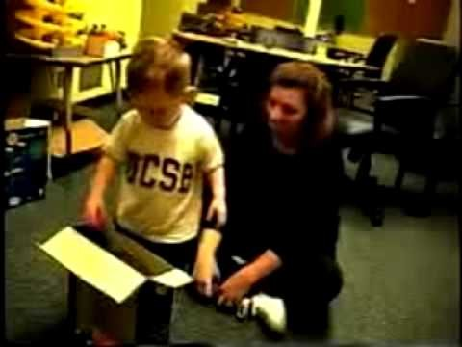
PRT Video
Notes:
Before during and after
Shows that there is an effect and does work
Notice that they were able to deal with the problem behaviors

Slide 24
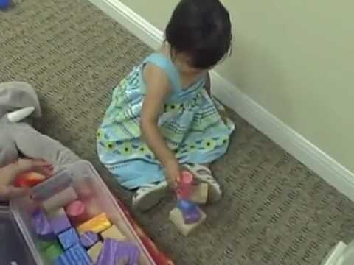
Another Example of PRT

Slide 25
Pivotal Response Training
Pros
Cons
Empirical support
Child driven/naturalistic
Ability to use in multiple settings
Increases motivation
Whole family can participate
Based on positive behavioral supports
Some skills are hard to teach with child directed approach
Not all students do well in this less structured setting
Need more research on components to understand implications of adaptations and modifications
Can be difficult to implement in the classroom.
Notes:
Families who are stressed or are going through difficult times might have more trouble with these practices especially in a consultation method

Slide 26
Discrete Trial Training (DTT)
  Discrete trial training (DTT) “is a one-to-one instructional approach used to teach skills in a planned, controlled, and systematic manner.” (National Professional Development Center on Autism Spectrum Disorders)
    Data driven
    Uses behaviorally based techniques (antecedents, consequences, reinforcement, positive praise)
    Each trial has clearly defined beginning and ending
    Early childhood and Elementary
    Communication/language, social skills, academic skills, problem behaviors or skill acquisition

Slide 27
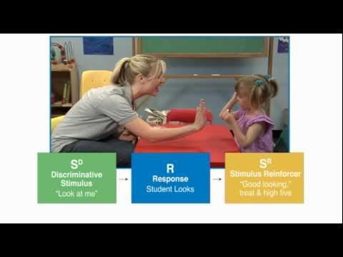
DTT video

Slide 28
Applications of DTT
Learning readiness skills
Preverbal communication
  Requesting and labeling
Pre-academic skills
Play and social interaction skills
Classrooms
Rethink
  7 videos about Discrete Trial Teaching with examples
Often used with other methods

Slide 29
Discrete Trial Training
Pros
Cons
Data driven
Based on Applied Behavioral Analysis (ABA) principles
Evidence based
Breakdown of tasks allows targeting of specific deficits
Very structured
  “robotic”
Some children fail to generalize across multiple environments
Can lead to over dependence on prompts

Slide 30
A Randomized Clinical Trial Comparison Between Pivotal Response Treatment (PRT) and Structured Applied Behavior Analysis (ABA) Intervention for Children with Autism
Pivotal Response Training
  Natural reinforcers
  Child choice
  Mastered mixed with target behaviors
  All attempts rewarded
Structured ABA
  Favorite toys and foods as reinforcers
  Teacher driven
  Exclusively target behaviors
  Shaping paradigm used for reinforcement
Notes:
Not specified as DTT but the intervention descriptions allude to similar format
Found PRT had better results
3 month intervention with 24 total hours (60 min 2X week)
still getting speech and other services conjointly

Slide 31
Comparisons
Pivotal Response Training (PRT)®
Utilizes Applied Behavioral Analysis (ABA) techniques
Used for: language/communication, social skills, academic skills and to decrease disruptive/self-stimulating behaviors
Naturalistic, child driven, play based
4 pivotal learning variables
Discrete Trial Training (DTT)
Utilizes Applied Behavioral Analysis (ABA) techniques
    Used for: communication/language, social skills, academic skills, problem behaviors or skill acquisition
    Data Driven, distinct trials
Teaching specific skills or steps to skill acquisition

Slide 32
Incidental Teaching
Specifically setup environment to encourage child initiation of activities and child choice
Follow the child’s lead and teach based on their choices
  Example: If child chooses to color then put markers in sight but out of reach to help teach them to request items
Most often used for teaching labeling and requesting
  Goes along well with DTT
Can also be used to strengthen existing adaptive behaviors
Rethink Autism
  Incidental teaching
  Incidental teaching for Expanding Language

Slide 33
Other Similar Methods
Loosely Structured Training
Free Operant Instruction
Less defined than DTT
Flexibility with the selected tasks
Often have peer models and/or Behavioral Skills Training (BST)
Can be done in small groups
Used to enhance play and communication skills, and social interaction
Can be used alongside DTT for labeling and requesting
No systematic instruction or set format for the learning environment
“Catch them being good”
Praise and discouragement used to shape behaviors
Helps with strengthening existing adaptive behaviors

Slide 34
Questions?

Slide 35
References
  American Academy of Pediatrics: Recent Information Pertaining to Autism. (n.d.). Retrieved from https://www.aap.org/en-us/about-the-aap/Committees-Councils-Sections/Council-on-Children-with-Disabilities/Pages/Recent-Information.aspx
  Smith, T., Magyar, C., & Arnold-Saritepe, A. (2002). Autism spectrum disorder. In D. T. Marsh, M. A. Fristad, D. T. Marsh, M. A. Fristad (Eds.) , Handbook of serious emotional disturbance in children and adolescents (pp. 131-148). Hoboken, NJ, US: John Wiley & Sons Inc.
  Autism Speaks: Recent Information Pertaining to Autism. (n.d.). Retrieved from https://www.aap.org/en-us/about-the-aap/Committees-Councils-Sections/Council-on-Children-with-Disabilities/Pages/Recent-Information.aspx
  Bogin, J., Sullivan, L., Rogers, S., & Stabel. A. (2010). Steps for implementation: Discrete trial training. Sacramento, CA: The National Professional Development Center on Autism Spectrum Disorders, The M.I.N.D. Institute, The University of California at Davis School of Medicine
  Bozkus-Genc, G., & Yucesoy-Ozakan, S. (2016) Meta-analysis of pivotal response training for children with autism spectrum disorder. Education and Training in Autism and Developmental Disabilities, 51(1), 13-26.
  Centers for Disease Control: Data & Statistics. (2016). Retrieved from http://www.cdc.gov/ncbddd/autism/data.html
  Green, G. Early behavioral intervention for autism: What does research tell us? Choosing an Effective Treatment, Ch. 3 29-43

Slide 36
References (continued)
  Koegel Autism Research Centers website: The Gevirtz School (GGSE) - UC Santa Barbara. (n.d.). Retrieved from http://education.ucsb.edu/autism/pivotal-response-treatment
  Mohammadzaheri, F., Koegel, L. L., Rezaee, M., & Rafiee, S. (2014). A randomized clinical trial comparison between pivotal response treatment (PRT) and structured applied behavior analysis (ABA) intervention for children with autism. Journal Of Autism & Developmental Disorders, 44(11), 2769-2777.
  Reed, S. R. (2013). Adapting individual components of pivotal response training for the classroom: Using basic research to inform practice. Dissertation Abstracts International, 74,
  Schreibman, L., Dawson, G., Stahmer, A. C., Landa, R., Rogers, S. J., McGee, G. G., Kasari, C., Ingersoll, B., Kaiser, A. P., Bruinsma, Y., McNernery, E., Wetherby, A., Halladay, A. (2015). Naturalistic developmental behavioral interventions: empirically validated treatments for autism spectrum disorder. Journal of Autism and Developmental Disorders, 45, 2411-2428
  Smith, T. & Magyar, C. (2002). Behavioral Assessment and Treatment.
  STAR Program: Second Edition. (n.d.). Retrieved from http://starautismsupport.com/star-program-second-edition
  Suhrheinrich, J., Stahmer, A. C., Reed, S., Schreibman, L., Reisinger, E., & Mandell, D. (2013). Implementation challenges in translating pivotal response training into community settings. Journal Of Autism And Developmental Disorders, 43(12), 2970-2976. doi:10.1007/s10803-013-1826-7
  Vismara, L.A., & Bogin, J. (2009). Steps for implementation: Pivotal response training. Sacramento, CA: The National Professional Development Center on Autism Spectrum Disorders, The M.I.N.D. Institute, The University of California at Davis School of Medicine.

